Slide 1
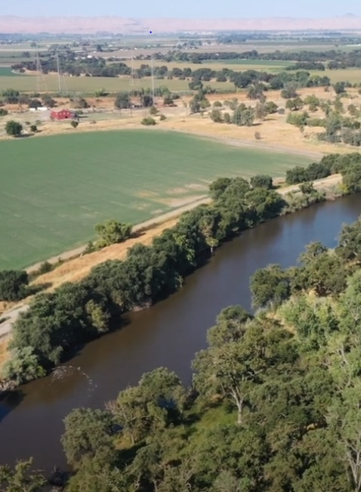

Paradise Cut Bypass Expansion
and Multi-Benefit Project
Advisory Committee Meeting
April 21, 2025
11.30 am – 1.00 pm
Location: City of Lathrop City Council Chamber
390 Towne Centre Drive │ Lathrop, California 95330

Slide 2
Administrative Matters
  Roll Call
  Introduction of Darren Suen, Executive Director of SJAFCA
  Approve 12/2 Meeting Summary (Attachment A) [Possible Action]
Recommend approval of updated Paradise Cut Bypass Expansion and Multi-Benefit Project Engagement Strategy to SJAFCA (Attachment B) [Possible Action]
  Updates to Engagement Strategy (Attachment B1)
Paradise Cut Feasibility Study Update
  Receive update on the Paradise Cut Feasibility Study (Attachment C)
  Chapter 5: Formulation of Preliminary Alternatives (Attachment D)
Advisory
Committee
Agenda

Slide 3
Operations and Maintenance (O&M) Discussion
SJAFCA Update
DWR, CVFPB, and Sacramento San Joaquin Delta Conservancy Updates
Advisory Committee Comments
Public Comments
Adjournment
Advisory
Committee
Agenda

Slide 4
Administrative Matters

Slide 5
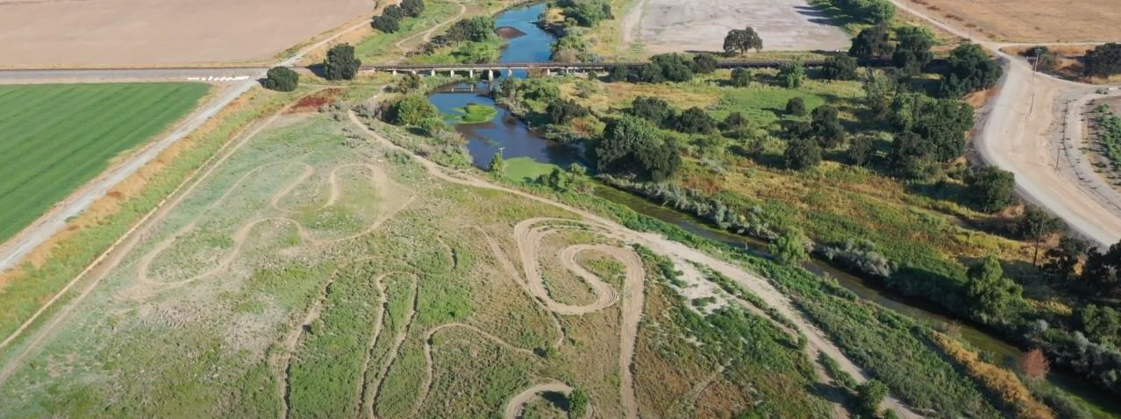
Administrative Matters
Roll call
Introduction of Darren Suen, Executive Director of SJAFCA
Approve 12/2 Meeting Summary (Attachment A) [Possible Action]

Slide 6
Recommend approval of updated Paradise Cut Bypass Expansion and Multi-Benefit Project Engagement Strategy To SJAFCA (Attachment B) [Possible Action]

Slide 7
Paradise Cut Feasibility Study Update

Slide 8

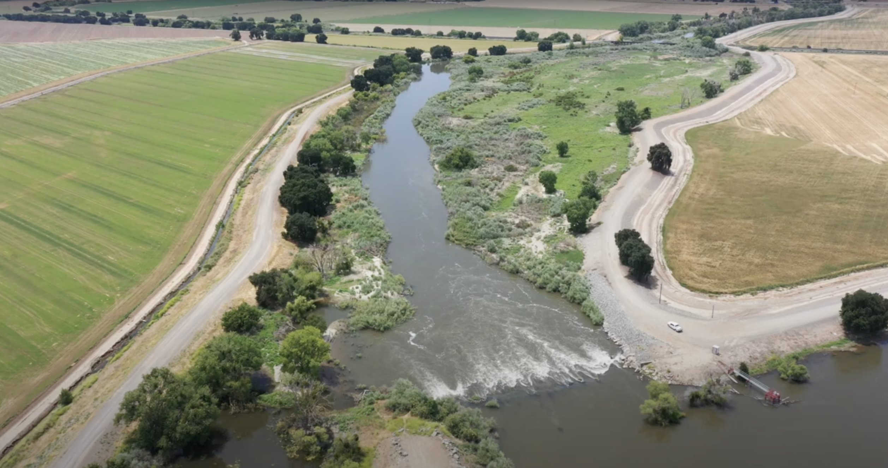
Paradise Cut Bypass Expansion and
Multi-Benefit Project

Slide 9
Description of Preliminary Alternatives
Notes:
Avery to present

Slide 10
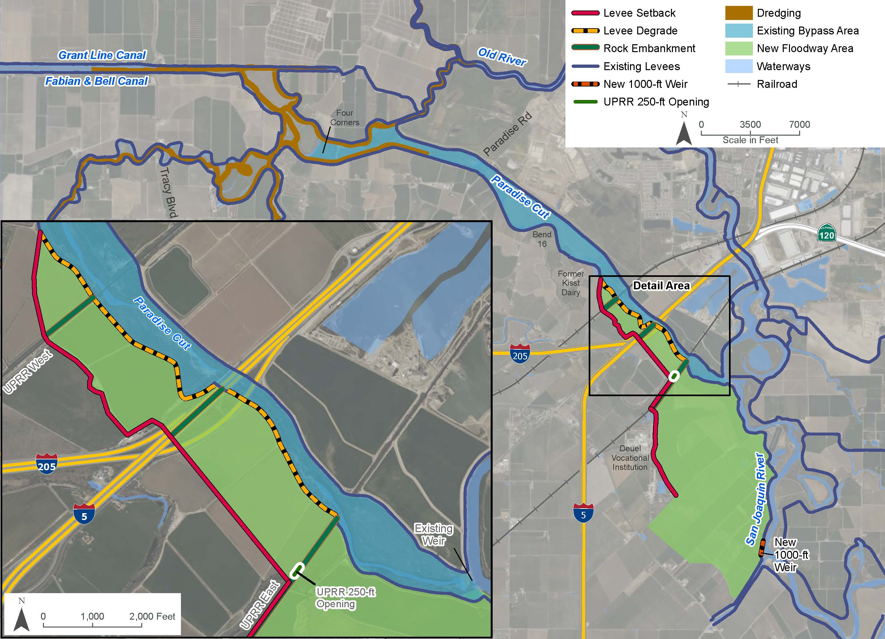
Alternative 3: Phase 2 Plan
Based on the Plan from Phase 2, which added a new 1,000-ft long weir on the San Joaquin River, upstream of Paradise Cut, and added a 250-ft opening in the east UPRR crossing.
Levees on the left bank of Paradise Cut (in RD 2095 and 2058) would be set back from the Deuel Vocational Institution to the east UPRR crossing, and from the east UPRR crossing to just beyond the west UPRR crossing.
New floodway areas would be restored or farmed to create habitat for target terrestrial species.

Slide 11
Alternative 3: Phase 2 Plan
Placeholder map

Slide 12
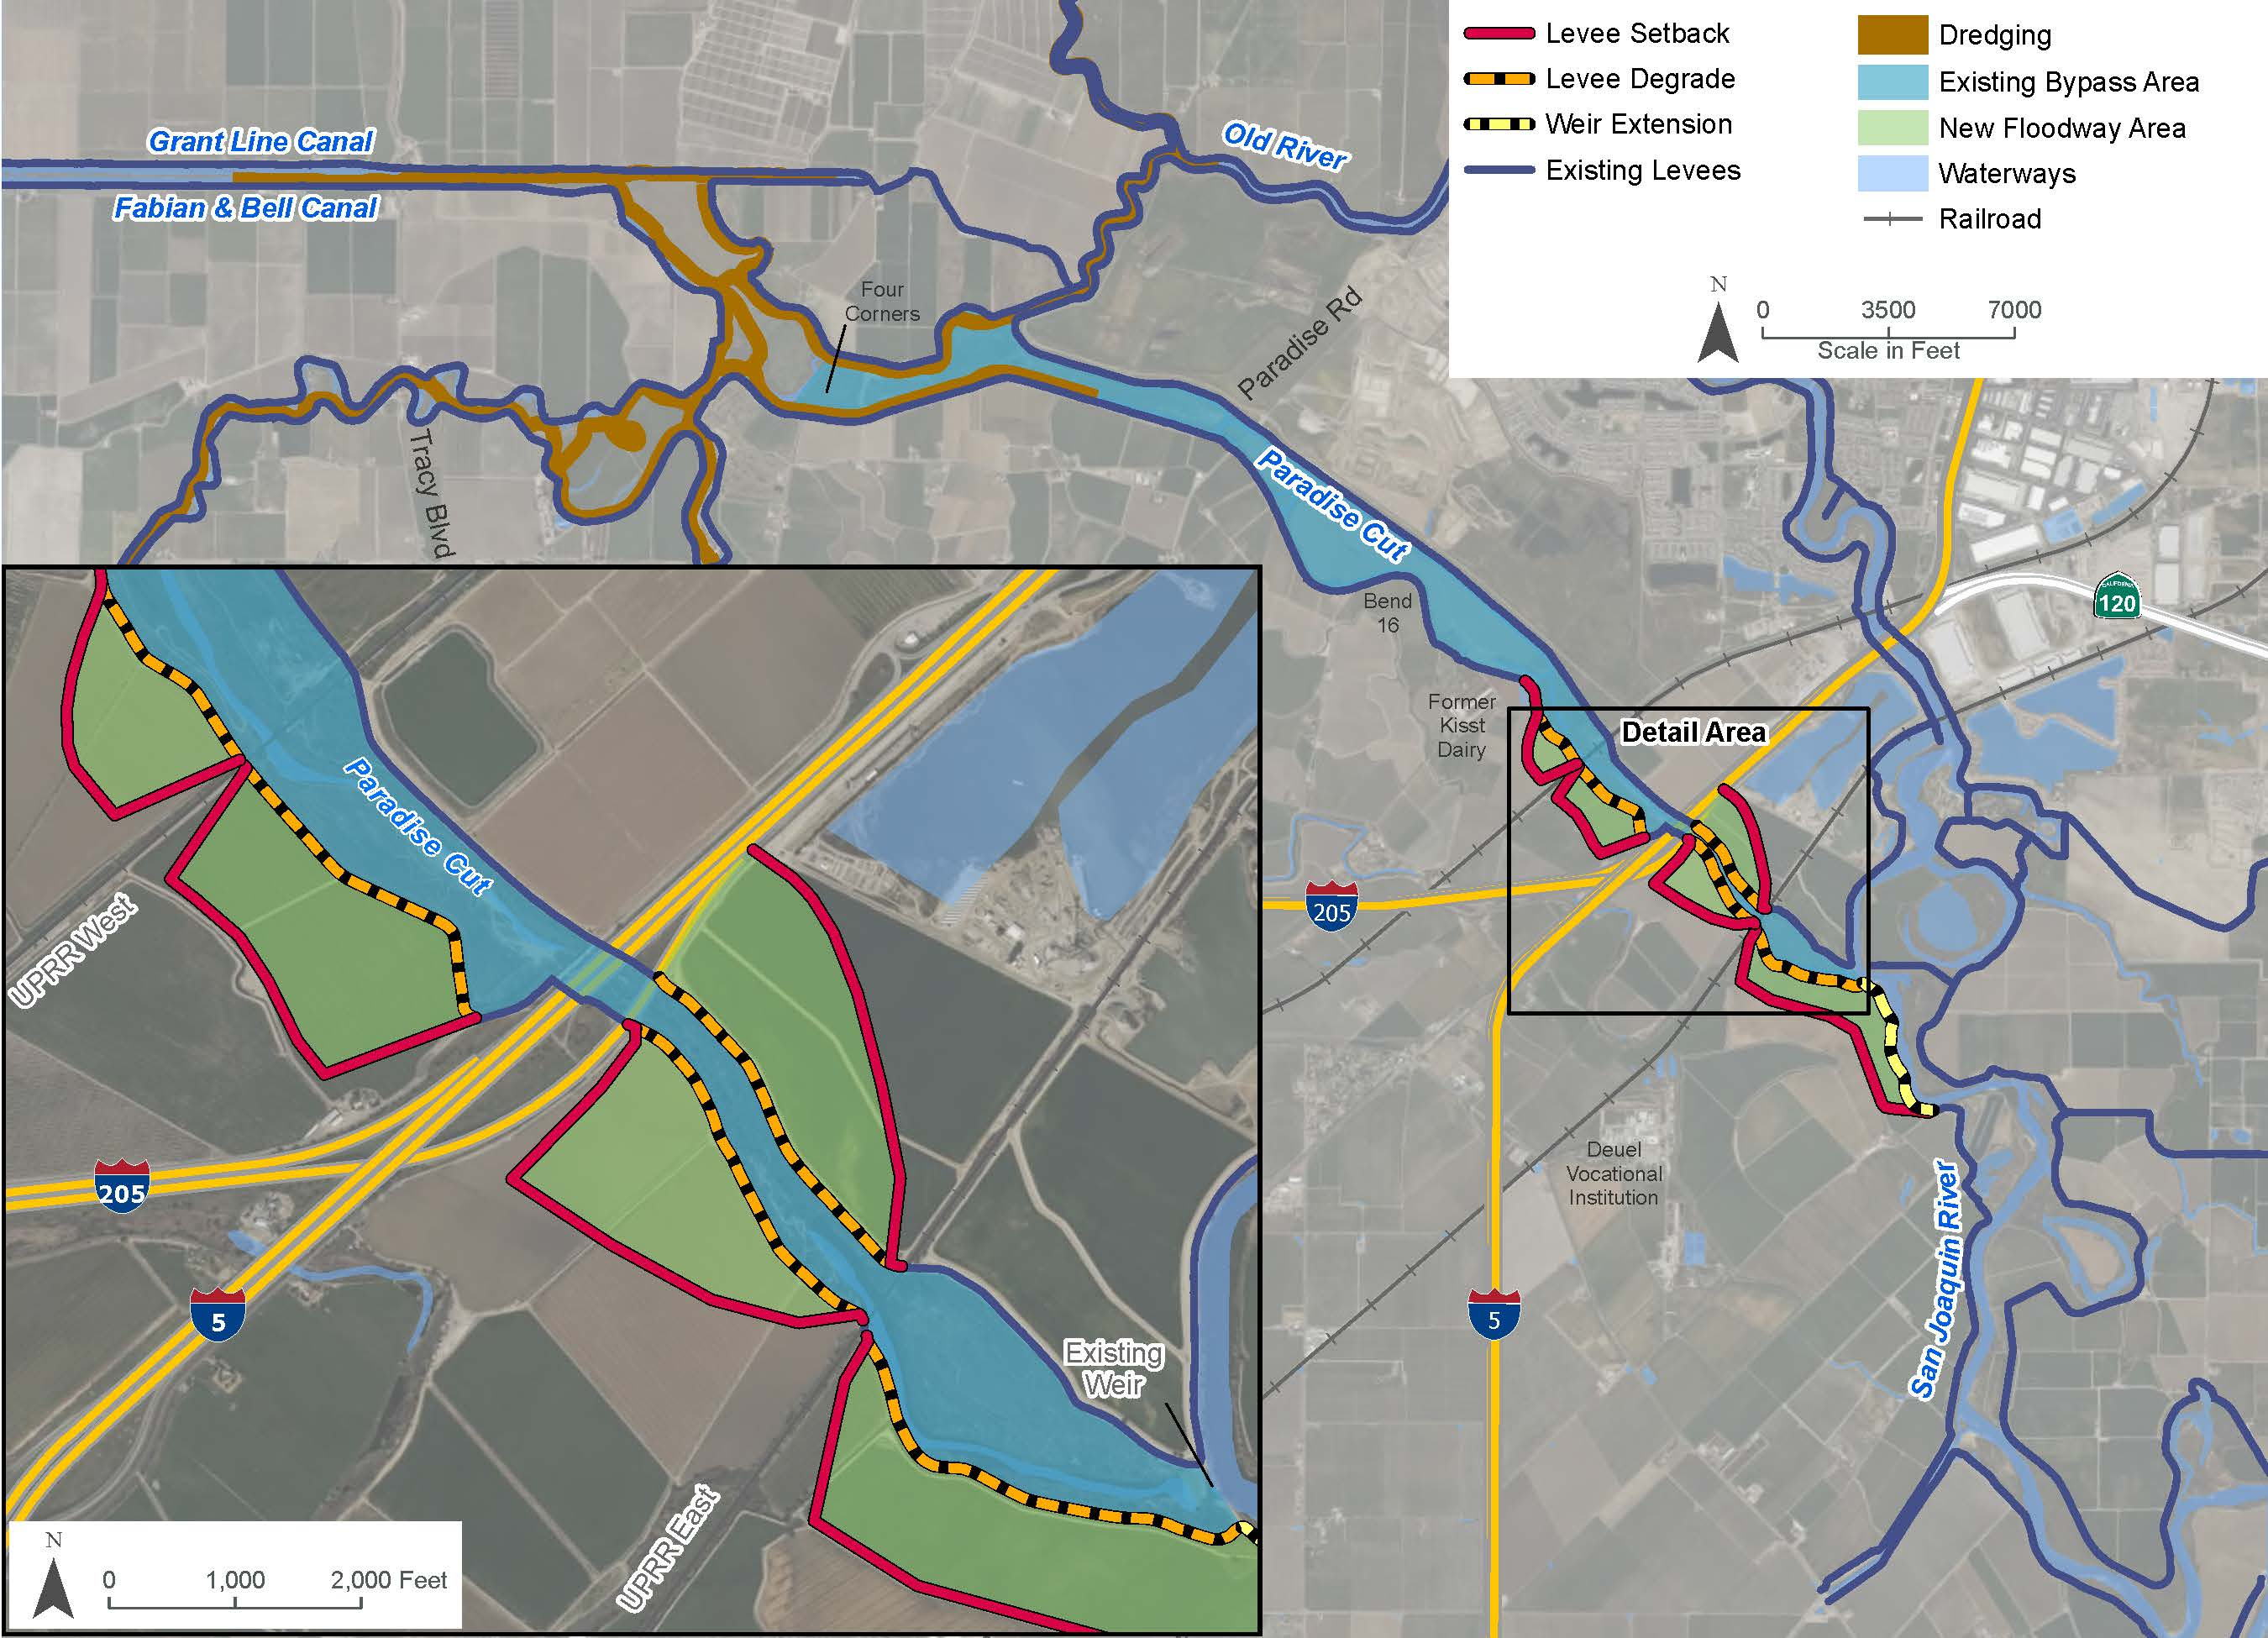
Alternative 1: Minimum Plan A
Does not modify rail or road crossings
Extends the existing Paradise Cut weir upstream along the San Joaquin River
Levees on the left bank of Paradise Cut would be set back from the extended weir to the west UPRR crossing (in RDs 2095 and 2058).
Levee on the right bank of Paradise Cut (in RD 2107) would be set back from the east UPRR crossing to I-5.
New floodway areas would be restored to create habitat for target terrestrial species.

Slide 13
Alternative 1: Minimum Plan A
Placeholder map

Slide 14
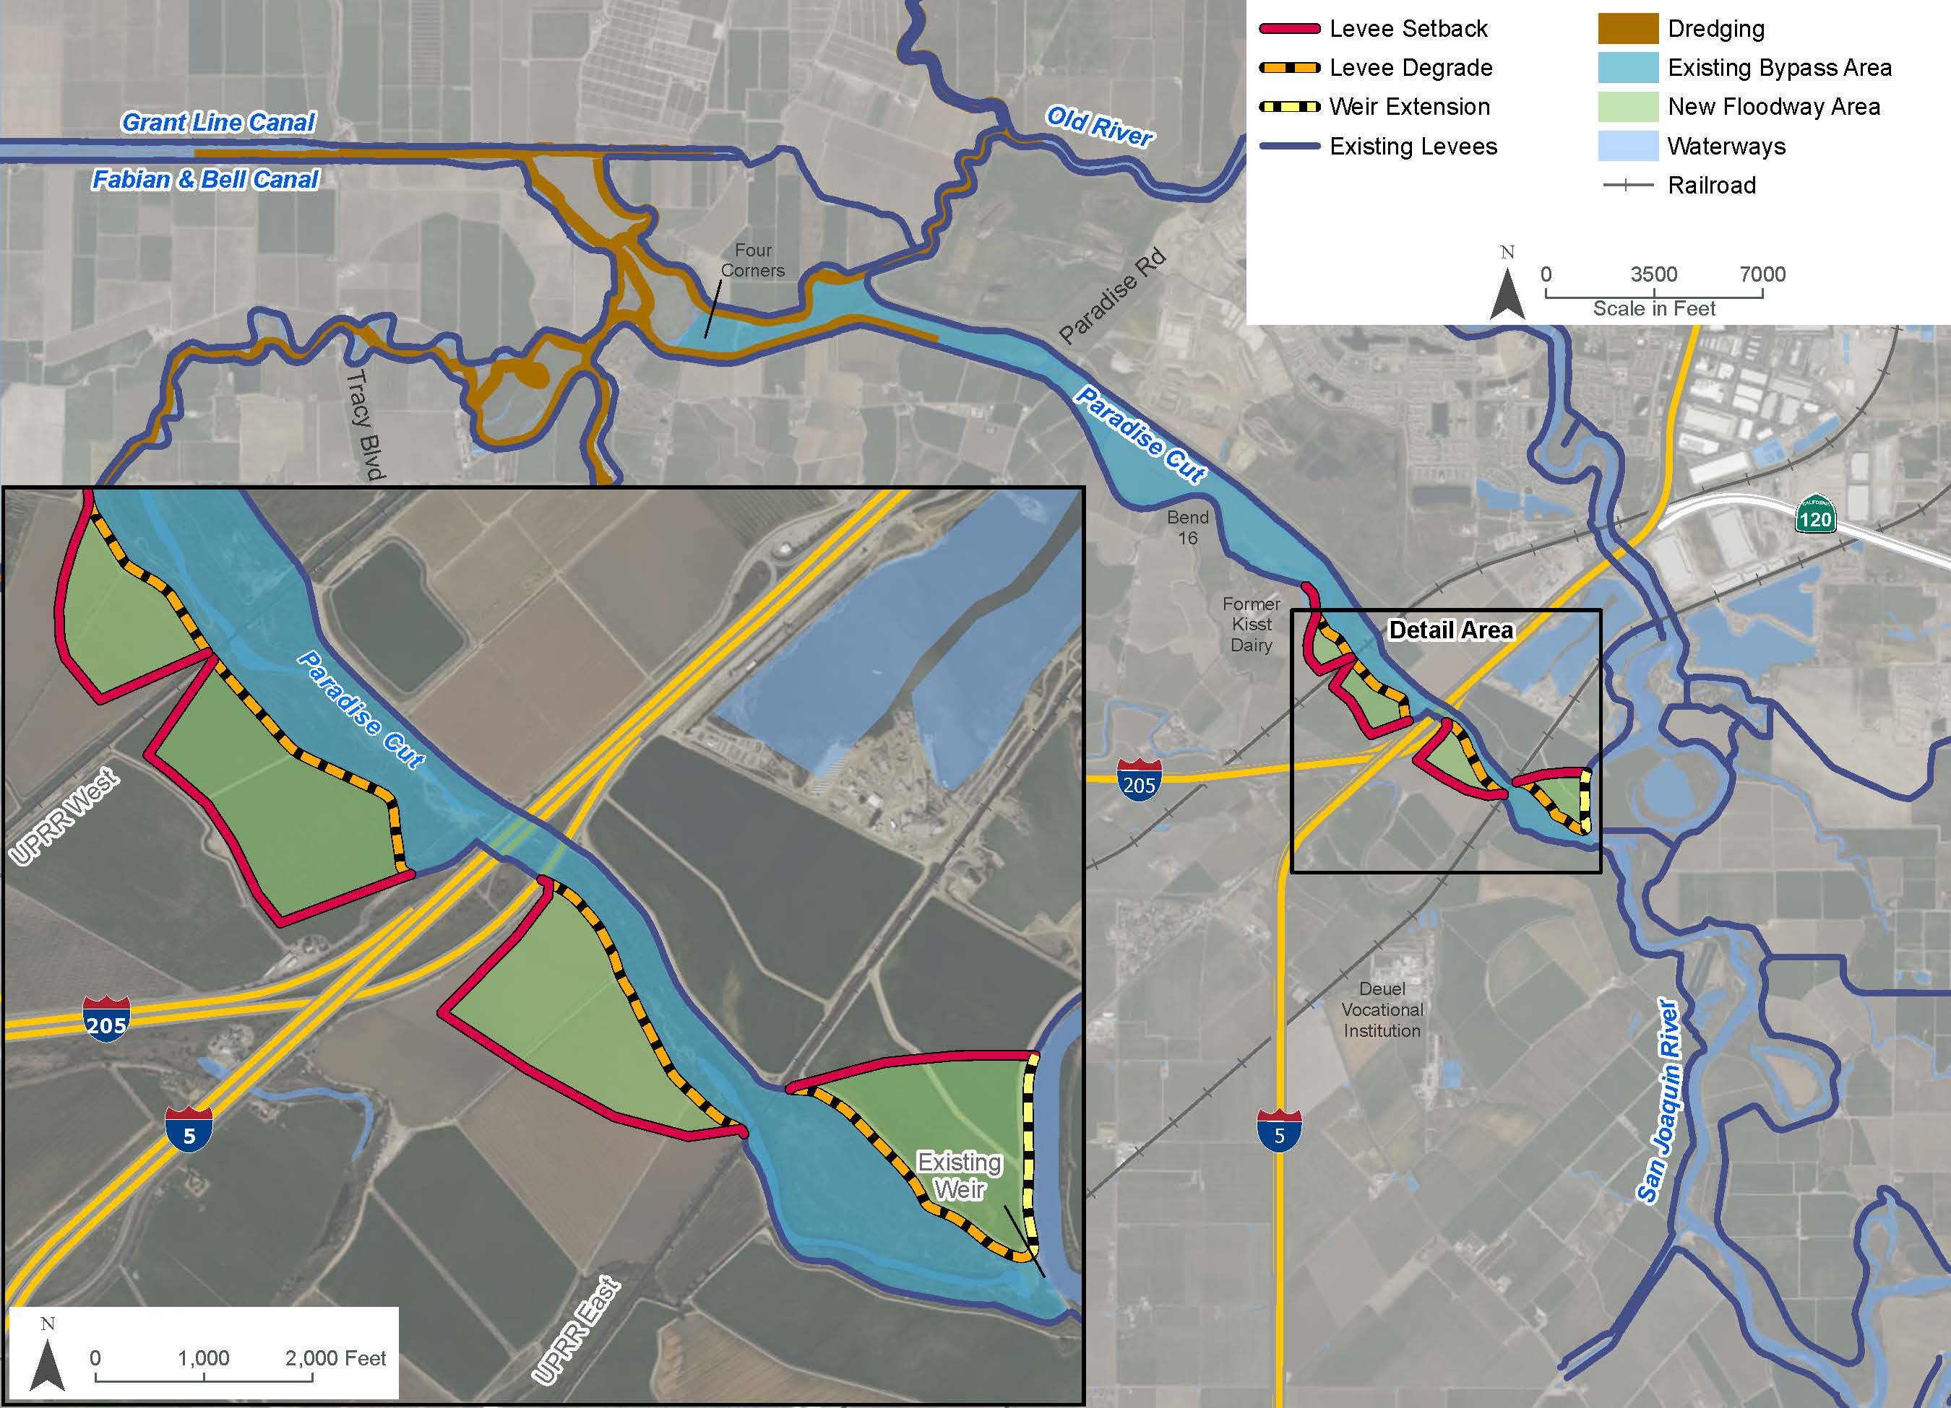
Alternative 2: Minimum Plan B
Does not modify rail or road crossings
Extends the existing Paradise Cut weir downstream along the San Joaquin River
Levee on the right bank of Paradise Cut (in RD 2107) would be set back from the weir to the east UPRR crossing
Levees on the left bank of Paradise Cut (in RD 2095 and 2058) would be set back downstream of the east UPRR crossing
New floodway areas would be restored to create habitat for target terrestrial species.

Slide 15
Alternative 2: Minimum Plan B
Placeholder map

Slide 16
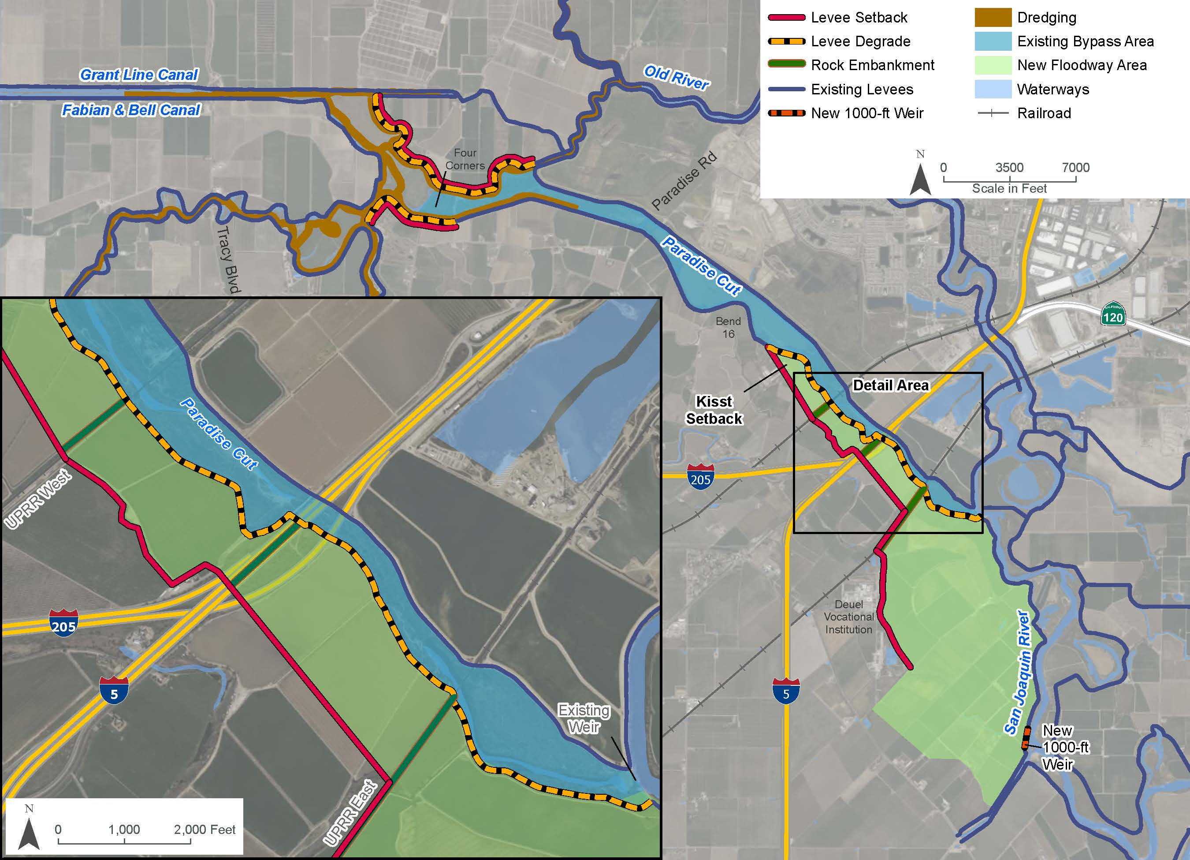
Alternative 4: Modified Phase 2 Plan
Based on the Phase 2 Plan but excludes the east UPRR rail opening and includes additional downstream setback levees.
In place of the east UPRR rail opening, the existing Paradise Cut left bank levee would be degraded from the existing Paradise Cut weir to the east UPRR crossing.
Additional downstream levee setbacks include a setback levee on the left bank of Paradise Cut at Kisst Dairy (in RD 2058), and ecological levee setbacks along RD 2058 and RD 2089 levees, within the Four Corners area.
The new floodway areas would be restored or farmed to create habitat for target terrestrial species.

Slide 17
Alternative 4: Modified Phase 2 Plan
Placeholder map

Slide 18
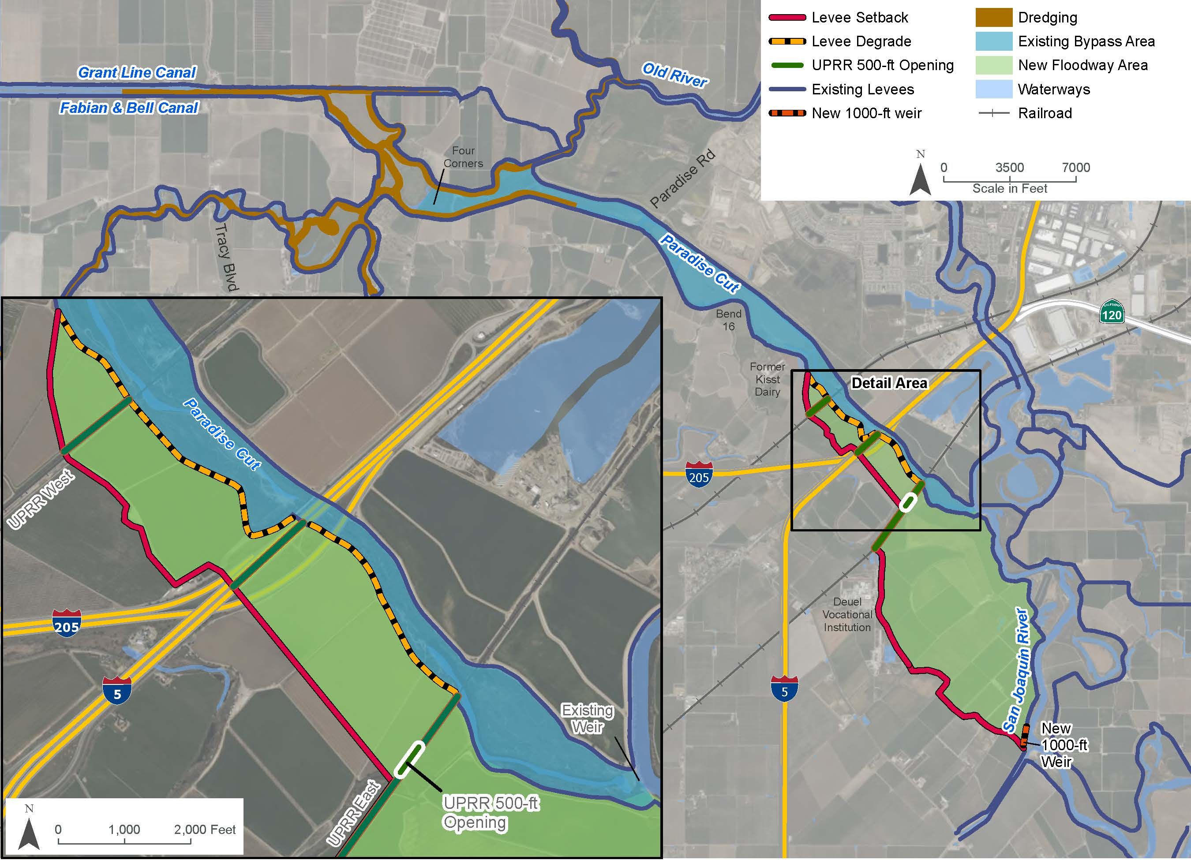
Alternative 5: Modified CVFPP
Based on the Modified CVFPP plan from Phase 2, which added a new 1,000-ft long weir on the San Joaquin River upstream of Paradise Cut and added a 500-ft opening in the east UPRR crossing.
Levees on the left bank of Paradise Cut (in RD 2095 and 2058) would be set back from the new weir to the Deuel Vocational Institution, from the Deuel Vocational Institution to the east UPRR crossing, and from the east UPRR crossing to up to and just beyond the west UPRR crossing.
New floodway areas would be restored to create habitat for target terrestrial species.

Slide 19
Alternative 5: Modified CVFPP
Placeholder map

Slide 20
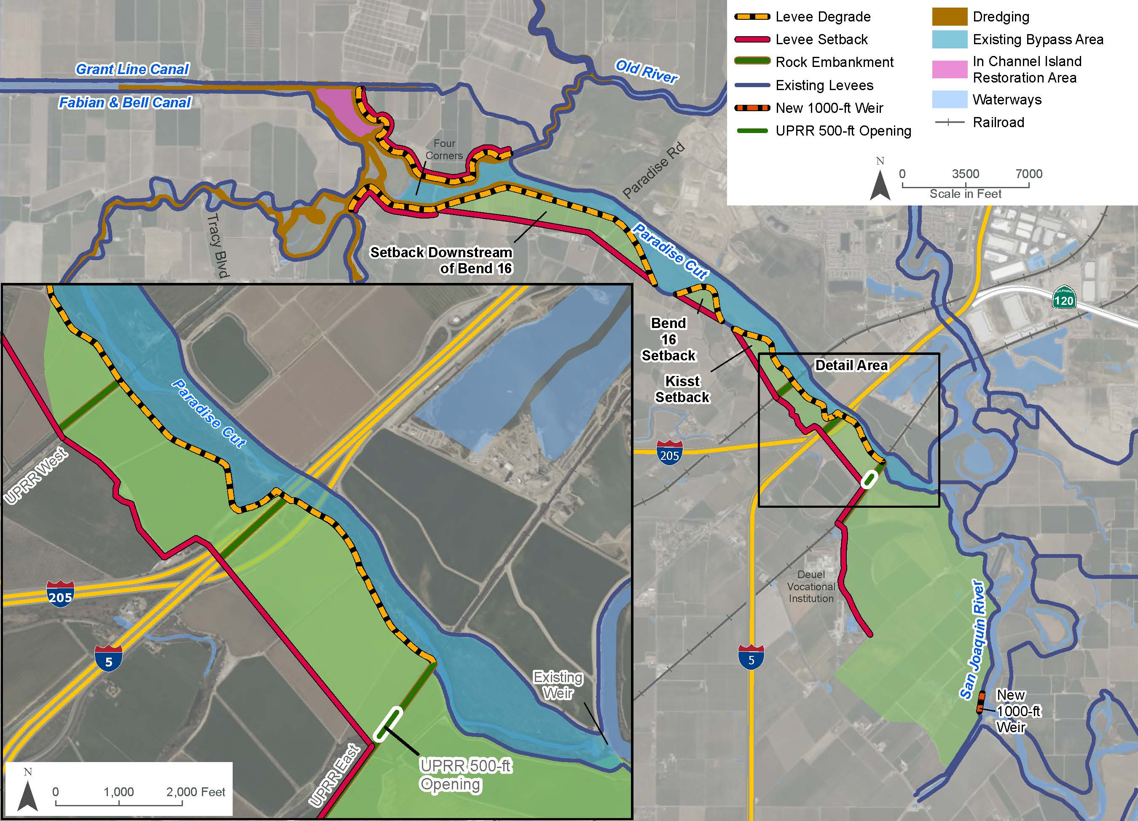
Alternative 6: Phase 2 Plan Plus
Enlarged version of the Phase 2 Plan, with a 500-ft opening in the east UPRR crossing and additional levee setbacks.
Additional downstream levee setbacks include setback levees on the left bank of Paradise Cut at Kisst Dairy (in RD 2058), at Bend 16, and downstream of Bend 16, and ecological levee setbacks along RD 2058 and RD 2089 levees, within the Four Corners area.
New floodway areas would be restored or farmed to create habitat for target terrestrial species.
A 100-acre island near Salmon Slough, would be restored as habitat for target terrestrial species.

Slide 21
Alternative 6: Phase 2 Plan Plus
Placeholder map

Slide 22
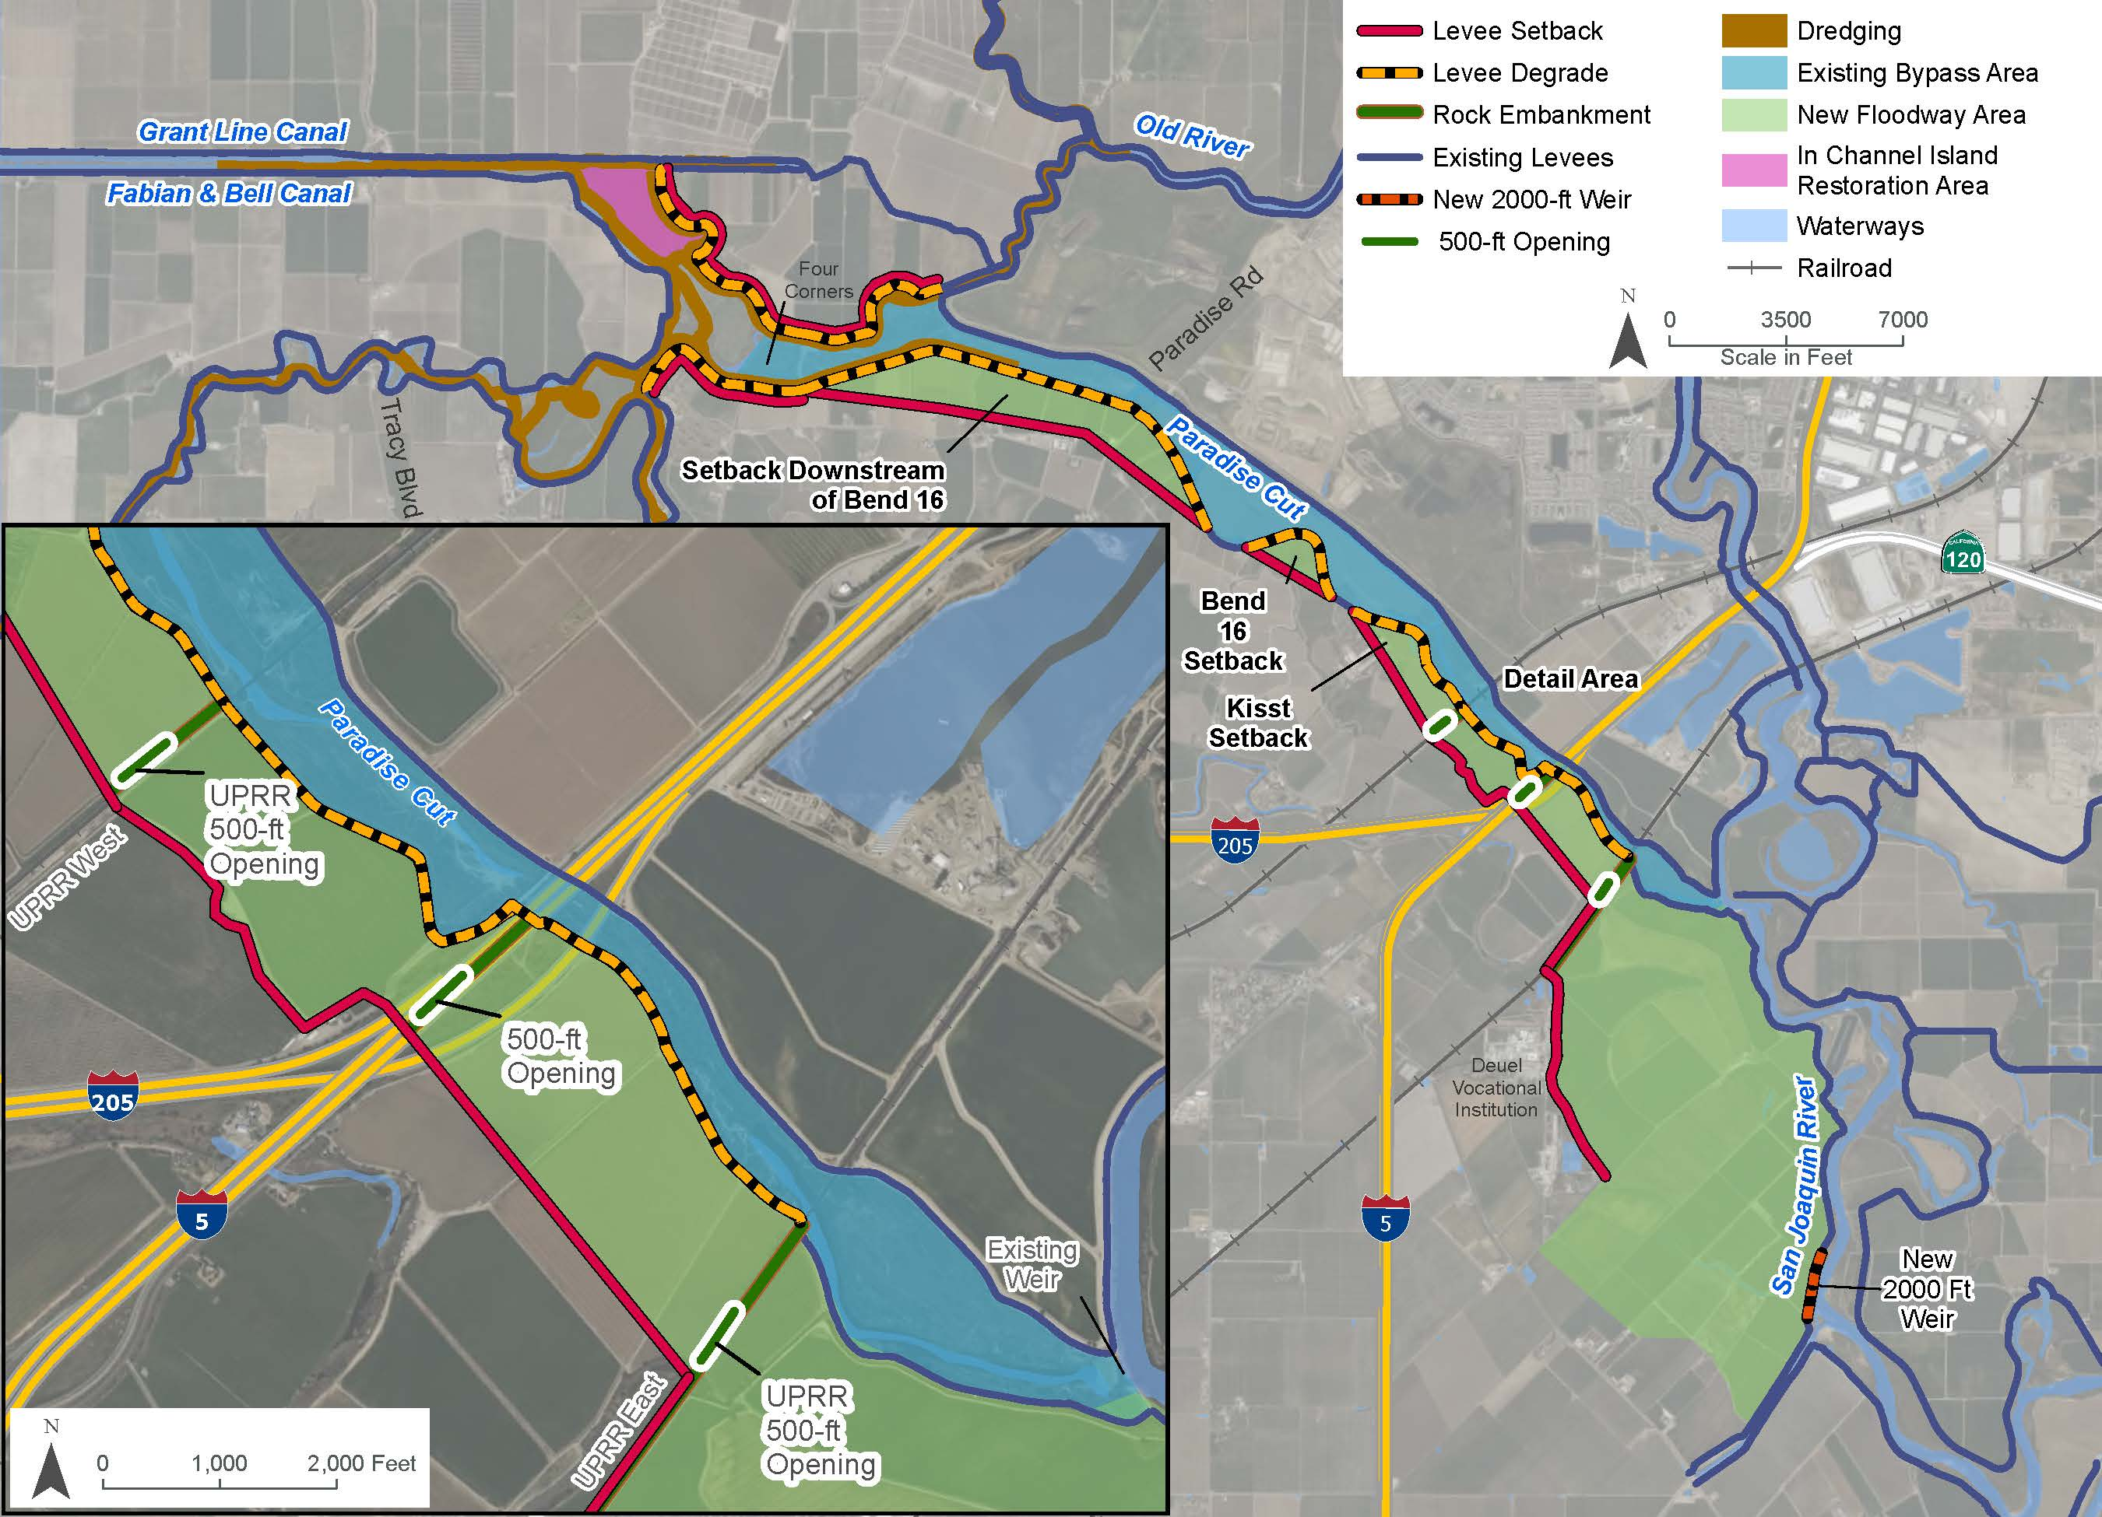
Alternative 7: Maximum Plan
Enlarged version of the PMP from Phase 2, with a new 2,000-ft long weir along the San Joaquin River upstream of Paradise Cut and 500-ft openings in the east UPRR crossing, I-5, and the west UPRR crossing.
Same downstream levee setbacks as the Phase 2 Plan Plus, including setback levees on the left bank of Paradise Cut at Kisst Dairy (in RD 2058), at Bend 16, and downstream of Bend 16, and ecological levee setbacks along RD 2058 and RD 2089 levees, within the Four Corners area.
New floodway areas would be restored or farmed to create habitat for target terrestrial species.
A 100-acre island near Salmon Slough, would be restored as habitat for target terrestrial species.

Slide 23
Alternative 7: Maximum Plan
Placeholder map

Slide 24
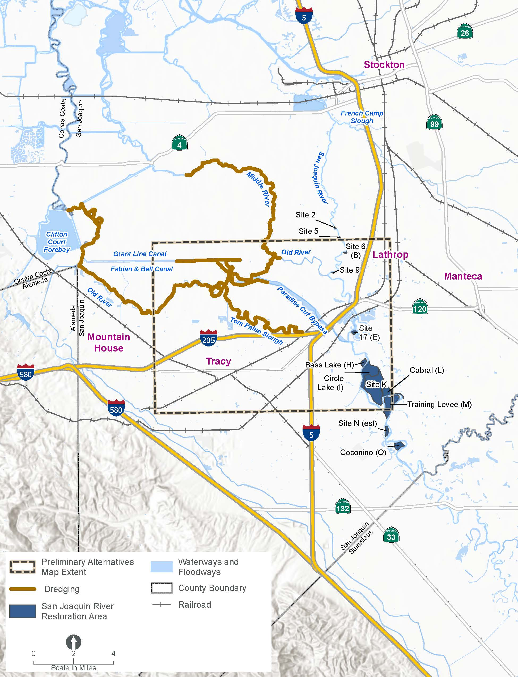
Management Actions Common to all Preliminary Alternatives
39 miles of dredging included in all preliminary alternatives:
  Downstream portion of Paradise Cut
  Tom Paine Slough
  Middle River
  Western reach of Old River
  Eastern reach of Grant Line Canal
  Four Corners area
Restoration opportunities at 12 sites on the right and left banks of the San Joaquin River are carried forward and will be considered separately for the preferred alternative.

Slide 25
Evaluation & Comparison of Preliminary Alternatives
Notes:
Avery to present

Slide 26
Evaluation Criteria
Criterion | Proxy or metric
How well does the alternative contribute to the Project objectives?
Reduce catastrophic flood risk for communities including Lathrop, Manteca, and Stockton | Relative stage reduction on the San Joaquin River, at head of Old River, using the design flood event (1955 design)
Protect farms from uncontrolled flooding | Relative stage reduction (or increase) on Paradise Cut at the UPRR east crossing and at Paradise Road, using the design flood event (1955 design)
Restore and improve the quantity, diversity, and connectivity of riverine, floodplain, riparian, and wetland habitat for native fish and wildlife | A preliminary estimate of acreage within the new floodway footprint (including new levee setback areas and the new upstream floodway) that could be conserved as working lands or restored for habitat
Improve irrigation intake reliability and waterway navigability | Irrigated farmland acreage reliant on water supply intakes that have restored channel depths

Slide 27
Evaluation Criteria
Criterion | Proxy or metric
What is the anticipated cost of the alternative?
Capital cost | Relative cost based on miles of new levees, miles of levee degrade (including weirs), number and size of openings in rail and road crossings, real estate costs, soil cleanup and remediation, mitigation, including compensatory mitigation, and other soft costs
Potential loss in RD revenue | Relative area of new floodway footprint, where benefit assessments that fund O&M would be reduced or eliminated
Is the alternative scalable to meet future flood risk management and ecosystem needs?
Is the alternative scalable/adaptable? | Does the alternative preclude future addition or expansion of a new upper weir and/or downstream setbacks?

Slide 28
Results: Minimum Plans
Alternative 1. Minimum Plan A
How well does the alternative contribute to the Project objectives?
  Minimum Plan A (Alt 1): slightly greater stage reduction on the San Joaquin River.
  Minimum Plan A (Alt 1): slightly greater acreage within the new floodway footprint that could be conserved as working lands or restored for habitat.
What is the cost of the alternative?
  Minimum Plan B (Alt 2): lower expected capital cost
  Minimum Plan B (Alt 2): less acreage where benefit assessments could be reduced or eliminated.
Can the alternative be scaled-up to meet future needs?
  Minimum Plan B (Alt 2): is scalable.
Alternative 2. Minimum Plan B
Notes:
The alternatives have the same result for the other Project objectives.
Both alternatives are lower cost than other alternatives.

Slide 29
Results: Alternatives with a new upstream weir and modified crossings
Alternative 3. Phase 2 Plan
How well does the alternative contribute to the Project objectives?
  Phase 2 Plan (Alt 3): greater stage reduction within Paradise Cut, upstream of the east UPRR crossing and less stage increase at Paradise Road.
What is the cost of the alternative?
  Phase 2 Plan (Alt 3): lower expected capital cost.
Can the alternative be scaled-up to meet future needs?
  Both alternatives are scalable.
  Modified CVFPP (Alt 5): is more adaptable.
Alternative 5. Modified CVFPP
Notes:
The alternatives have the same result for the other Project objectives.
Both alternatives are significantly more costly than the Minimum Plans.
Phase 2 Plan (Alt 3) has a lower expected capital cost due to fewer levee miles and a smaller 250-ft opening in the east UPRR crossing.
Both alternatives are scalable, but the Modified CVFPP (Alt 5) is more-so due to the larger, 500-ft opening in the east UPRR crossing.

Slide 30
Results: Alternatives with downstream levee setbacks
Alternative 4. Modified Phase 2 Plan
How well does the alternative contribute to the Project objectives?
  Maximum Plan (Alt 7): greater stage reduction on the San Joaquin River.
  Modified Phase 2 Plan (Alt 4): greater stage reduction within Paradise Cut, upstream of the east UPRR crossing and less stage increase at Paradise Road.
  Phase 2 Plan Plus (Alt 6) and Maximum Plan (Alt 7): greater acreage within the new floodway footprint that could be conserved as working lands or restored for habitat.
What is the cost of the alternative?
  Modified Phase 2 Plan (Alt 4): lower expected capital cost.
  Modified Phase 2 Plan (Alt 4): less acreage where benefit assessments could be reduced or eliminated.
Can the alternative be scaled-up to meet future needs?
  All three plans are scalable.
Alternative 6. Phase 2 Plan Plus
Alternative 7. Maximum Plan
Notes:
Modified Phase 2 Plan (Alt 4) has a lower expected capital cost due to fewer levee miles and no openings in the east UPRR crossing; and less acreage where benefit assessments could be reduced or eliminated.

Slide 31
Final Array of Alternatives
Notes:
Ric to present

Slide 32
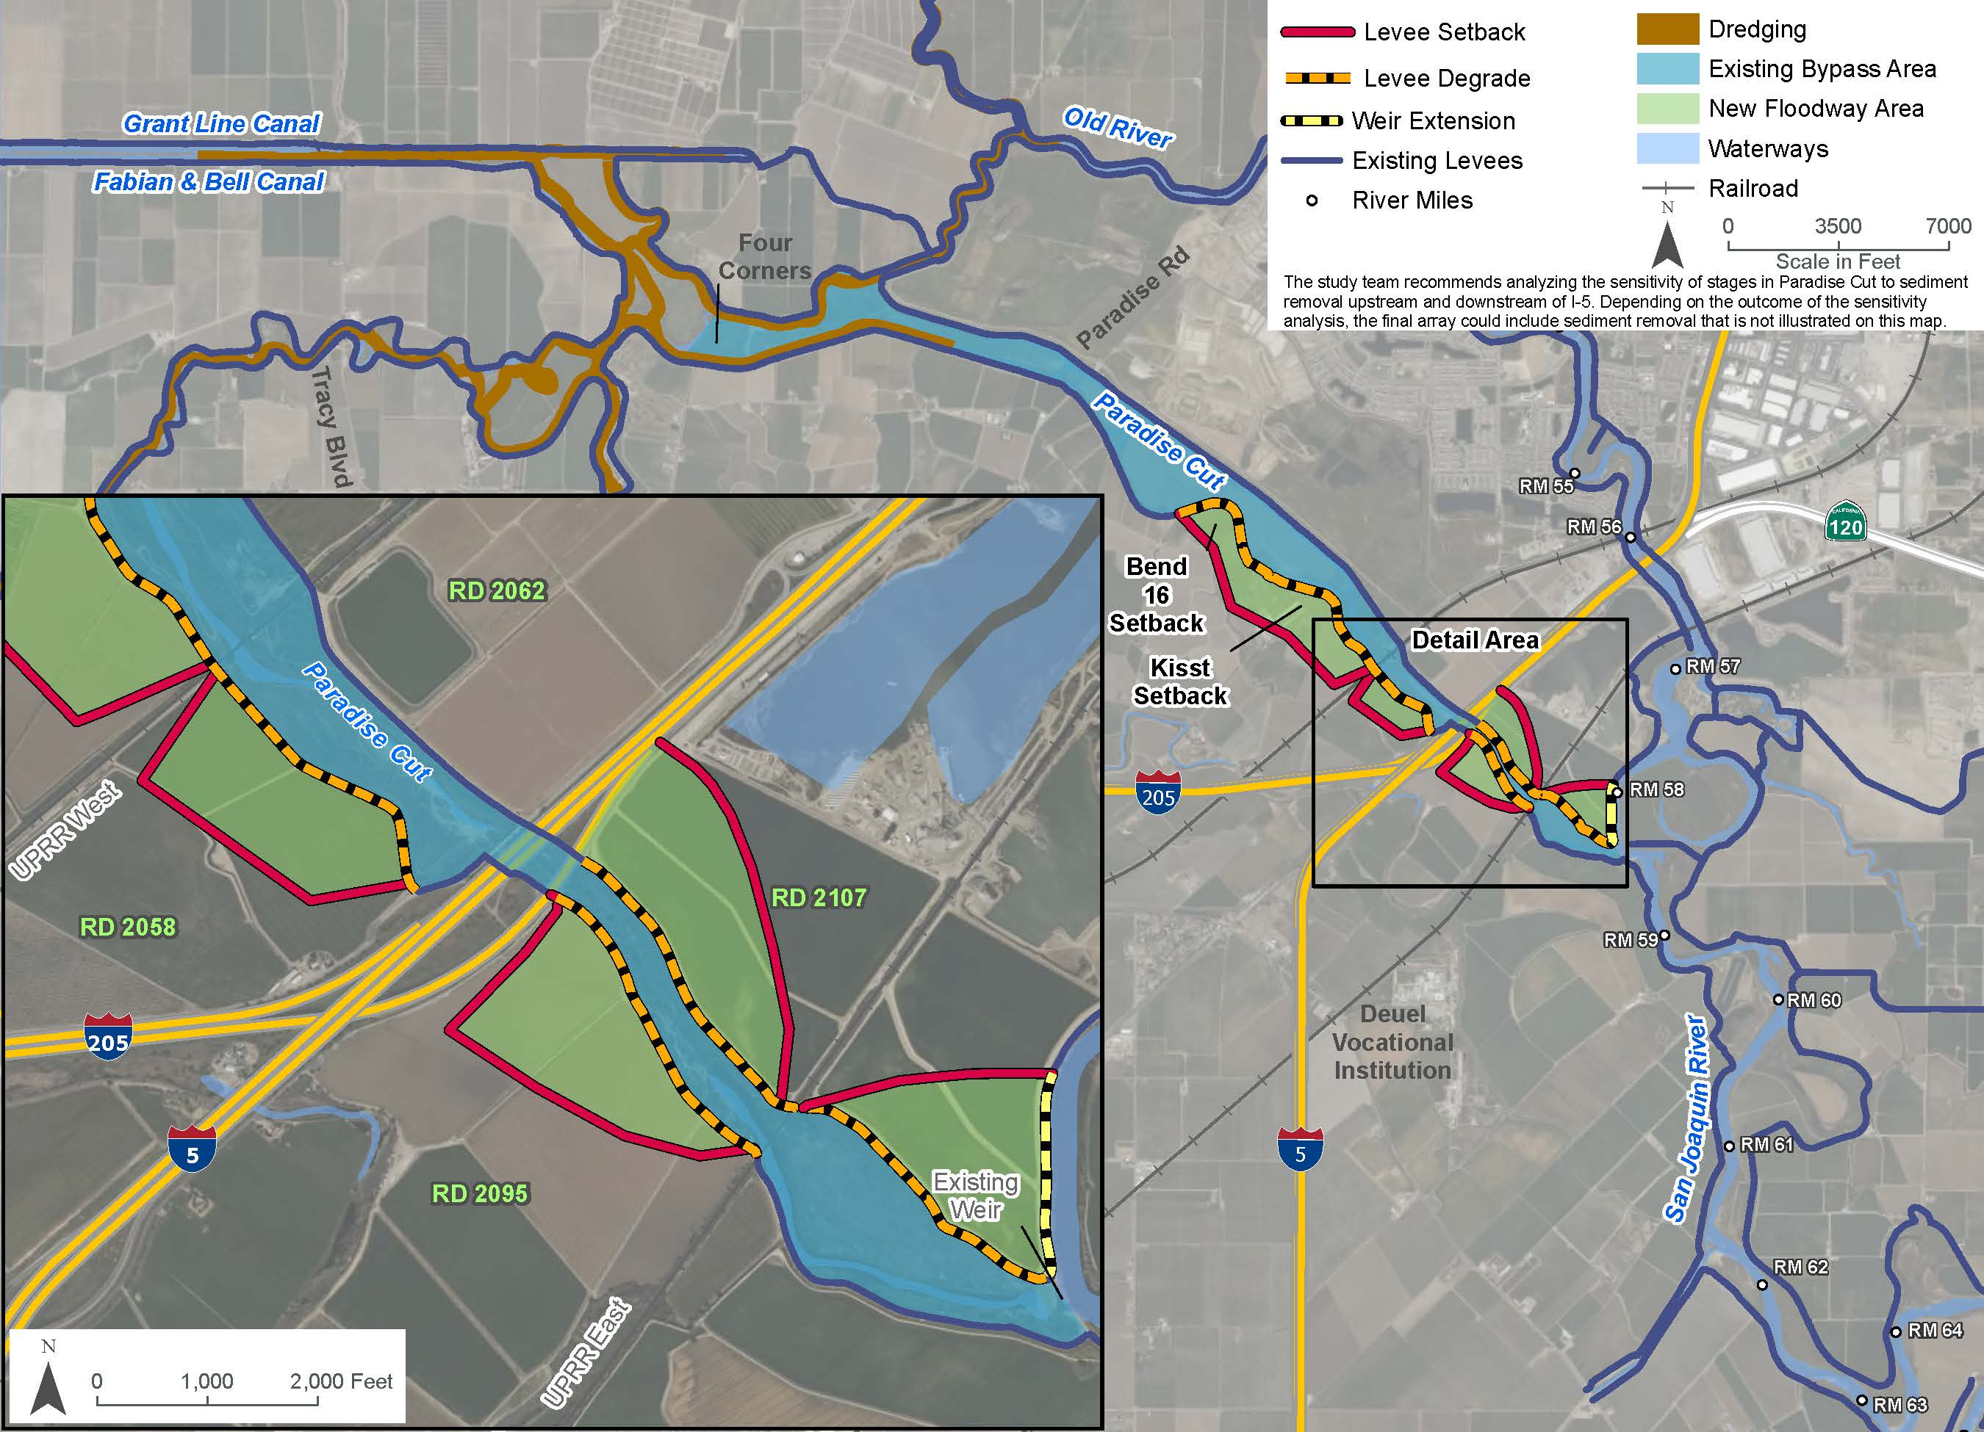
Minimum Plan B (Alternative 2) + Modifications
Add levee setback on the right bank of Paradise Cut between the east UPRR crossing and I-5.
Add downstream levee setbacks at Kisst Dairy and Bend 16.
Refine levee alignments and tie-ins.
Potentially, remove sediment upstream and downstream of I-5 crossing.

Slide 33
Minimum Plan B (Alternative 2) + Modifications

Slide 34
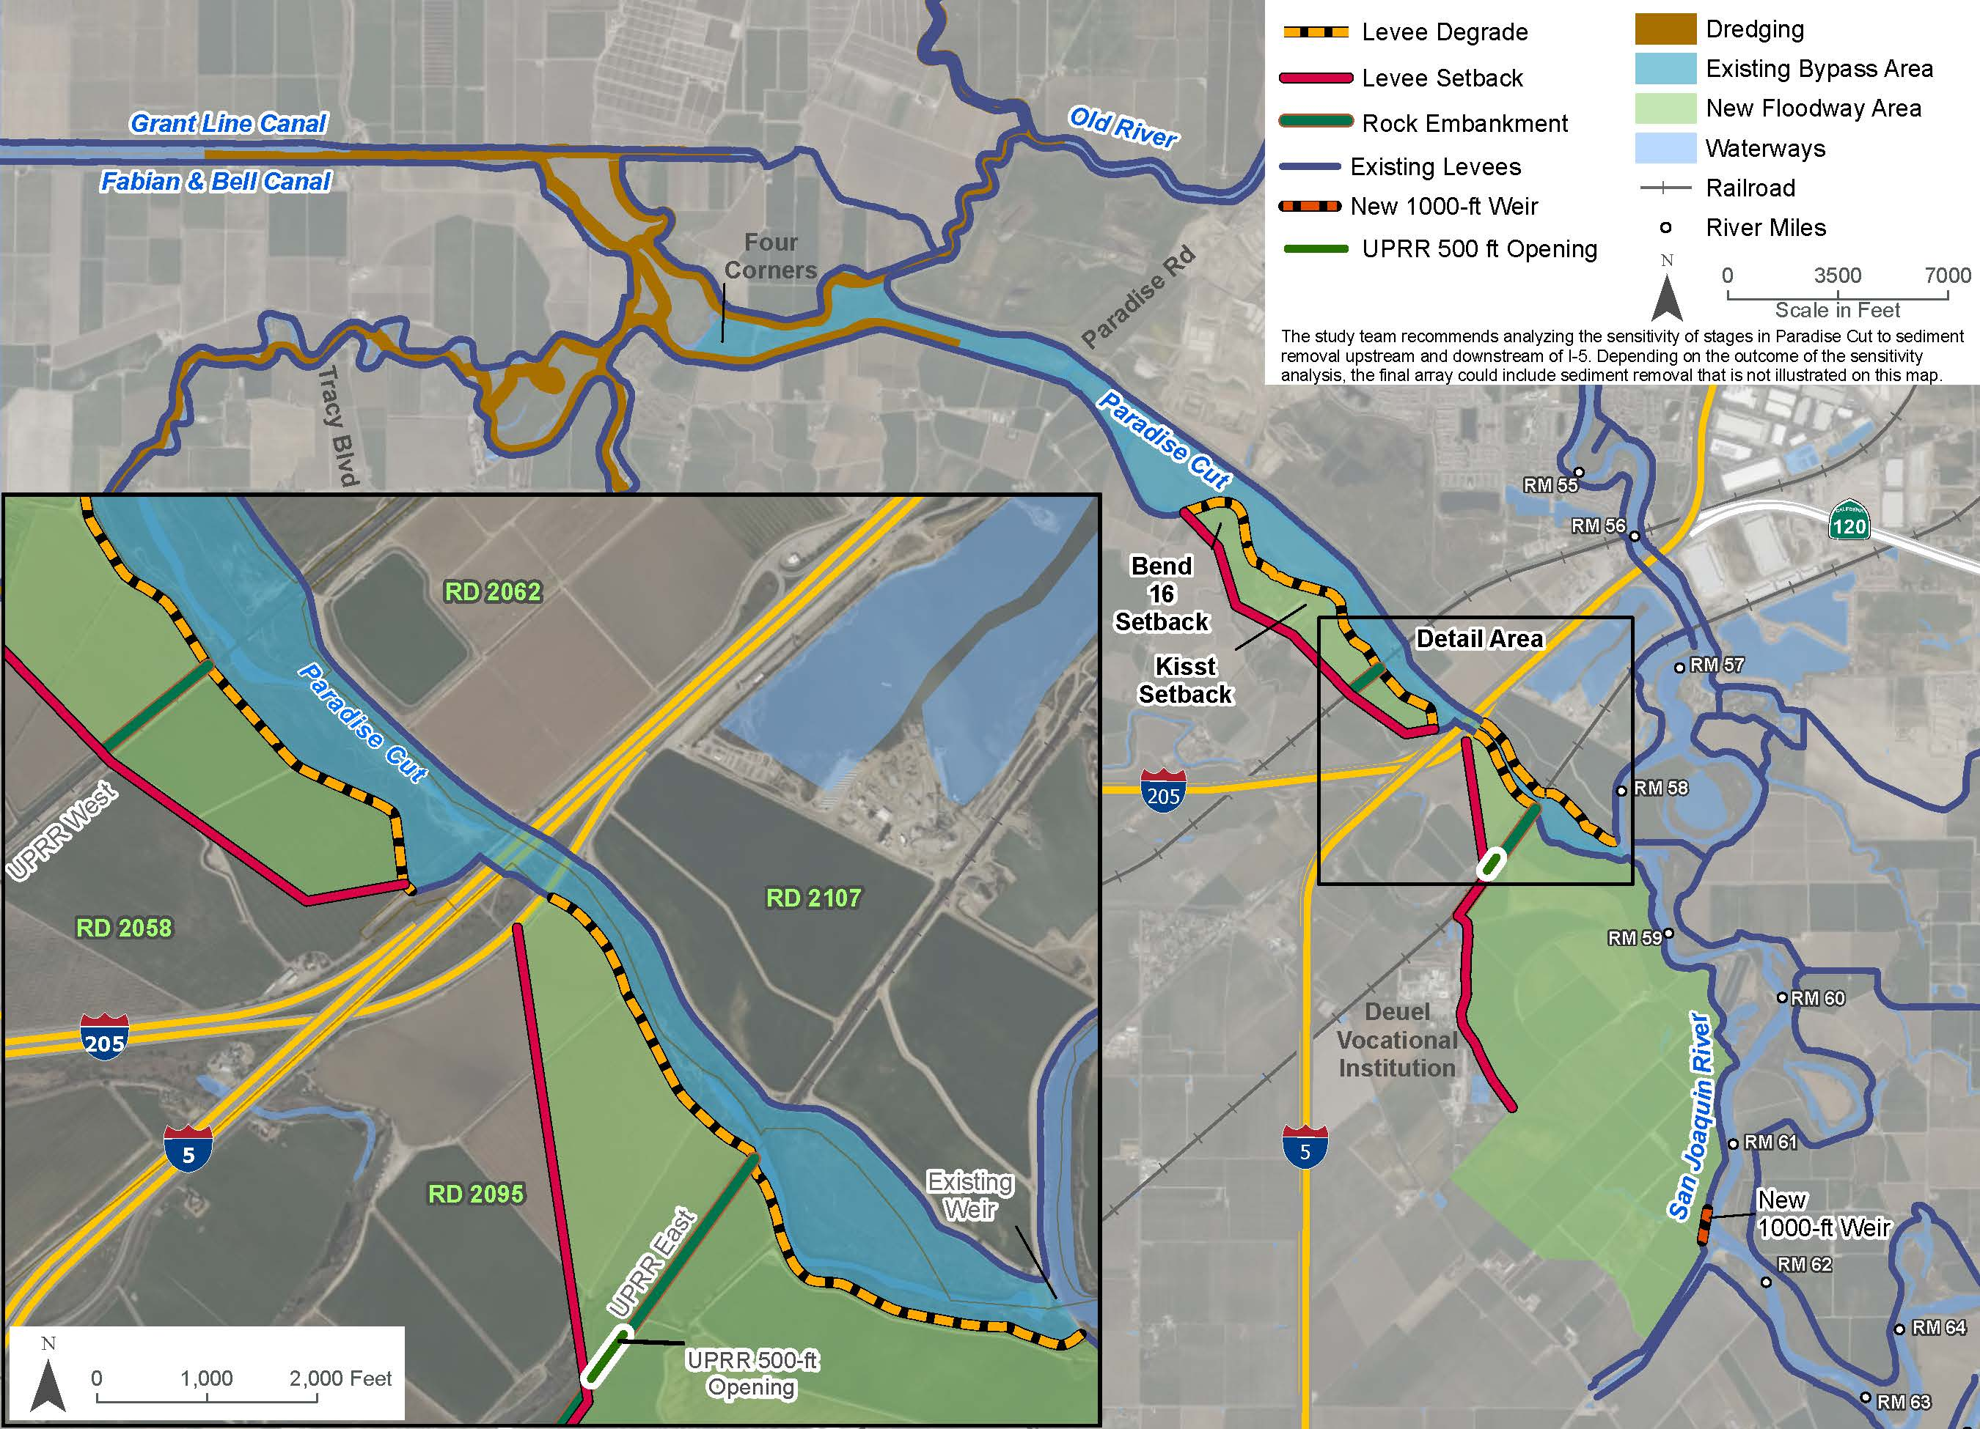
Phase 2 Plan (Alternative 3) + Modifications
Replace the 250-foot opening with a 500-foot opening in the east UPRR crossing.
Add downstream levee setbacks at Kisst Dairy and Bend 16.
Refine levee alignments and tie-ins.
Potentially, remove sediment upstream and downstream of I-5 crossing.

Slide 35
Phase 2 Plan (Alternative 3) + Modifications

Slide 36
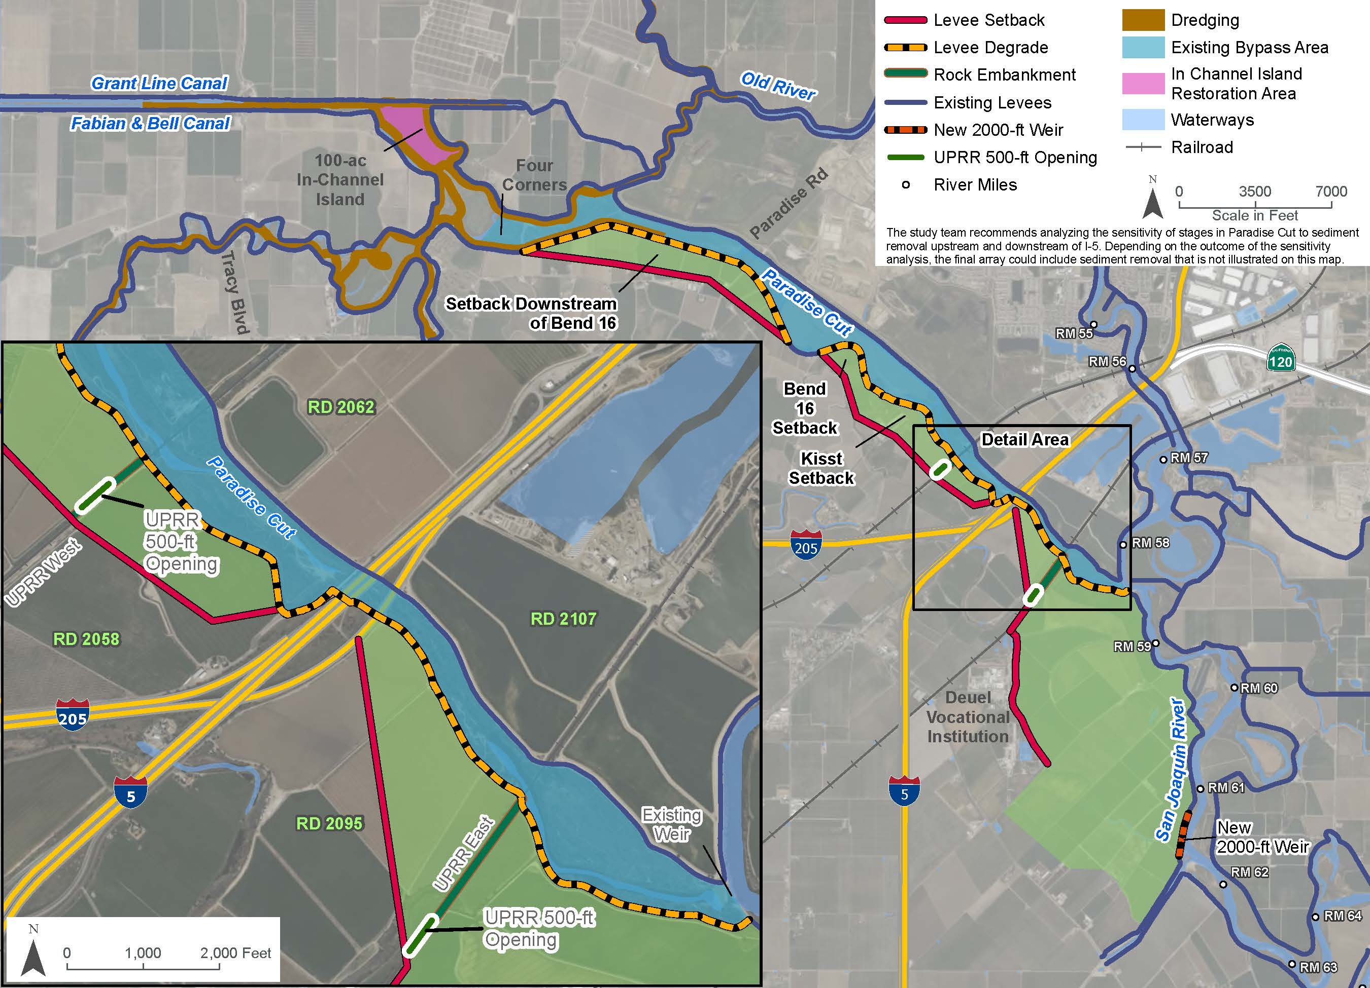
Phase 2 Plan Plus (Alternative 6) + Modifications
Remove the ecological levee setbacks concept in the Four Corners area;
Replace the new 1,000-ft long weir with a new 2,000-ft long weir upstream on the San Joaquin River.
Add a levee degrade on the left bank of Paradise Cut between the existing weir and the east UPRR crossing.
Add a 500 ft opening in the west UPRR crossing.
Refine levee alignments and tie-ins.
Potentially, remove sediment upstream and downstream of I-5 crossing.

Slide 37
Phase 2 Plan Plus (Alternative 6) + Modifications

Slide 38
Operations and Maintenance (O&M) Discussion
Notes:
Ric to present

Slide 39
Identified as a feature of the Lower San Joaquin River and Tributaries Project in the USACE 1956 Design Memorandum. Identified as “Paradise Dam.”
Not identified as a State Plan of Flood Control facility in the 2022 Central Valley Flood Protection Plan
Research on O&M responsibilities for the existing Paradise Cut Weir

Slide 40
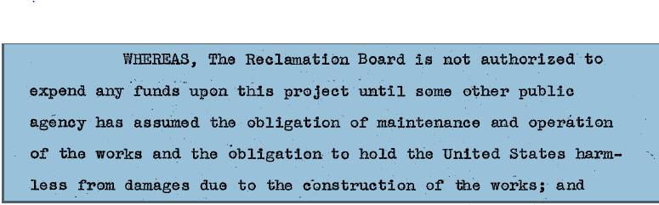
To maintain and operate, in accordance with the regulations prescribed by the Secretary of the Army, all levee and channel improvements together with all other project works within the jurisdiction or boundaries of RD No XXX
Assurance Agreement for Lower San Joaquin River and Tributaries Project

Slide 41

O&M Manual
Paragraph 1-01 - The improvement covered by this manual is that part of the Lower San Joaquin River and Tributaries Project levees and channels that border Reclamation District No XXXX.
There is specific direction on what is required for O&M of the levee. There is no language specifying what is required for channel maintenance.

Slide 42
Paradise Cut Channel Easements
Paradise Cut Land and Easement Acquisition Strategy Memo does not identify SSJDD easements for most of Paradise Cut
Working with CVFPB staff to confirm this is accurate

Slide 43
SJAFCA Update

Slide 44
California Department of Water Resources, Central Valley Flood Protection Board, and Delta Conservancy Updates

Slide 45
Advisory Committee Comments

Slide 46
Public Comments

Slide 47

Adjournment
  Glenn Prasad | Project Manager
  glenn.prasad@sjafca.org
  Melissa Weymiller | Project Manager
  melissa@larsenwurzel.com
  Ric Reinhardt | Feasibility Study Technical Team Lead
  rreinhardt@woodrodgers.com
  Petrea Marchand | Engagement & Facilitation Lead
  petrea@conserosolutions.com

Slide 48
Extra Slides

Slide 49
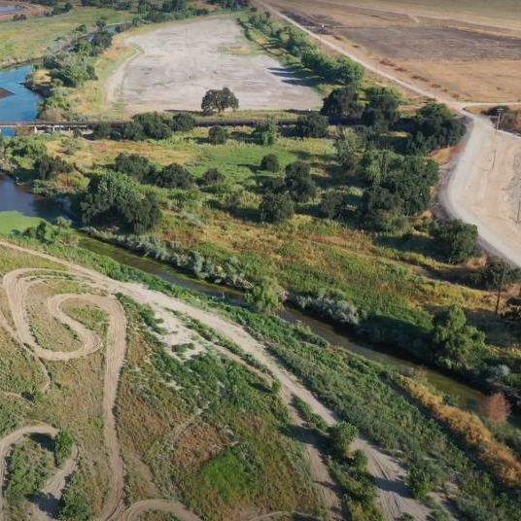
Goals
Flood risk reduction: Increase flood system resiliency in the South Delta.
Ecosystem restoration: Restore habitat and ecosystem functions necessary for climate change resilience.
Water supply: Improve water supply reliability and resilience to climate change by supporting more flexible water supply management.

Slide 50
Objectives
Reduce catastrophic flood risk for communities including Lathrop, Manteca, and Stockton.
Protect farms from uncontrolled flooding.
Restore and improve the quantity, diversity and connectivity of riverine, floodplain, riparian, and wetland habitat for native fish and wildlife.
Improve irrigation intake reliability and waterway navigability.

Slide 51
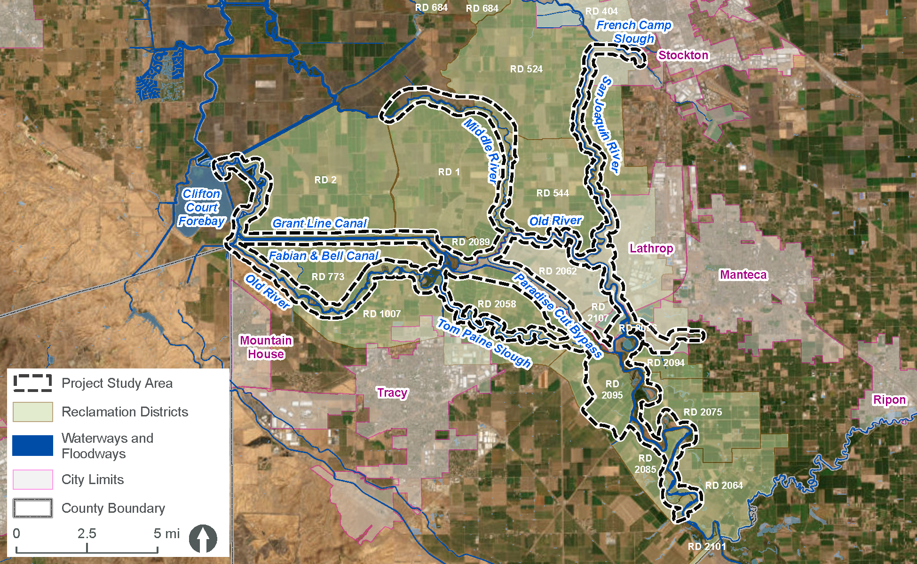
Study Area

Slide 52
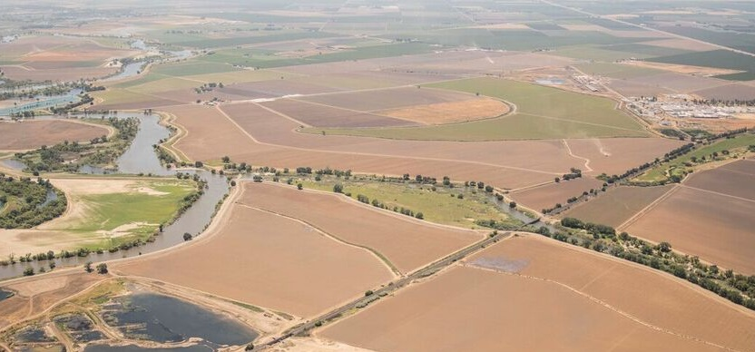

Phase 2 Plan Aerial View
Expanded inundation area
New weir
Existing
weir
Existing Paradise Cut area
Looking south up the San Joaquin River.
Photo by Daniel Nylen, American Rivers.

Slide 53
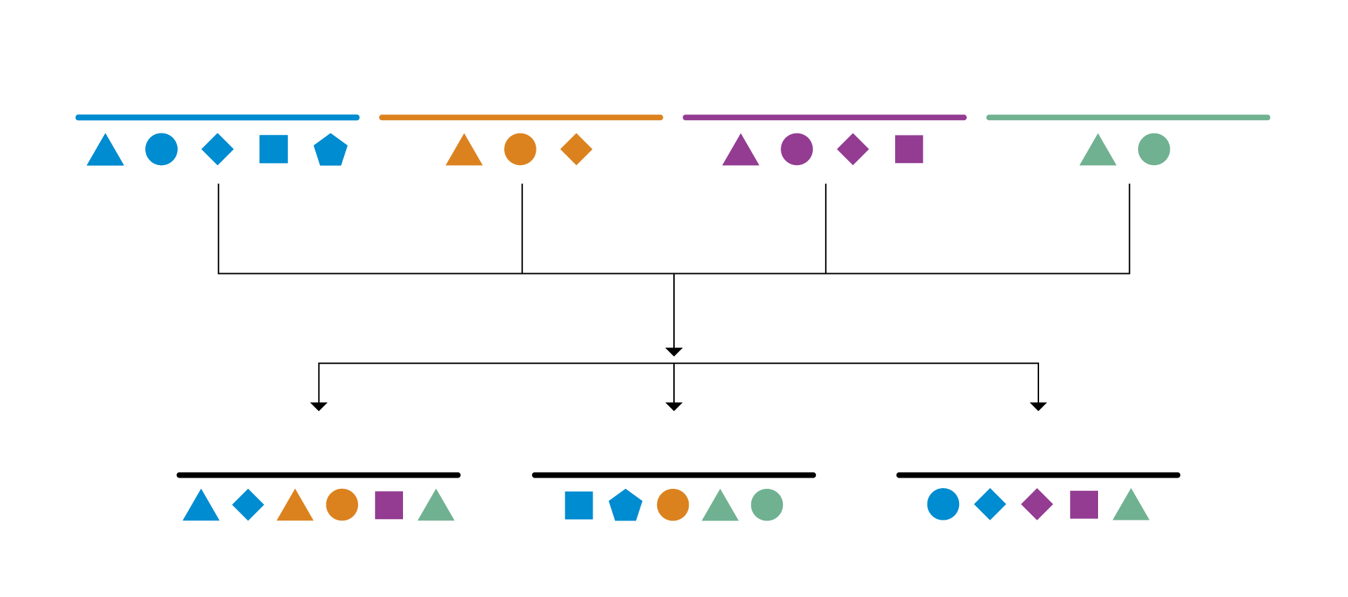
Alternative Formulation Process
Channel Restoration Management Actions
Flood Risk Management Actions
Ecosystem Management Actions
Downstream Hydraulic Mitigation
Preliminary
Alternative A
Preliminary
Alternative B
Preliminary
Alternative C
Notes:
A Management Actions is feature or individual action that can serve as a building block to alternatives that meet the goals and objectives of a proposed Project.
Management Actions have been compiled from past work and outreach and engagement.
Identified Management Actions are grouped into various Preliminary Alternatives
Preliminary Alternatives will be screened into final array of alternatives (up to 4 including No-Action Alternative)
Screening Process to be discussed at Planning Charette

Slide 54
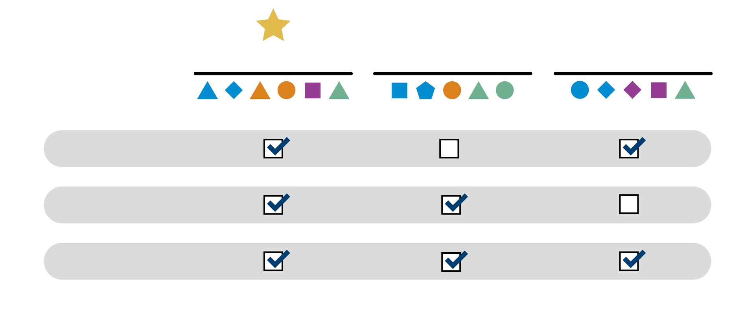
Evaluate and Compare Final Alternatives
Alternative A
Alternative B
Alternative C
Criterion 1
Criterion 2
Criterion 3
Notes:
Final array of alternaives (up to 4), including No-Action Alternative will be evaluate and compared to determine the recommended alternative
Evaluation Criteria includes achievement of objectives (Quantitative), Cost (Quantitative), acceptability, and possibly other factors

Slide 55
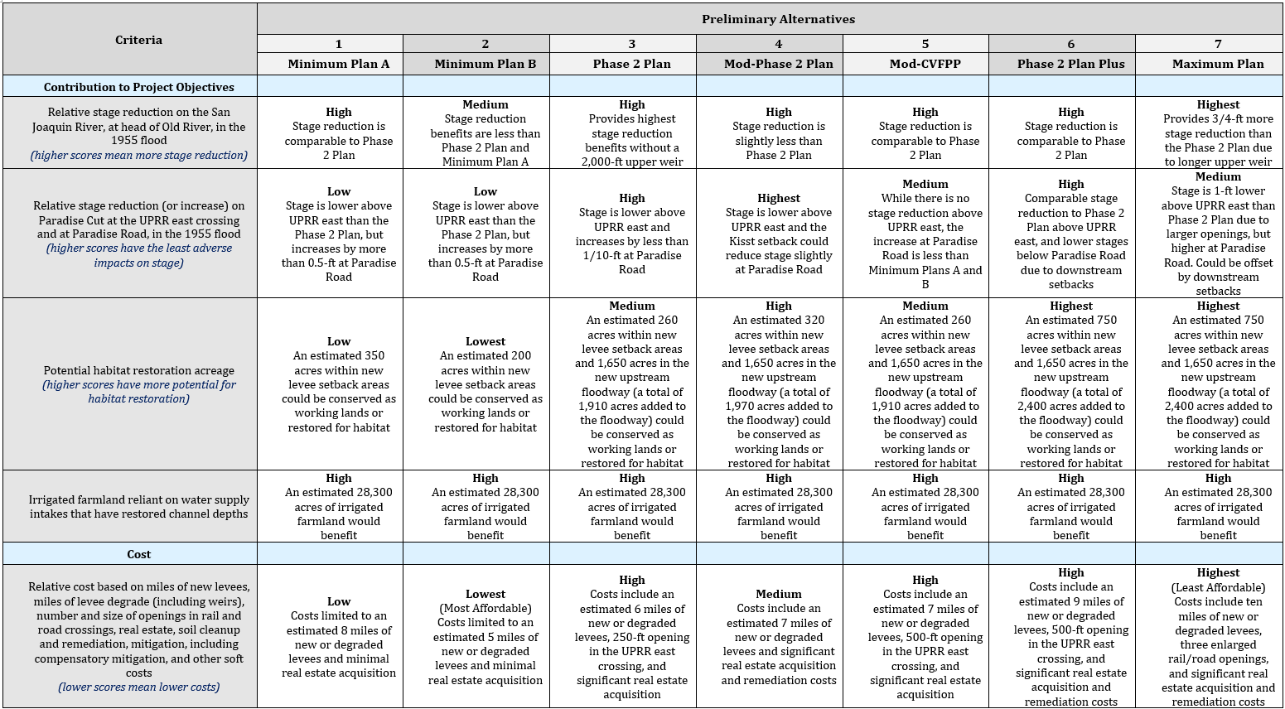
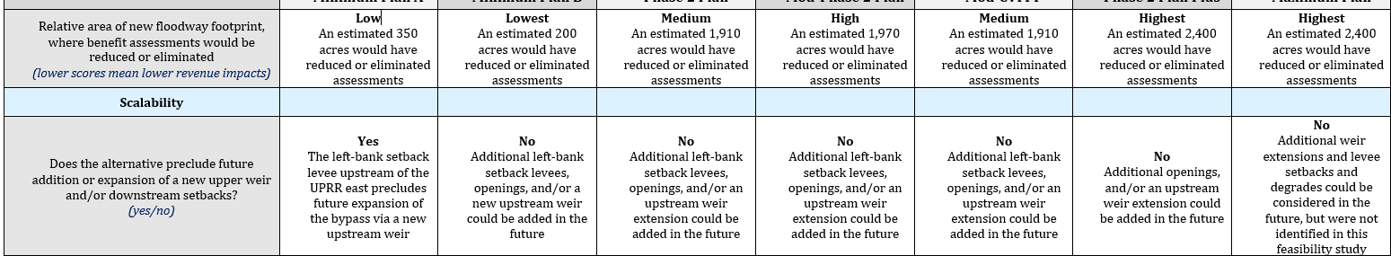
Results Summary

