Slide 1

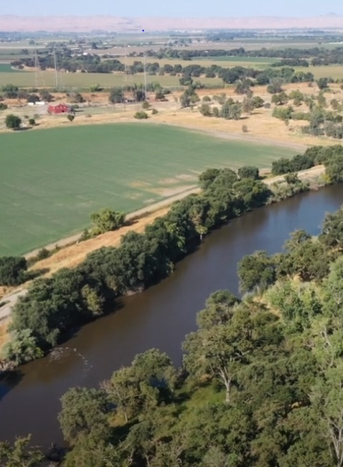
Paradise Cut Bypass Expansion
and Multi-Benefit Project
Advisory Committee Meeting
October 15, 2024
11.30 am – 1.00 pm
Location: San Joaquin Council of Governments (SJCOG)
555 E Weber Ave Stockton, California 95202

Slide 2
Administrative Matters (Consero Solutions)
  Roll Call
  Approve of 8/26 Meeting Summary [Possible Action]
  Approve correction to 8/26 meeting agenda packet [Possible Action]
  Receive and file updated study area map [Possible Action]
Public Outreach Update (Consero Solutions)
Recommend Approval to SJAFCA of Paradise Cut Bypass Expansion and Multi-Benefit Project Engagement Strategy [Possible Action] (Consero Solutions)
Receive and File Final Decision Recommendation Framework (LWA/SJAFCA)
Feasibility Study Update (LWA)
SJAFCA Update (SJAFCA)
DWR and CVFPB Updates (DWR and CVFPB)
Advisory Committee Comments
Public Comment
Adjournment
Advisory
Committee
Agenda

Slide 3
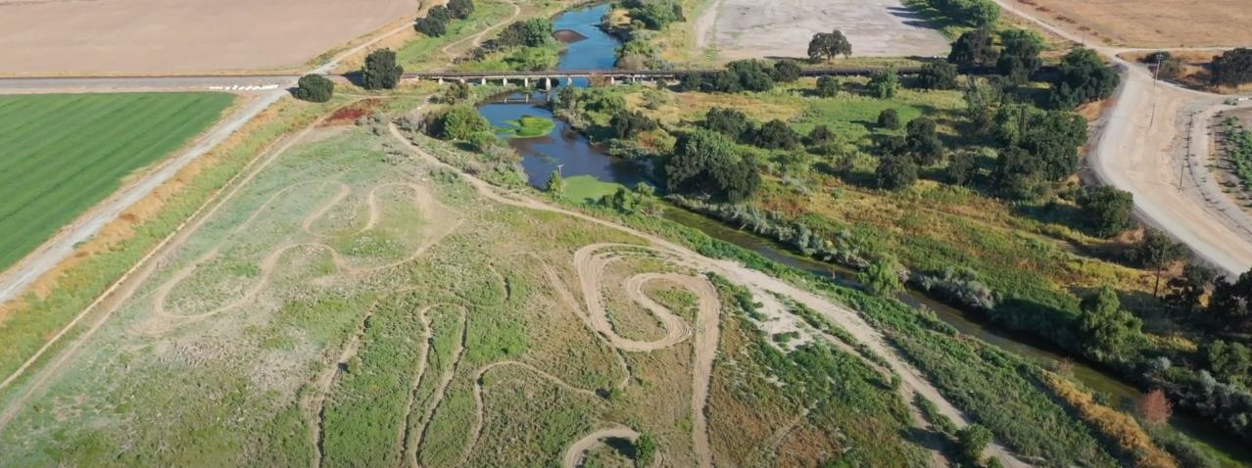

Administrative Matters
Roll call
Approve 8/26 Meeting Summary (Attachment A) [Possible Action]
  Approve correction to 8/26 Advisory Committee meeting agenda packet to correct project goals, objectives, and study area attachment (Attachment B) [Possible Action]

Slide 4
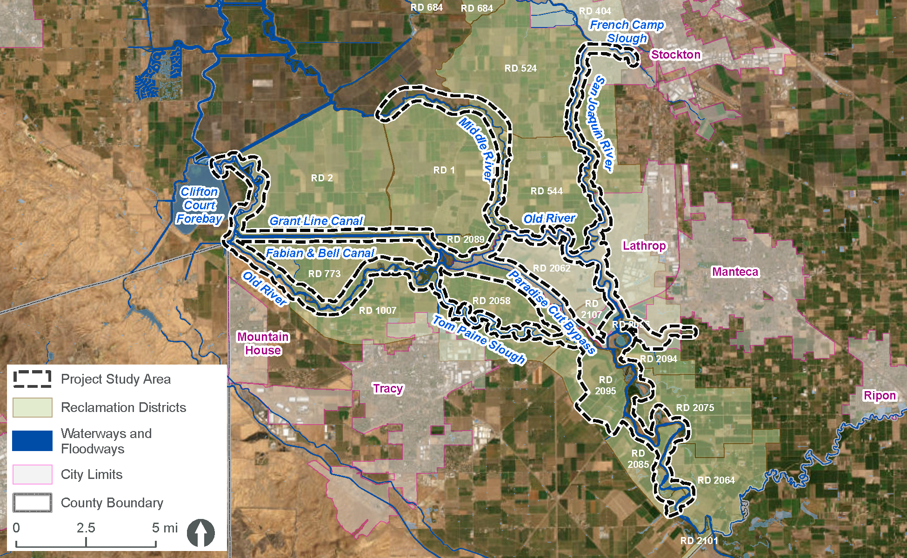
  Receive and file updated study area map with Advisory Committee feedback incorporated (Attachment B) [Possible Action]

Slide 5
Public Outreach

Slide 6
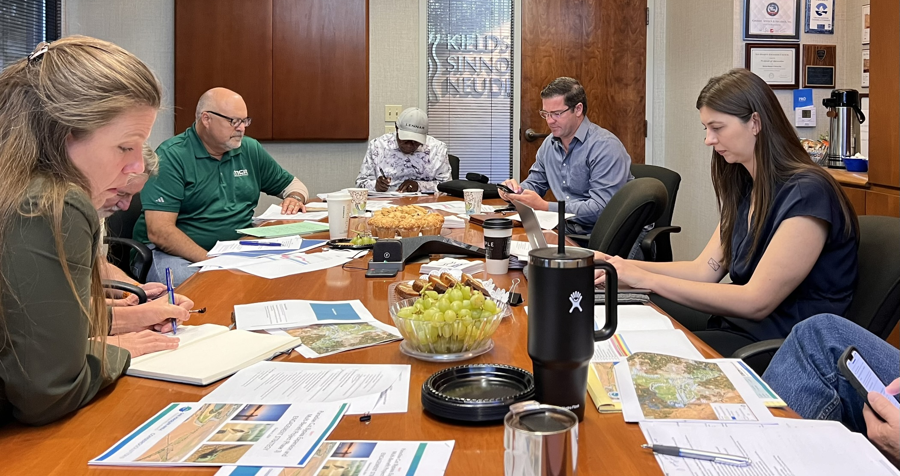
October Small Group RD Meetings: Key Takeaways
Study area, goals, objectives acceptable
Engage engineers in early stages of alternative development
Add “governance” to feasible definition
Expand feasible definition to include cost of long-term operations and maintenance for all elements of the Project, including dredging
Send documents over email instead of posting to web site
Provide significant advance notice of deadlines to allow scheduling of RD Board meetings

Slide 7
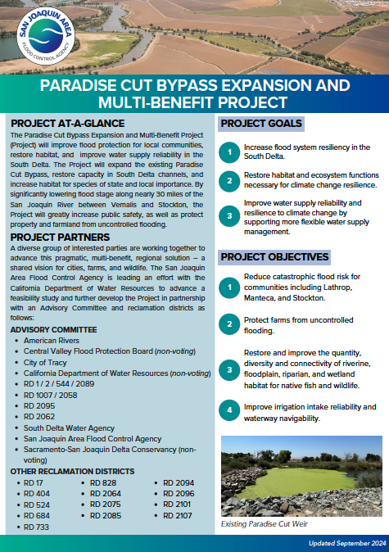
Updated Project Flyer
(Attachment C)
2-page document providing overview of Project
Page 1: project at-a-glance, project partners, project goals and objectives
Page 2: site map, description of funding for Phases 1-3, milestones, contact information

Slide 8
Engagement Strategy

Slide 9
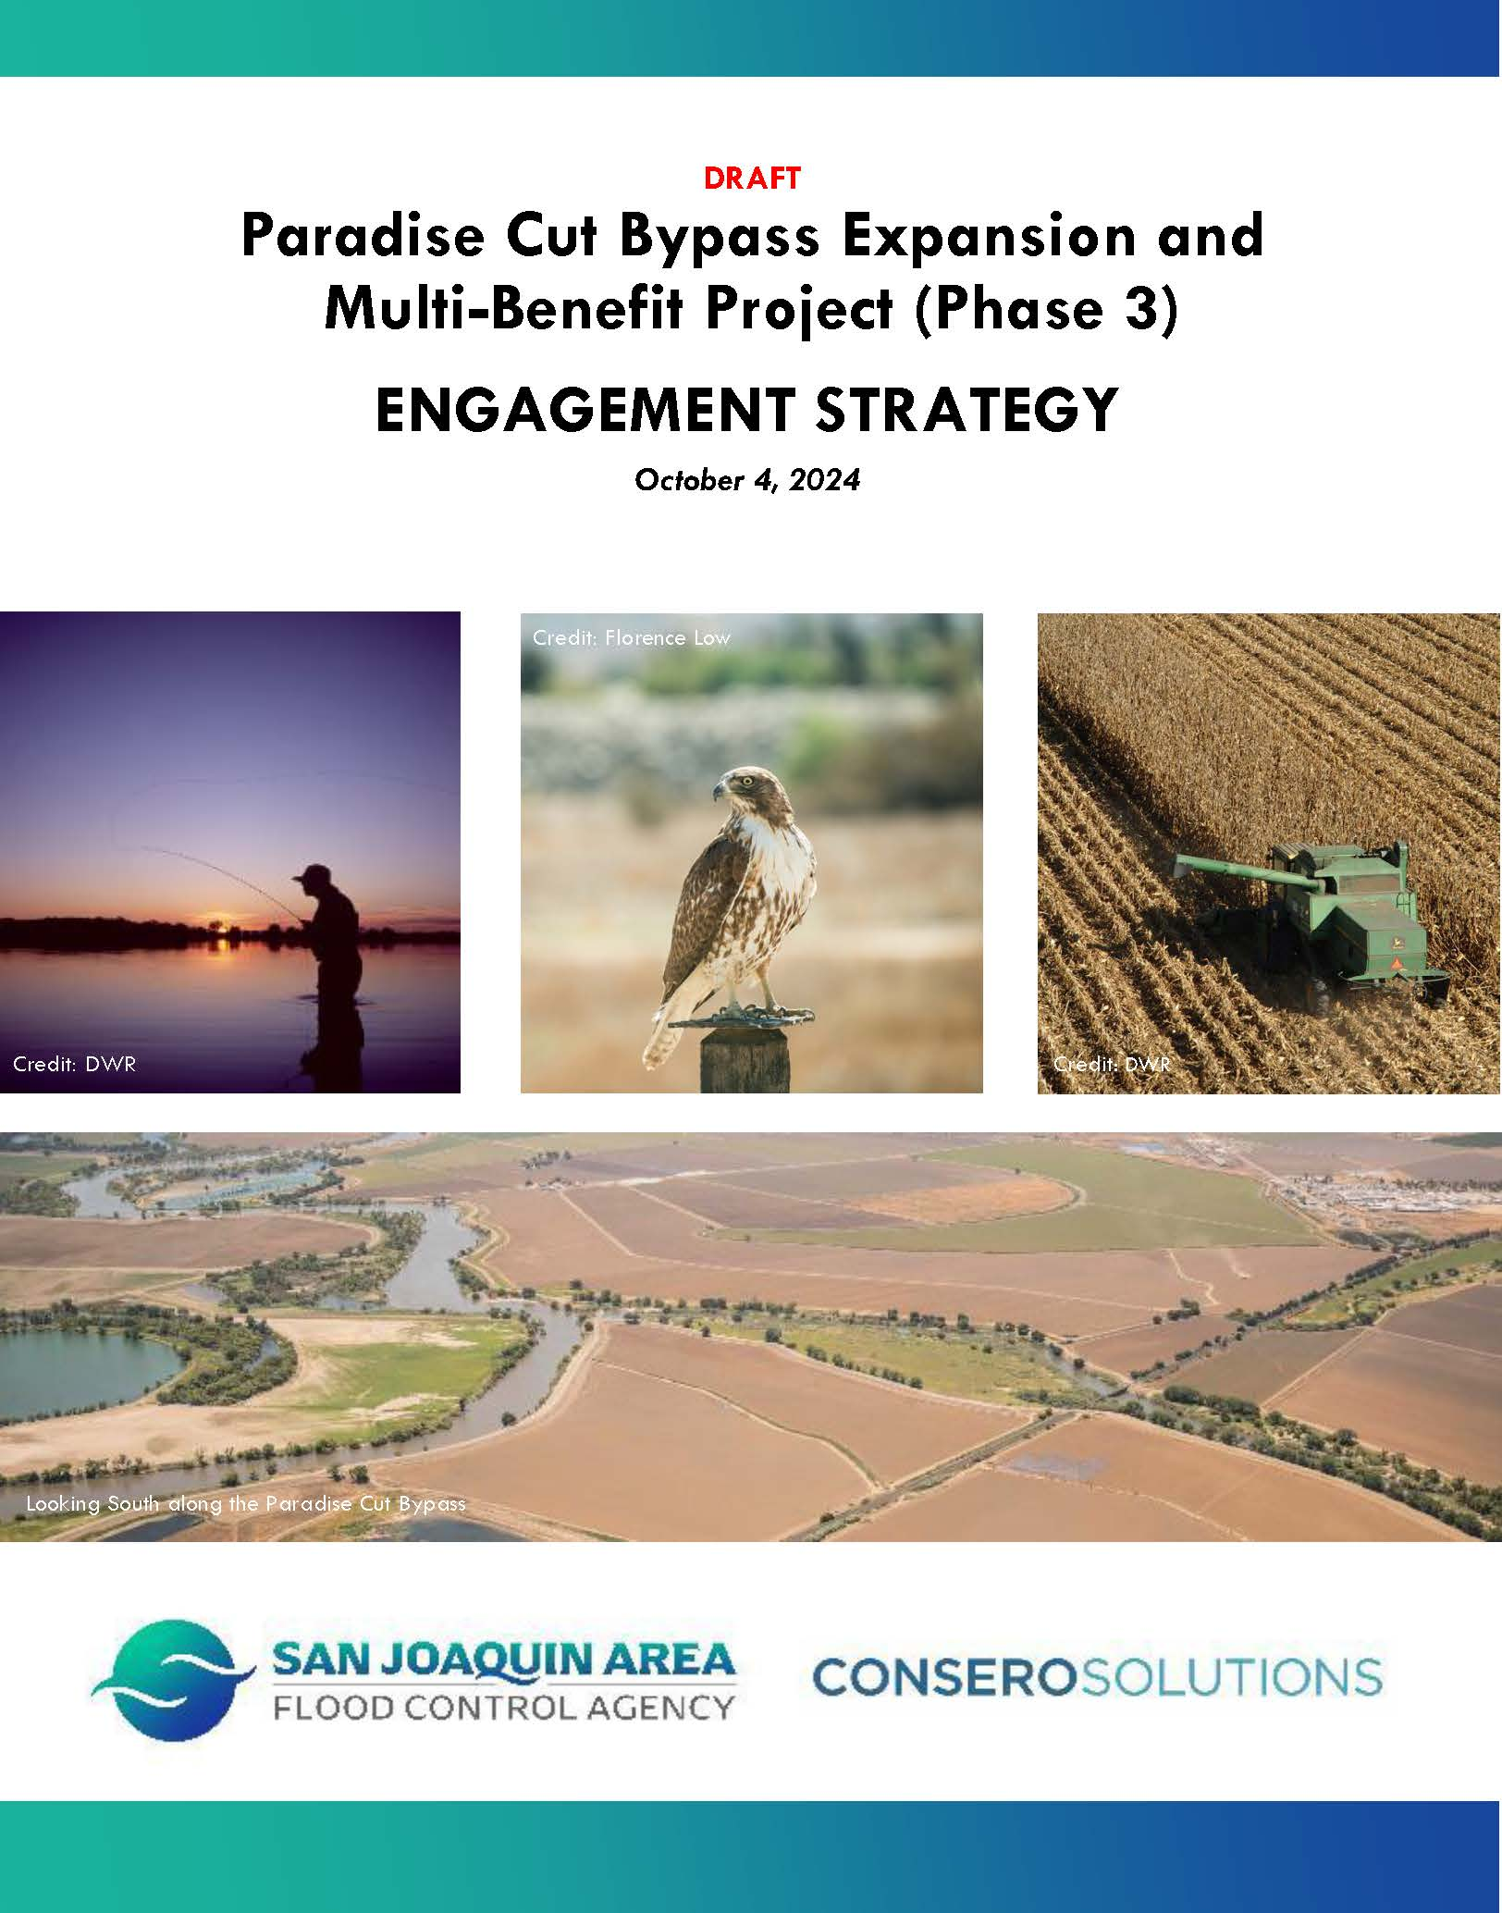
Recommend Approval to SJAFCA of Paradise Cut Bypass Expansion and Multi-Benefit Project Engagement Strategy (Attachment D) [Possible Action]

Slide 10

Updated Engagement Schedule
September 2024: Completed updated Project Overview
October 2024: Introduced reclamation districts to the Project and secured feedback on study area, goals and objectives, and engagement strategy
November 2024: Complete Frequently Asked Questions; additional primary
audience meetings
December 2024: Advisory Committee meeting; send letter to primary audiences regarding comments on draft deliverables

Slide 11
Updated Engagement Schedule
January/February 2025: First virtual newsletter and update to Project page on SJAFCA website
March 2025: Send letter to primary audiences regarding comments
on draft deliverables
May/June 2025: 10-day comment period; Advisory Committee meeting; meetings with primary audiences regarding Draft Alternatives Formulation and Screening Technical Memorandum
June/July 2025: Second virtual newsletter and update to Project page on SJAFCA website

Slide 12
Updated Engagement Schedule
August/September 2025: 10-day comment period; Advisory Committee meeting, meetings with primary audiences regarding the final Evaluation and Comparison of Alternatives Memo
October/November 2025: Public workshop #1
December 2025: 10-day comment period; Advisory Committee meeting; meetings with primary audiences regarding draft feasibility study, public workshop #2, third virtual newsletter and update to Project page on SJAFCA website

Slide 13
Decision Recommendation Framework

Slide 14
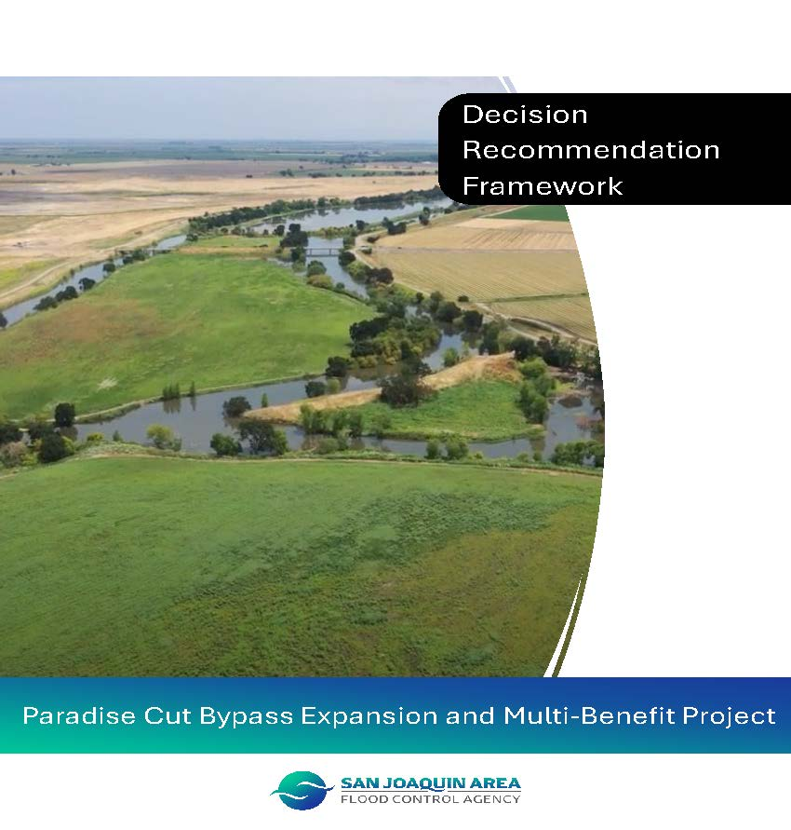
Receive and File Final Decision Recommendation Framework (Attachment E)
14

Slide 15
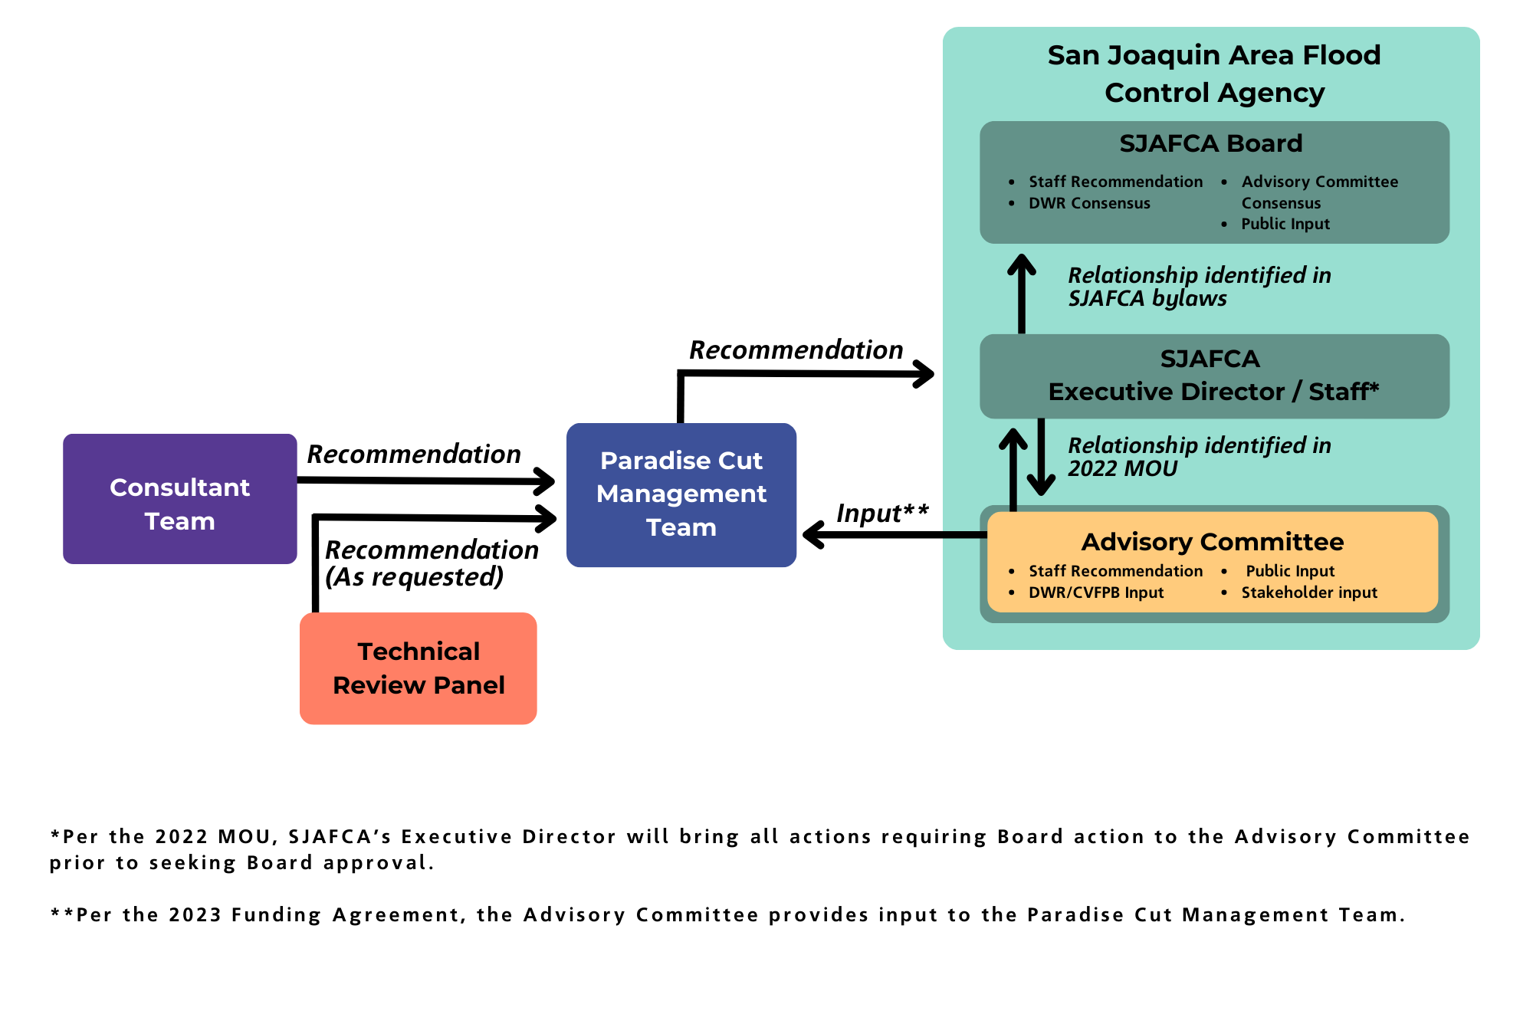
Updated Decision Recommendation Process

Slide 16
Feasibility Study Update

Slide 17
SJAFCA Update

Slide 18
SJAFCA Updates
  Board approval of name change
  Delegation to Executive Director:
    Resolution No. SJAFCA 24-30: Resolution Authorizing the Executive Director to Approve All Administrative, Technical and Policy-Level Decisions and Documents on the Feasibility Study, including Recommendations of the Paradise Cut Advisory Committee.
    Board approved the resolution with the request to staff that the Board receive future updates on the decisions that have been made by the Executive Director pursuant to this resolution.
  September 9, 2024 site visit

Slide 19
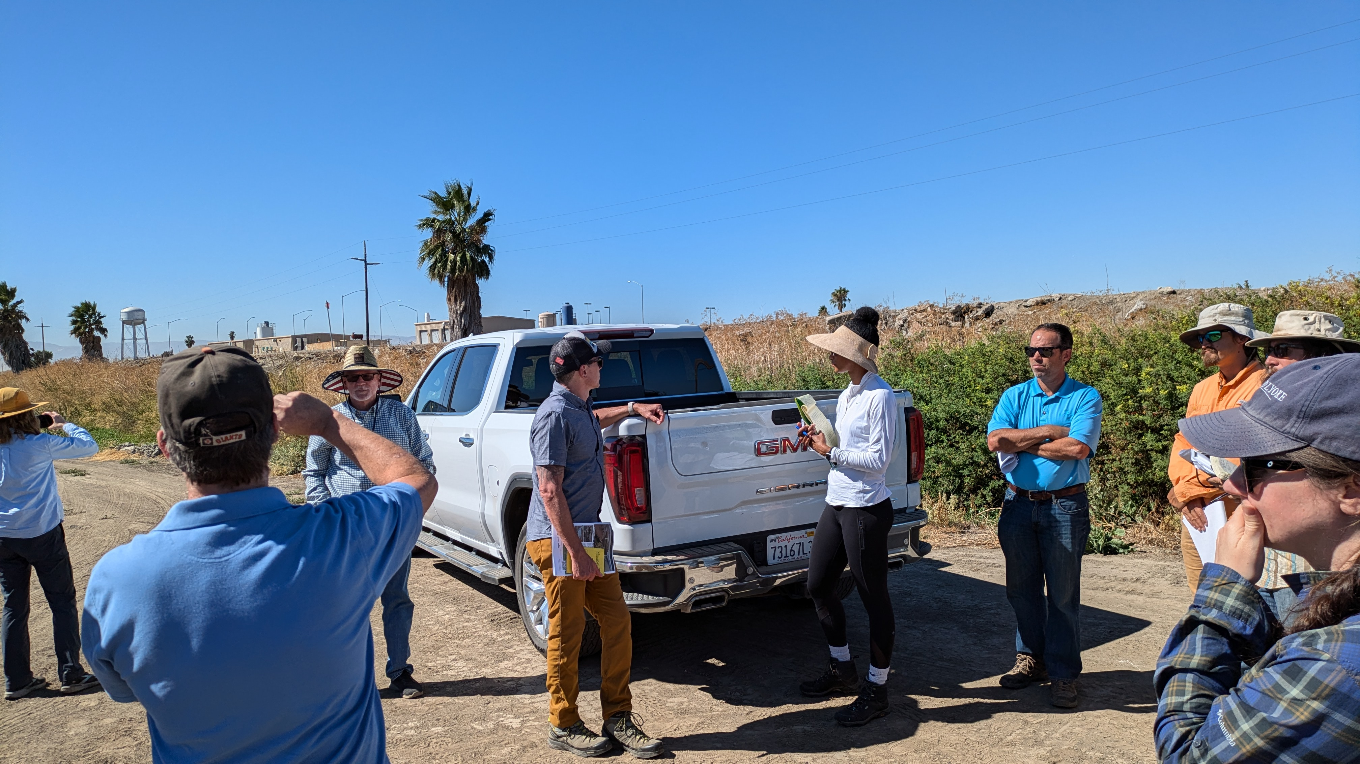
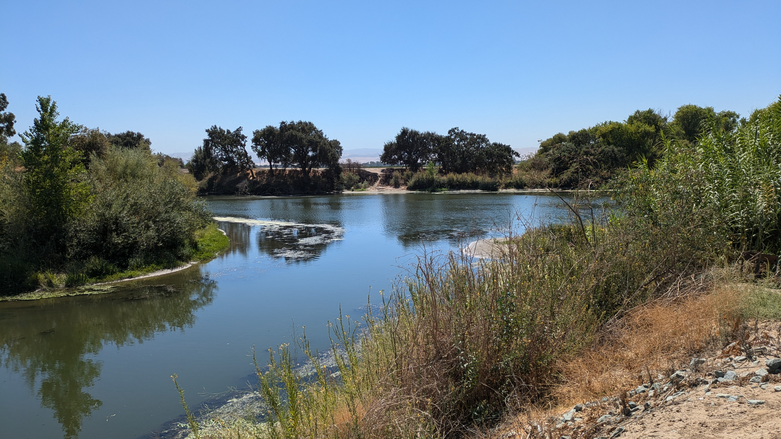
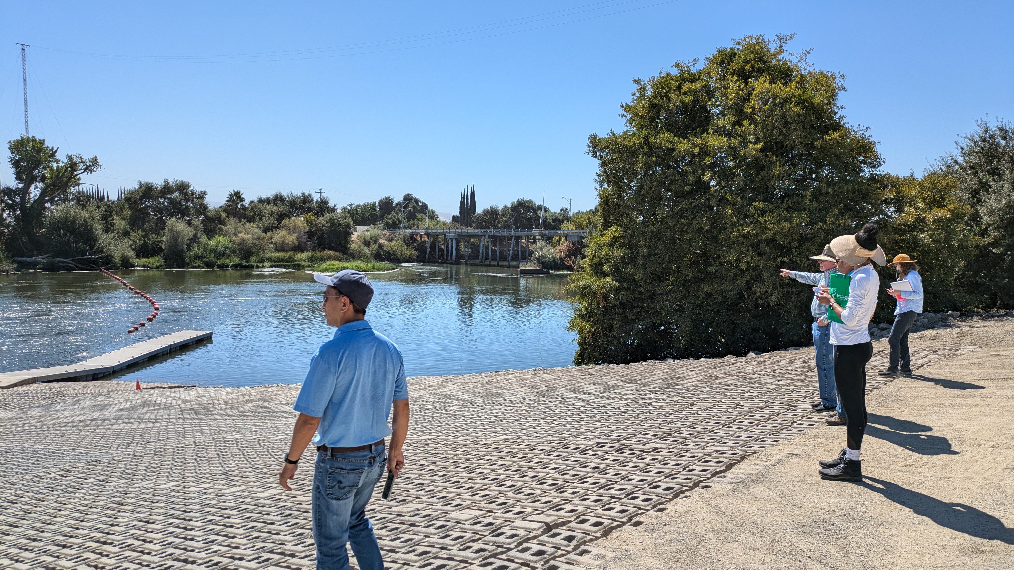
September 9, 2024 Site Visit

Slide 20
California Department of Water Resources and Central Valley Flood Protection Board Updates

Slide 21
Advisory Committee Comments

Slide 22
Public Comment

Slide 23
Adjournment
  Glenn Prasad | Project Manager
  glenn.prasad@sjafca.org
  Melissa Weymiller | Project Manager
  melissa@larsenwurzel.com
  Petrea Marchand | Engagement & Facilitation Lead
  petrea@conserosolutions.com

