Slide 1

PROPOSED MOSSDALE TRACT
ENHANCED INFRASTRUCTURE FINANCING DISTRICT
Lathrop City Council
January 10, 2022
SJAFCA MISSION STATEMENT - Reduce and Manage the Region’s Flood Risk
Notes:
Seth

Slide 2
SJAFCA Mossdale Program
SJAFCA Strategic Plan Priority Actions related to Mossdale Tract Urban Level of Protection:
Support USACE in initiating Phase 2 of the Lower San Joaquin River Project Feasibility Study
Complete the Mossdale Urban Flood Risk Reduction Study and advance Design and Environmental Review
Achieve 200-year Urban Level of Flood Protection for the Mossdale Tract Area (by 2028) and present Adequate Progress until Improvements are Complete
Implementation of the proposed Enhanced Infrastructure
Financing District is integral to Adequate Progress
2
Notes:
Seth

Slide 3

Mossdale Tract Funding
Program must be completed by 2028 (AB 838 3-Year Extension)
  Phase 4 Work (200-Year ULOP Project) currently estimated to be $230M (2021$’s) taking into consideration SJAFCA’s Climate Adaptation Policy
  Almost entirely locally funded at this time
New Local Funding Mechanisms
  Development Impact Fee collected throughout Mossdale Tract Basin
    Been in place since early 2019. Currently working through update process.
  Proposed Overlay Assessment District
    Would overlay RD 17’s existing assessment funding the local share of the Phase 3 Levee Seepage Repair Project. Preliminary Rates are being evaluated. Looking to advance assessment formation in the Spring (early 2022).
  Proposed Mossdale Tract Enhanced Infrastructure Financing District
    A partnership between the Cities of Lathrop, Manteca, and Stockton and San Joaquin County dedicating a portion of Property Tax Increment toward the project to fund / finance the Project.
Reduce and Manage the Region’s Flood Risk
3
Notes:
Seth

Slide 4
Summary of Request
  Start formation of the EIFD by adopting the Resolution of Intention
Establishes the Governance Entity (a Public Financing Authority) which is the entity that will:
  Prepare the necessary documentation - the Infrastructure Financing Plan; and,
  Take the formal steps of forming the EIFD subject to approval by the participating agencies
Appoint Members of PFA including Lathrop City Council Members and Public Members
  Staff recommendation is to overlap membership between EIFD PFA and SJAFCA as much as possible for administrative efficiencies. Public Members will be chosen today from applications received, subject to approval by the other agencies.
Set forth the hearing and noticing actions to be carried out consistent with relevant EIFD Law
Reduce and Manage the Region’s Flood Risk
4
Notes:
Seth

Slide 5
Policy Considerations
  The Mossdale Tract Area EIFD will allow Lathrop and the other Affected Taxing Entities to continue to validate their findings of Adequate Progress toward ULOP.
  The effective use of an EIFD as a tool for infrastructure finance should result in positive economic and fiscal impacts to the community.
    The Center for Business and Policy Research at the Eberhardt School of Business concluded that total economic benefits of future development in the basin, which would only be able to move forward if the ULOP project is completed, would be more than $11 Billion and 66,000 jobs at buildout.
    In addition, analyses completed by SJAFCA’s consultant team estimate positive fiscal impacts for each of the ATEs.
Reduce and Manage the Region’s Flood Risk
5
Notes:
Jamie / Amy

Slide 6
EIFD Formation Process
Formation process starts with an initial action of a Participating Entity.
  Governance Entity / PFA
    Membership Requirements – 2 from each Participating Entity plus 2 Public Members (10 Member Board vs. SJAFCA 9 Member Board)
Process continues with meetings of new PFA
  Five Meetings of PFA
    Two organizational meetings / call for preparation of IFP / Three Noticed Public Hearings
  Multiple mailed notices to all property owners/residents within the EIFD
Formation is conditioned on Participating Entity approval
  Participating entities must approve IFP prior to Third/Final Public Hearing of PFA
Reduce and Manage the Region’s Flood Risk
6
Notes:
Jamie / Amy

Slide 7
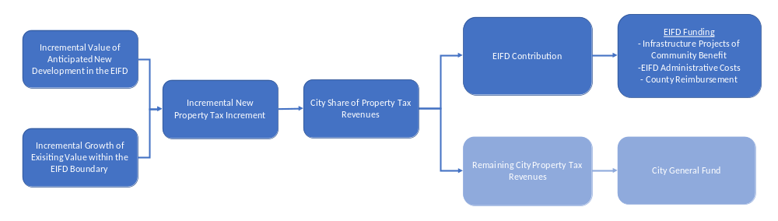
Enhanced Infrastructure Financing Districts
An Enhanced Infrastructure Financing District (EIFD) is a tax increment financing mechanism through which jurisdictions allocate a portion of new property tax revenues to fund eligible improvements of communitywide benefit.
Reduce and Manage the Region’s Flood Risk
7
Notes:
Jamie / Amy
Glenn’s comment - Recommend stating this verbally: The concept is that, without the EIFD funding there is no Project, without the Project new development cannot occur, so committing tax increment toward the Project is appropriate and critical for new development.

Slide 8
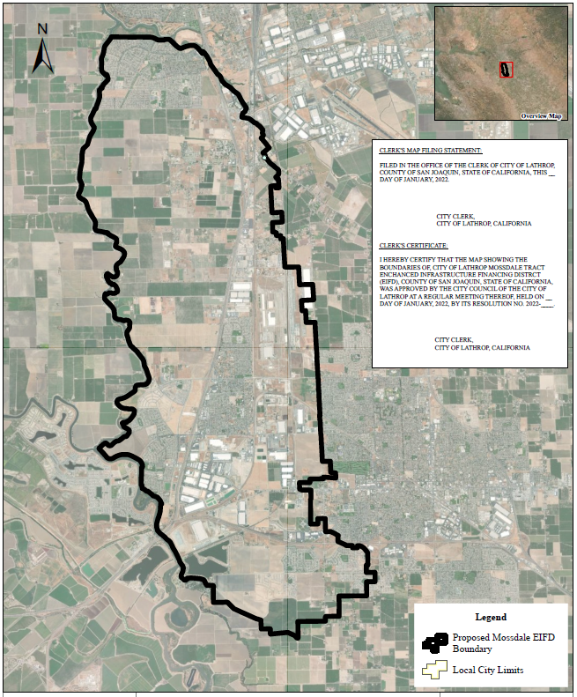
Proposed Boundary of the EIFD
Reflects the Area of Benefit of ULOP
Consistent with the Area subject to the Regional Levee Impact Fee and Proposed Overlay Assessment District
Notes:
Jamie / Amy

Slide 9
Infrastructure Financing Plan
As required by Government Code Sections 53398.59–53398.74, the completed IFP contains the following information:
The EIFD boundary
Public facilities and other forms of development or financial assistance
A finding of communitywide significance
Financial analyses that summarize:
  Maximum tax increment committed to the EIFD
  Amount of tax revenues generated for the EIFD
  A financing plan and any intention to incur debt
  A limit on total tax increment allocated to the EIFD
  The date the EIFD will cease to exist
  An analysis of projected net fiscal impacts of the EIFD on affected taxing entities
A dwelling unit replacement plan
The goals of the EIFD
Reduce and Manage the Region’s Flood Risk
9
Notes:
Jamie / Amy

Slide 10
Summary of Draft Analyses Completed
To be included as attachments to the IFP, drafts Fiscal Impact Analyses and EIFD Revenue Analyses have been completed for each affected taxing entity and ready for review by the new PFA.
Fiscal Impact Analysis
  The Fiscal Impact Analysis estimates the costs of providing municipal services to development within the EIFD as well as the net fiscal impact to each jurisdictions General Fund of EIFD development, including estimated EIFD contributions under each scenario.
EIFD Revenue Analysis
  The EIFD Revenue Analysis estimates the annual EIFD contribution generated by anticipated development within each jurisdiction, under both allocation scenarios.
  Preliminary Bond Proceeds Analysis
  A preliminary Bond Proceeds Analysis has been completed in order to estimate the capacity of the EIFD to generate proceeds for construction of the Mossdale ULOP Project.
Reduce and Manage the Region’s Flood Risk
10
Notes:
Jamie / Amy
Verbally - Provide an explanation as to why the drafts are not included here.

Slide 11
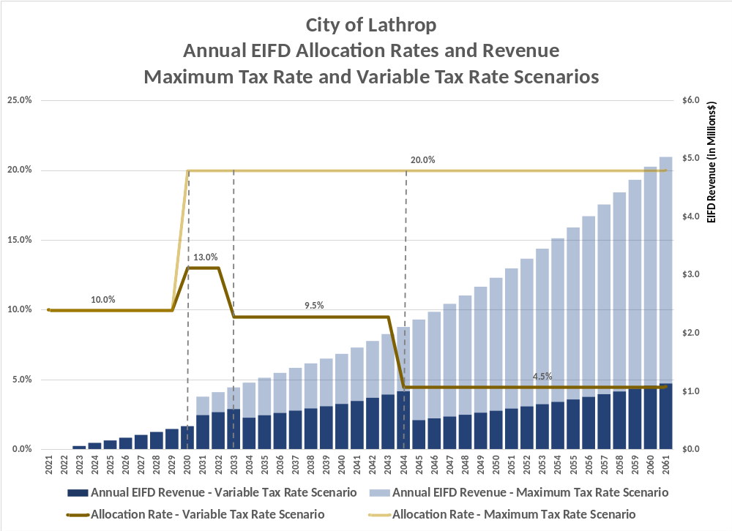
City of Lathrop Annual EIFD Revenues and Rates
Reduce and Manage the Region’s Flood Risk
11
Notes:
Jamie / Amy
Address concept of declining need of % tax increment needed to cover debt issued to complete project. (AV and gross property taxes will grow over time thus a smaller percentage of the tax increment is needed over time to service one series of debt that is expected to be issued to complete the project…) The maximum rate of 20% is set to ensure that we have the capacity needed to completed project (think of it as contingency in any given year…)

Slide 12
Next Steps & Requested Action
Cities of Manteca and Stockton and San Joaquin County would each adopt companion resolutions that:
  Declare their intent to participate in the EIFD; and,
  Appoint their respective members to the PFA Board (consistent with the intent to overlap the SJAFCA Membership as much as possible)
Participating Member Agency Actions are scheduled throughout June
First Public Financing Authority Meeting would be scheduled for Mid-February
Recommendation: Council adoption of the attached Resolution of Intention proposing to establish an Enhance Infrastructure Financing District and appointing two Lathrop Members and two Public Members.
Reduce and Manage the Region’s Flood Risk
12
Notes:
Seth wrap up

Slide 13

Questions?
SJAFCA MISSION STATEMENT - Reduce and Manage the Region’s Flood Risk
13
Notes:
Seth

