Slide 1
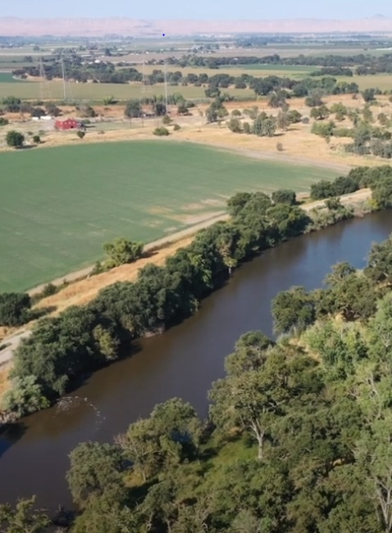

Paradise Cut Bypass Expansion
and Multi-Benefit Project
Advisory Committee Meeting
August 25, 2025
11.30 am – 1.00 pm
Location: City of Tracy │ 333 Civic Center Dr | Room 203
Tracy, CA, 95376

Slide 2
1. Administrative Matters (P. Marchand / L. Randall) (5 minutes)
  Roll Call
  Approve 4/21 Meeting Summary (Attachment A) [Possible Action]
2. Receive Paradise Cut Feasibility Study Update (Attachment B) (M. Weymiller / D. Trieu / B. Haines / R. Reinhardt / N. Kingwood / A. Livengood) (65 minutes)
  Evaluation of Final Array of Alternatives (40 minutes)
    Review of Alternative Development and Evaluation Process (5 minutes)
    Hydraulics Analysis Results (15 minutes)
    Sedimentation Analysis Results (5 minutes)
    Habitat Concepts (5 minutes)
    Cost Estimates (10 minutes)
Advisory
Committee
Agenda

Slide 3
  C. Preparation for October 15, 2025 Advisory Committee Recommendation Regarding Potential Preferred Alternative
  Selection (25 minutes)
    New Quantitative Evaluation Criteria (10 minutes)
    Preferred Alternative Selection Process (15 minutes)
3. Outreach and Community Engagement Update (P. Marchand/M. Weymiller) (5 minutes)
  Receive updated Paradise Cut Bypass Expansion and Multi-Benefit Project Engagement Strategy (Attachment C)
  Receive Summer 2025 SJAFCA Newsletter (Attachment D)
4. SJAFCA Update (G. Prasad) (5 minutes)
5. Advisory Committee Comments (5 minutes)
6. Public Comments (5 minutes)
7. Adjournment
Advisory
Committee
Agenda

Slide 4
Administrative Matters

Slide 5
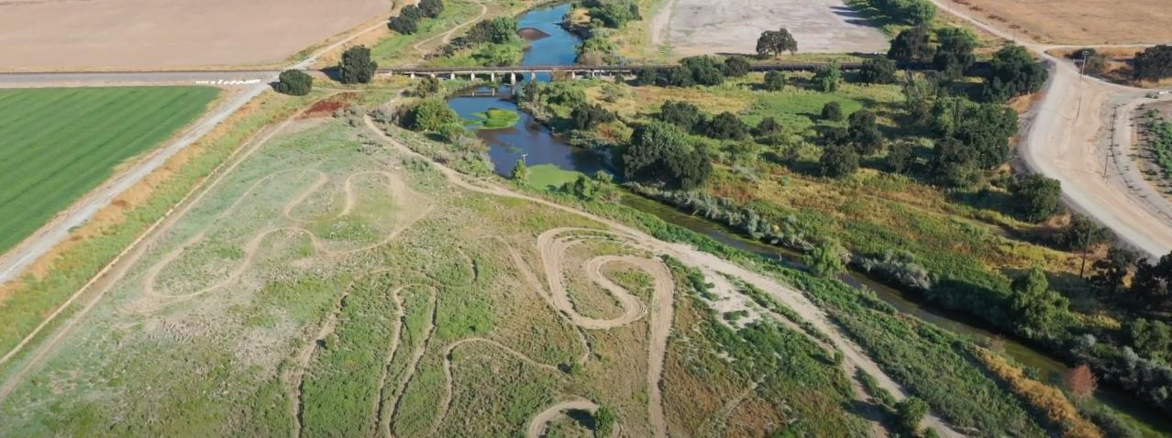
Administrative Matters
Roll call
Approve 4/21 Meeting Summary (Attachment A) [Possible Action]

Slide 6
Paradise Cut Feasibility Study Update

Slide 7
Final Array of Alternatives
Notes:
Avery to present

Slide 8
Alternative Development Process
August 2024 – Advisory Committee recommended Project Goals, Objectives, and Study Area to the SJAFCA Board of Directors, approved by the SJAFCA Board of Directors and DWR
December 2024 – January 2025 - The Technical Team developed seven preliminary alternatives and created evaluation criteria to help narrow the list to three final array of alternatives
February 2025 – The Technical Team met with Reclamation District representatives on February 21 for input on seven preliminary alternatives and the screening and evaluation criteria to reduce the seven alternatives to three final array of alternatives for further technical evaluation
March 2025 – The Technical Team revised the three final array of alternatives to incorporate feedback from Reclamation District representatives and the SJAFCA Board of Directors meeting on March 13, the SJAFCA Executive Director (D. Suen) approved the three final array of alternatives on March 17 for further study, and the Technical Team updated Chapter 5: Formulation of Preliminary Alternatives
April 2025 – The Advisory Committee reviewed and provided feedback on Chapter 5: Formulation of Preliminary Alternatives on April 21
April – August 2025 – The Technical Team completed evaluation and modeling for the three final array of alternatives, including a hydraulic analysis, sediment transport study, habitat concept development, and cost analysis

Slide 9
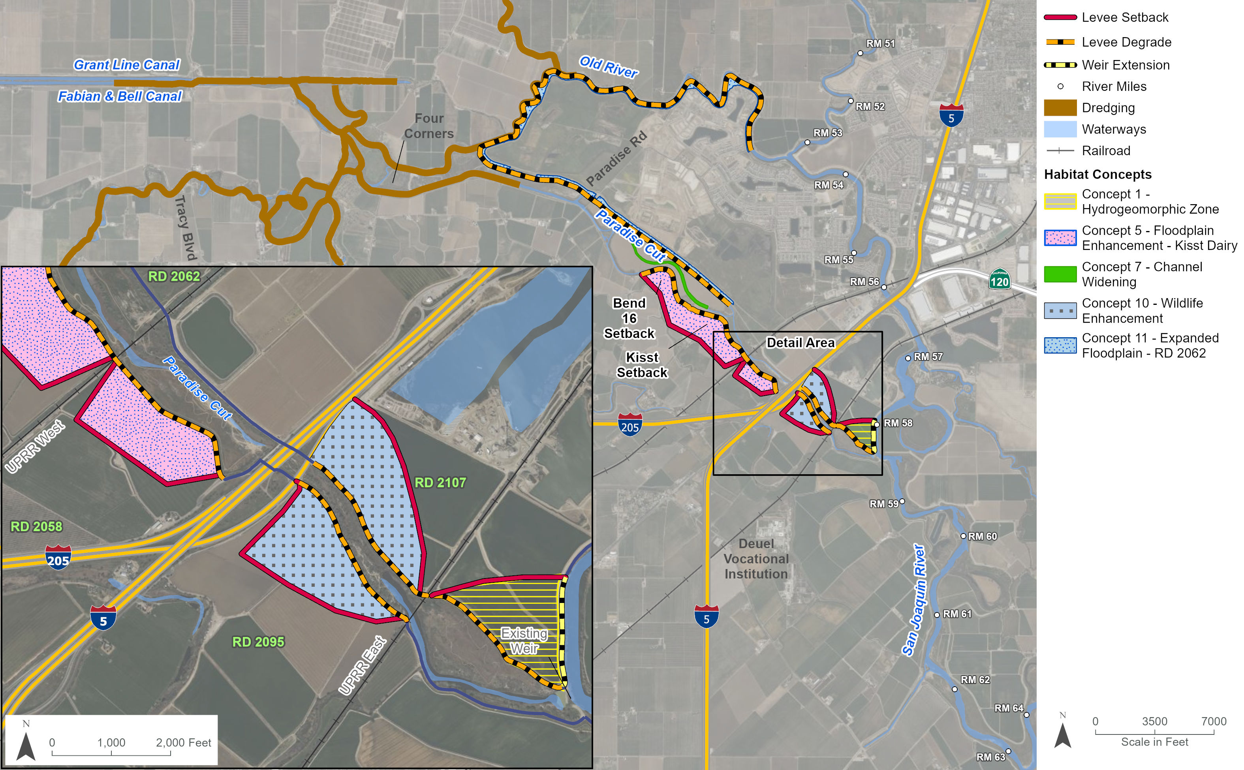
Alternative 2b: Extended Weir

Slide 10
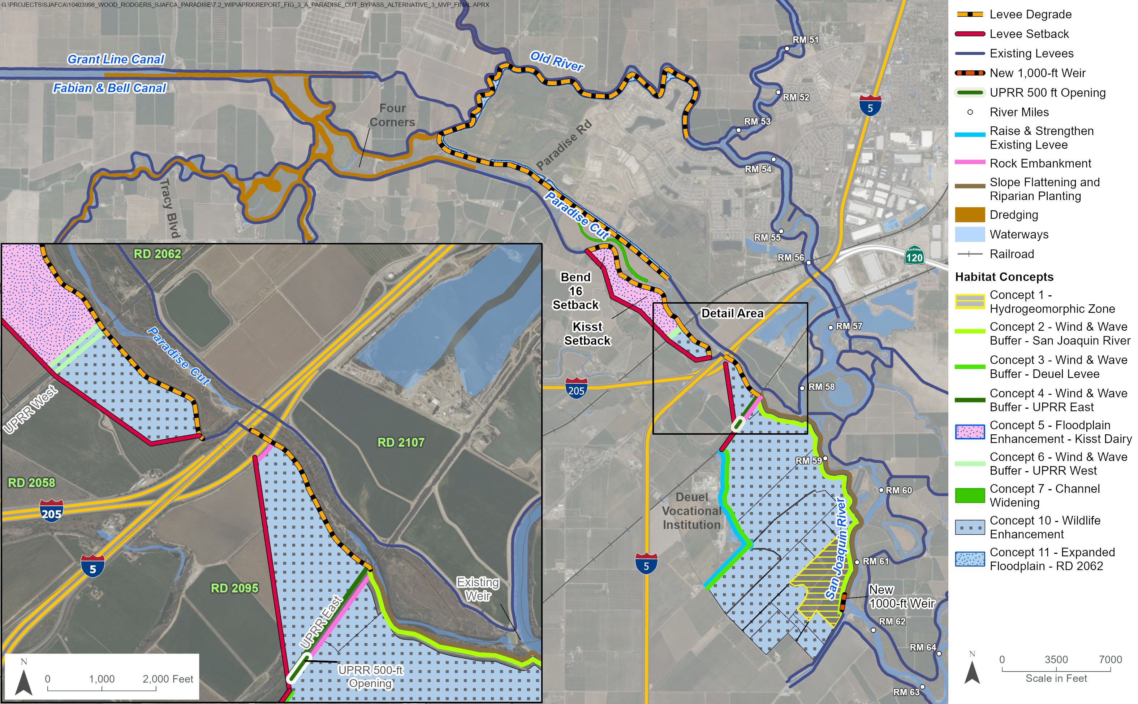
Alternative 3b: New 1,000-ft Upstream Weir

Slide 11
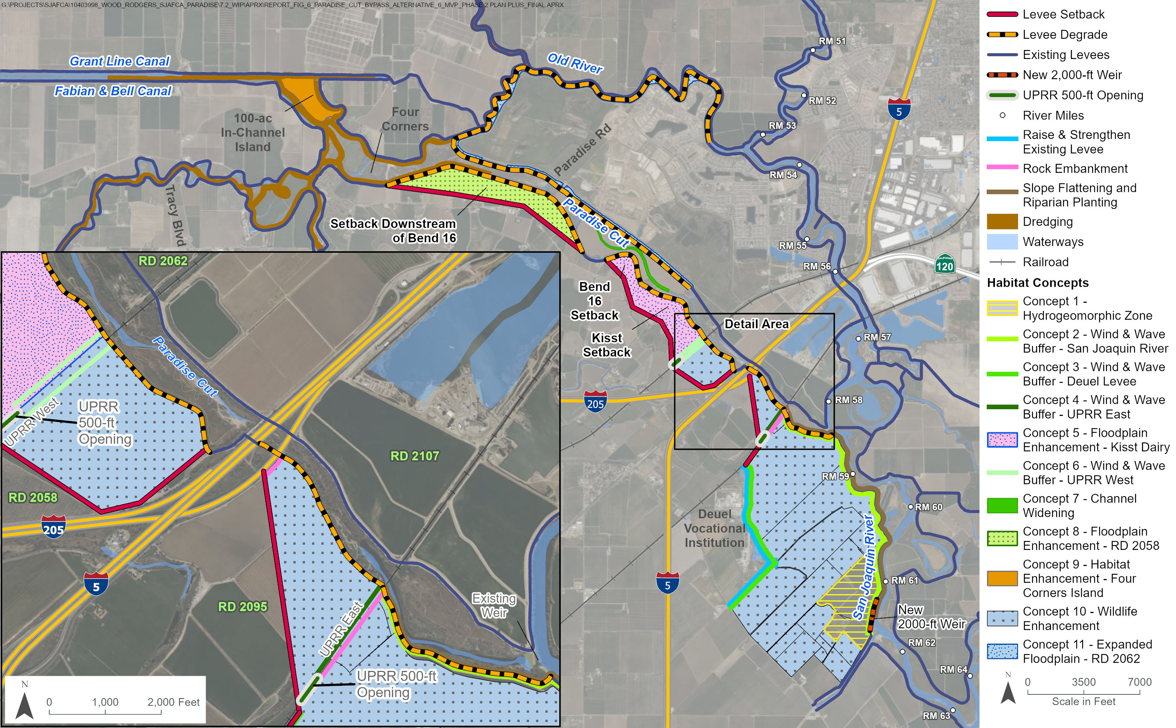
Alternative 6b: New 2,000-ft Upstream Weir

Slide 12
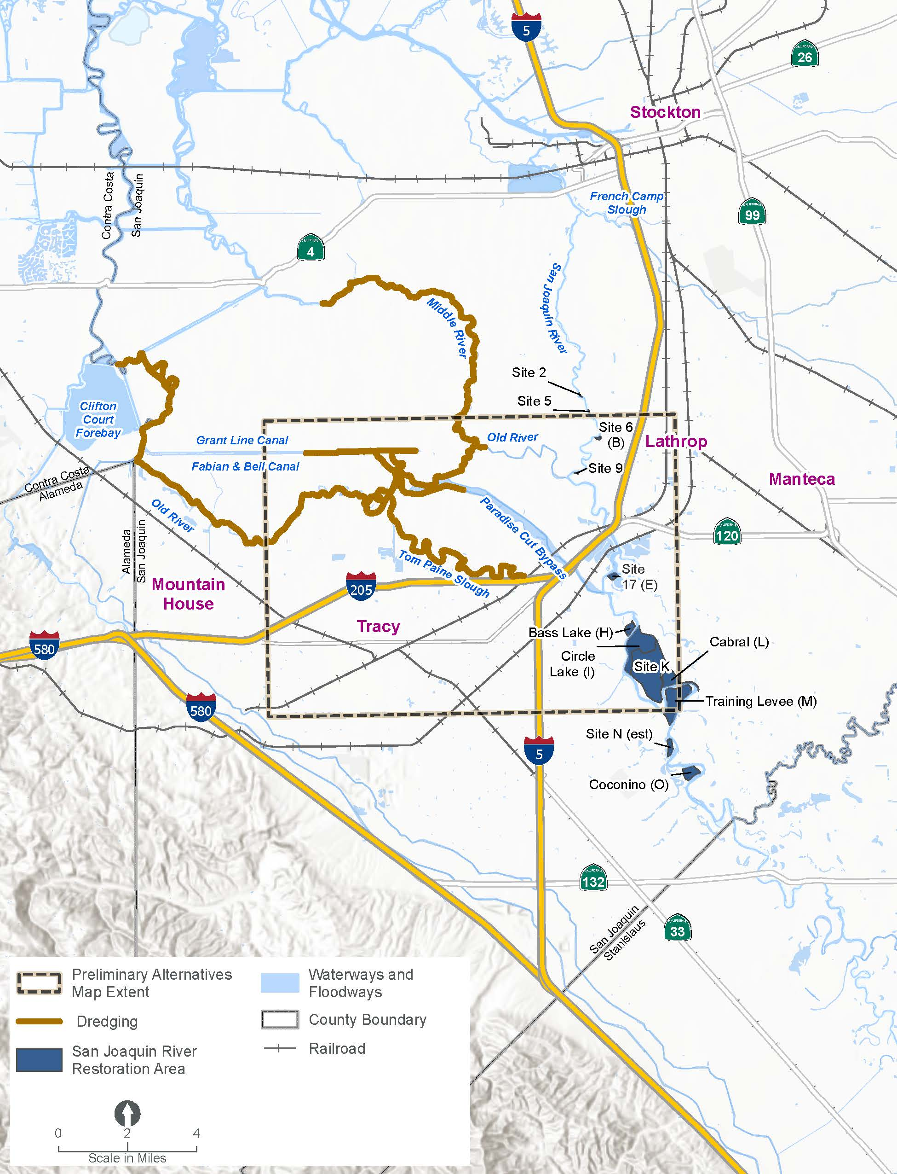
Management Actions Common to all Preliminary Alternatives
Over 40 miles of dredging included in all alternatives in the Final Array:
  Downstream portion of Paradise Cut
  Tom Paine Slough
  Middle River
  Western reach of Old River
  Eastern reach of Grant Line Canal
  Four Corners area
Restoration opportunities at 12 sites on the right and left banks of the San Joaquin River are carried forward and will be considered separately for the preferred alternative.

Slide 13
Hydraulic Analysis
Notes:
Avery to present

Slide 14
Hydraulic Analysis Overview
Background:
Completed hydraulic modeling for Alternative 2b, Alternative 3b, Alternative 3b with sediment removal, and Alternative 6B
Modeled flood benefits compared to the Future Without Project conditions, including Mossdale Tract Urban Flood Risk Reduction (UFRR) Project and Restore Federal Project Design Flow Split (San Joaquin River & Paradise Cut) to refine alternatives
Process:
  Assumed levees overtop but do not fail
  Modeled five flood events for each alternative
  Calculated changes in flow and stage at eight locations
  Compared flow and stage to the Future Without Project conditions
Notes:
Added by N. McDonald: The technical team completed hydraulic analysis modeling for Alternative 2b, Alternative 3b, Alternative 6b, and Alternative 3b with sediment removal to determine the flood benefits of the Project compared to the Future Without Project (FWOP) conditions and refine the alternatives.

Slide 15
Hydraulic Analysis Scenarios
Existing Condition (2024)
Future Without Project (FWOP)
  Mossdale Tract UFFR Project
  Restore Federal Project Design Flow Split (San Joaquin River & Paradise Cut)
Alternative 2b
Alternative 3b
Alternative 6b

Slide 16
Hydraulic Analysis Flood Events
Flood (Hydrologic) Events | Vernalis Peak Flow (cfs)
Federal Flood Project Design Flow (1955) | 52,000
100-Year | 84,000
200-Year | 97,000
Mossdale UFFR Design With Sea Level Rise (SLR) | 210,000
200-Year (2072 Projection) With SLR | 313,000

Slide 17
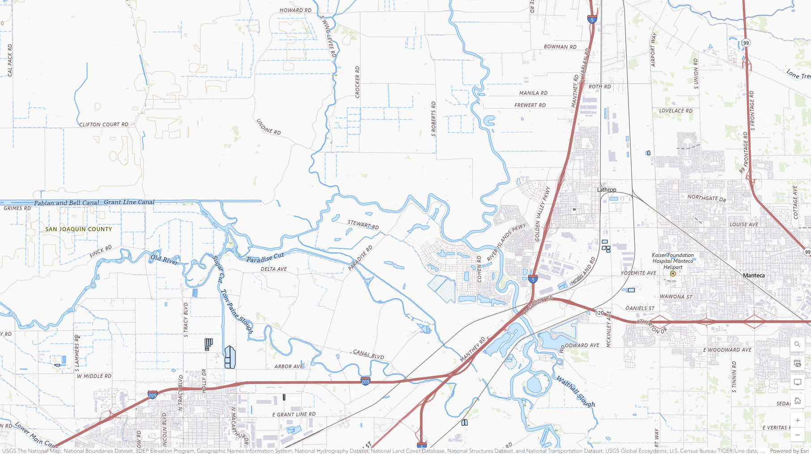
Hydraulic Analysis Locations
San Joaquin R at Howard Road Bridge
Middle R at Undine Road Bridge
Old R at Middle River
Grant Line C at Tracy Blvd Bridge
Paradise Cut at Paradise Road Bridge
San Joaquin R at I-5
Paradise Cut at UPRR-west
San Joaquin R d/s of Banta Carbona Canal

Slide 18

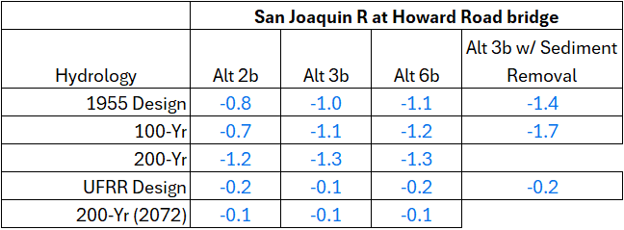
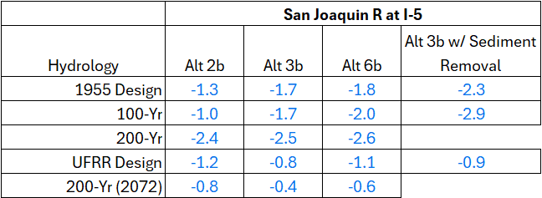
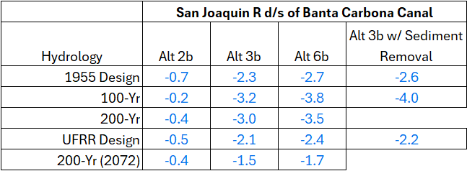

Slide 19
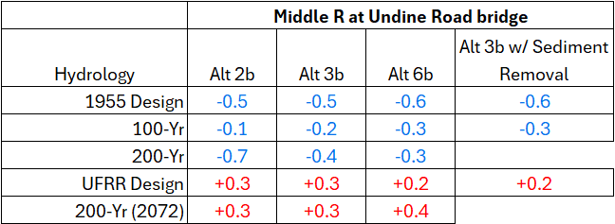
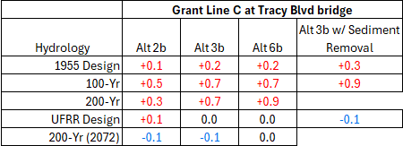
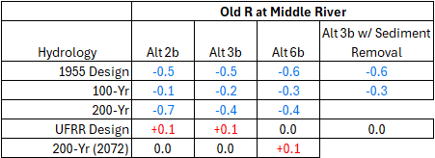
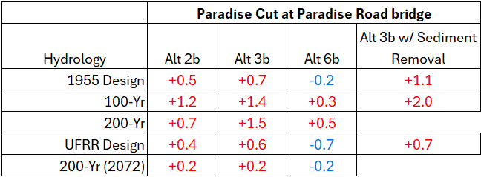
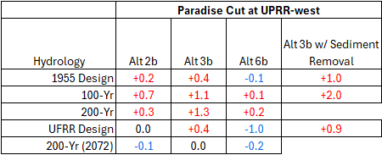
DRAFT

Slide 20
Hydraulic Analysis Findings & Next Steps
Findings:
Alternatives are effective in diverting flood waters into Paradise Cut.
  Alternatives reduce flow and stage in San Joaquin River.
  Alternatives increase flow/stage in Paradise Cut, Grant Line Canal and Old River downstream of Paradise Cut.
  Alternatives are more effective for flood events contained within the levee system.
  Overtopping of levee during extreme flood events reduce the effectiveness of any proposed weir expansions.
I-5/I-205 bridge and embankments cause backwater in Paradise Cut reducing the effectiveness of proposed weir expansions.
Removing sediment in Paradise Cut upstream and downstream of I-5/I-205 is effective in increasing flows into Paradise Cut reducing stages in the San Joaquin River by 0.5 to 1.0 ft.
Next Steps:
Continue hydraulic analysis to refine alternatives, including potentially modeling levee breaks and other hydrologic events to measure impacts.

Slide 21
Sediment Transport
Notes:
Avery to present

Slide 22
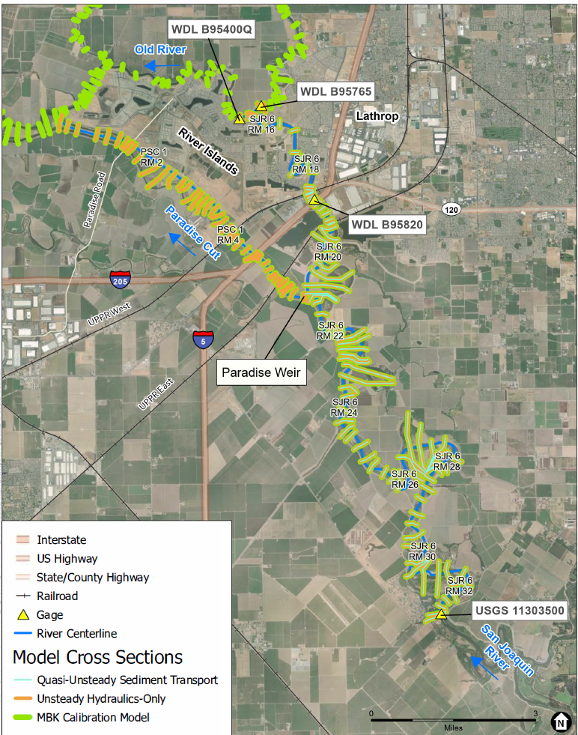
Sediment Transport Model Overview
Two Models
  Used the regional 1D unsteady model (MBK) to characterize flow over weir(s)
  Developed a local 1D quasi-unsteady model for sediment transport analysis
    Flow and sediment data from Vernalis
    Bridges removed for model stability
    Sediment over weir(s) limited to fine sand or smaller grain size
Model Calibration (Local 1D)
  DWR stage from Mossdale and Old River
  Observed bed change (2009-2022)
  Laursen-Copeland transport function

Slide 23
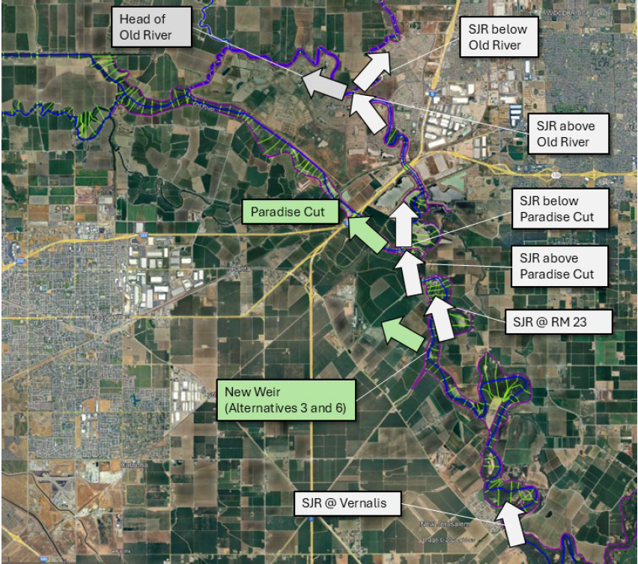
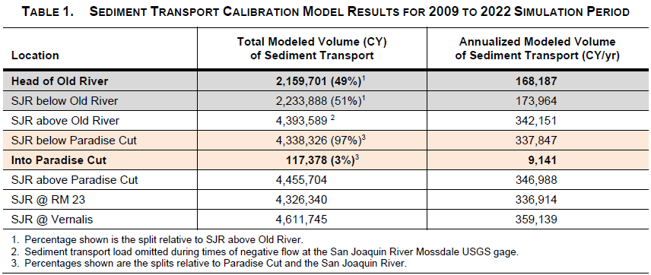
Sediment Transport Model Calibration and
Lower San Joaquin River Sediment Budget
Key Findings:
Only 3% of the long-term sediment load is diverted into the Paradise Cut bypass.
Sediment delivered downstream is evenly split between Old River and the San Joaquin River.

Slide 24
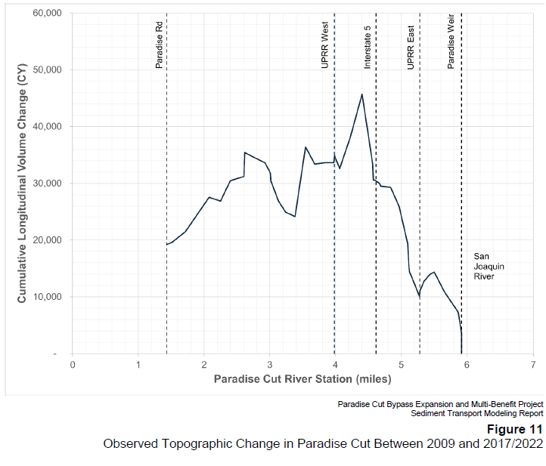
Bypass Trap Efficiency
Interstate 5 is a significant hydraulic constraint
  Backwater promotes upstream deposition of fine sand and smaller sediment
Results suggest that 39% of bypass sediment is “trapped” upstream of Interstate 5
  Based on predicted sediment flux into bypass and observed channel change during the 2009-2022 period
Downstream erosion due to entrenched channels and upstream storage
Erosion
Deposition

Slide 25
Comparative Analysis of Sediment Transport Models
Model Geometry
Event Hydrology
Existing conditions
  Updated bathymetry, 2D flow areas
Future without project conditions
  Mossdale UFFR implementation
  Restored design flow split at existing weir
Alternative 2 – Minimum Plan B
Alternative 3 – Phase 2 Plan
Alternative 6 – Phase 2 Plan Plus
Phase 3 feasibility study limited to large magnitude floods (flood risk reduction)
  1/100 AEP (2024)
  1/200 AEP (2024)
  1/200 AEP plus sea level rise and future climate projection (2072)
Phase 4 engineering and design should include a long-term period of record
  Hypothesis: most geomorphic work on the LSJR is performed during more frequent flood events when the weir is not activated (<15,000 cfs)

Slide 26
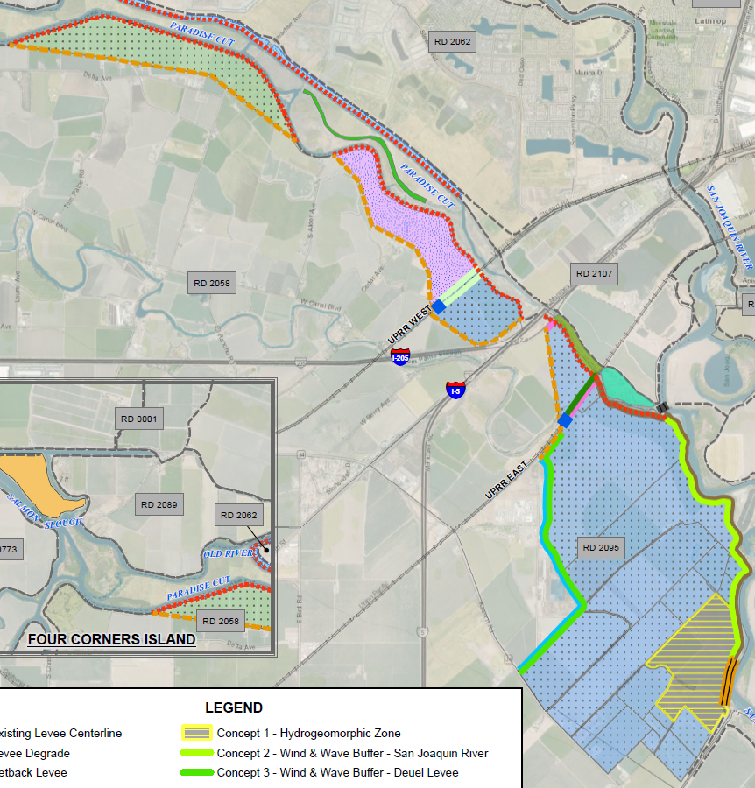
Alternatives Analysis
More sediment delivered to Paradise Cut during large floods
  3% of long-term sediment load
  9-26% of event-based sediment load
Less sediment delivered to Old River
  13-36% reduction relative to FWOP conditions
Alternatives should create similar or greater bypass trap efficiency
  Storage in upstream bypass expansion

Slide 27
Habitat Concepts
Notes:
Avery to present

Slide 28
Task Overview
Team effort to identify and characterize opportunities for habitat enhancement within and adjacent to the Paradise Cut bypass
  Team: Wood Rodgers, ICF, River Partners, HDR, MBK, and ESA
  Abbreviated habitat design charrette on March 17, 2025
  Follow up meetings to advance concepts and review results
  Final draft delivered on July 25, 2025
ESA analysis to understand relative contributions of concepts to the Conservation Strategy Measurable Objectives (CSMOs)

Slide 29
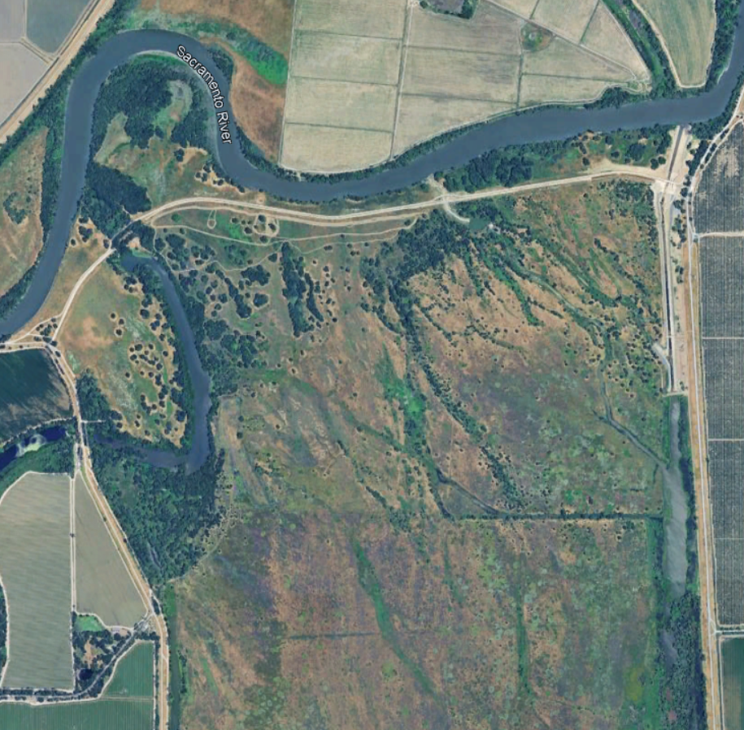
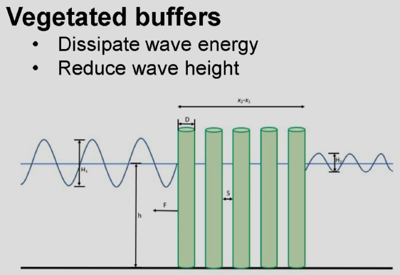
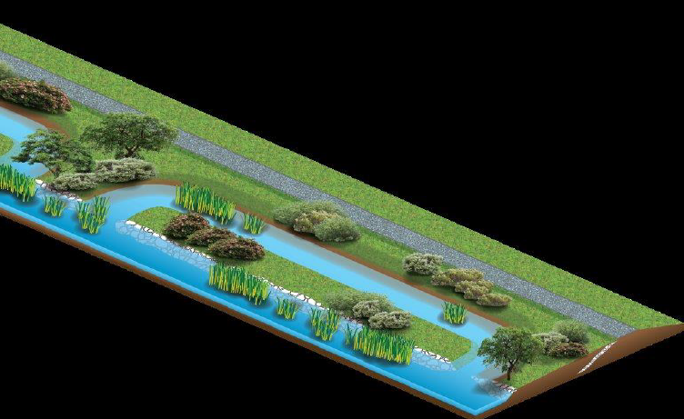
Habitat Concepts Identified
Hydrogeomorphic zones below weir(s)
Vegetated wind-wave buffers
Levee setbacks and floodplain enhancements
Remnant levee enhancements (channel islands)
Side-channels and inset floodplains

Slide 30
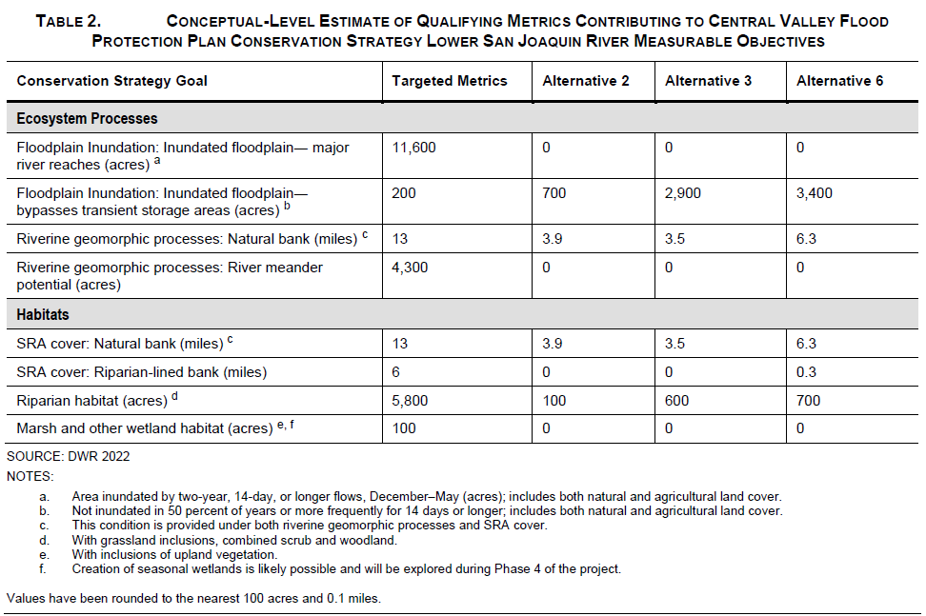
Contribution of Alternatives to CSMO Targets

Slide 31
Final Array Cost Estimate
Notes:
Avery to present

Slide 32
Cost Estimate
Phase 2 Cost – MVP - $166M Dredging - $63M (5 miles)
Channel Restoration – Common to all alternatives - $385 million
Hydraulic Mitigation – Coordinated with District Engineers, intended as a placeholder for cost
Contingency – 50% used for all alternatives
Cost for restoration is separate from environmental mitigation
Each project feature was developed as its own cost
Elements not Included in alternatives:
  In channel terrace removal under I-5 ($9M)
  500 ft openings in I-5, 205 and Manthey Rd ($77M)
Notes:
Channel sedimentation FWOP

Slide 33
Alternative Costs
Alt 2B - $636,693,000
  Large cost Items:
    Hydraulic mitigation - $61M, lands - $26M, setback levees -$35M
Alt 3B - $892,835,000
  Large cost Items:
    Hydraulic mitigation - $91M, lands - $119M, setback levees-$26M, DVI levee - $27M, UPRR opening - $24M, habitat $38M
Alt 6B - $1,043,185,000
  Large cost Items:
    Hydraulic mitigation - $56M, lands - $137M, setback levees-$52M, DVI levee - $27M, UPRR openings - $51M, habitat $69M
Notes:
Channel sedimentation FWOP

Slide 34
Annual Costs
Includes both O&M and lost RD revenue for setback areas
Alt 2B - $657,509/annually
Alt 3B - $1,514,450/annually
Alt 6B - $1,708,186/annually
O&M costs include habitat management and sediment removal downstream of new weir. It does not include costs the County will incur for closing and cleanup of roads.
Notes:
Channel sedimentation FWOP

Slide 35
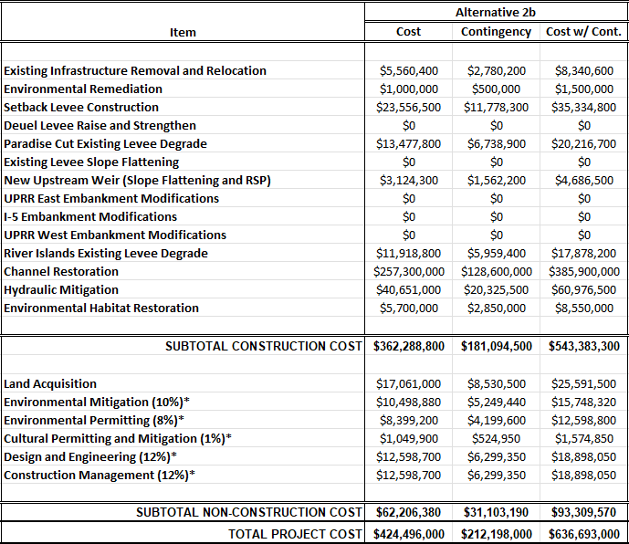
Alternative 2B
Notes:
Categories…shortened.
Problems:
Flood hazards pose a significant risk to public health, safety, and property.
Loss of habitat and floodplain processes threaten species and ecosystems.
Sedimentation of downstream channels reduces the reliability of irrigation water supply intakes.
Climate change will exacerbate existing problems in the study area.
Opportunities
The existing bypass provides a pathway to reduce flood stages on the San Joaquin River.
Lands in the study area are suitable for restoring habitat and ecosystem processes.
Ecosystem restoration could support regional mitigation needs.
There is local demand for beneficial reuse of sediment.
The predominant land use in the study area is agriculture, which provides multiple benefits and ongoing land stewardship.

Slide 36
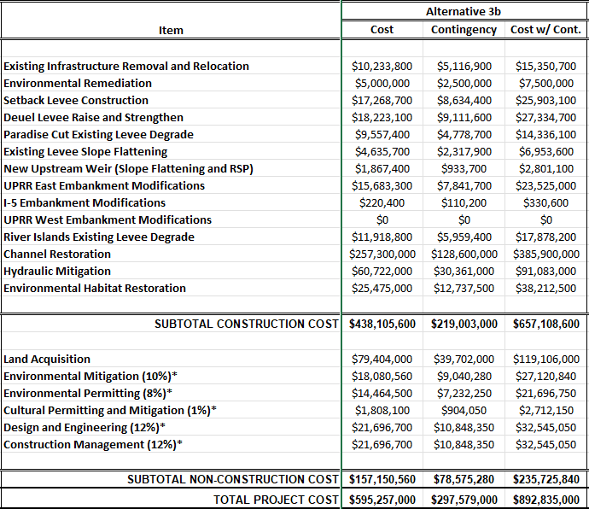
Alternative 3B
Notes:
Categories…shortened.
Problems:
Flood hazards pose a significant risk to public health, safety, and property.
Loss of habitat and floodplain processes threaten species and ecosystems.
Sedimentation of downstream channels reduces the reliability of irrigation water supply intakes.
Climate change will exacerbate existing problems in the study area.
Opportunities
The existing bypass provides a pathway to reduce flood stages on the San Joaquin River.
Lands in the study area are suitable for restoring habitat and ecosystem processes.
Ecosystem restoration could support regional mitigation needs.
There is local demand for beneficial reuse of sediment.
The predominant land use in the study area is agriculture, which provides multiple benefits and ongoing land stewardship.

Slide 37
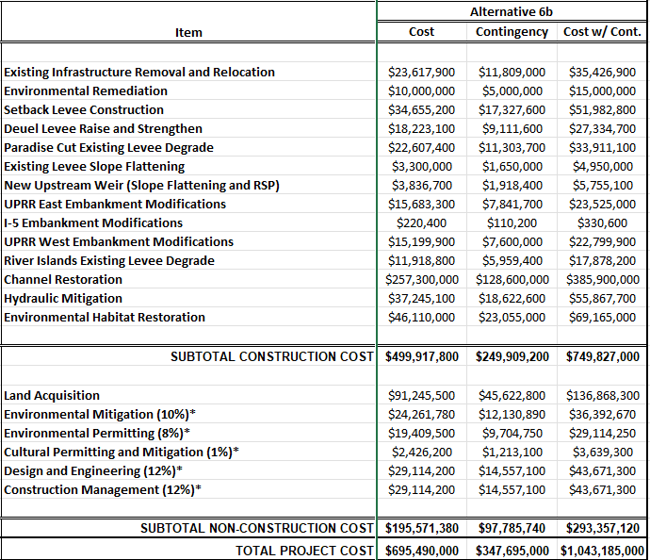
Alternative 6B
Notes:
Categories…shortened.
Problems:
Flood hazards pose a significant risk to public health, safety, and property.
Loss of habitat and floodplain processes threaten species and ecosystems.
Sedimentation of downstream channels reduces the reliability of irrigation water supply intakes.
Climate change will exacerbate existing problems in the study area.
Opportunities
The existing bypass provides a pathway to reduce flood stages on the San Joaquin River.
Lands in the study area are suitable for restoring habitat and ecosystem processes.
Ecosystem restoration could support regional mitigation needs.
There is local demand for beneficial reuse of sediment.
The predominant land use in the study area is agriculture, which provides multiple benefits and ongoing land stewardship.

Slide 38
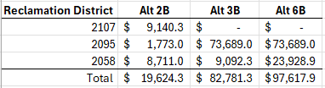
Reduced RD Revenue
Notes:
Categories…shortened.
Problems:
Flood hazards pose a significant risk to public health, safety, and property.
Loss of habitat and floodplain processes threaten species and ecosystems.
Sedimentation of downstream channels reduces the reliability of irrigation water supply intakes.
Climate change will exacerbate existing problems in the study area.
Opportunities
The existing bypass provides a pathway to reduce flood stages on the San Joaquin River.
Lands in the study area are suitable for restoring habitat and ecosystem processes.
Ecosystem restoration could support regional mitigation needs.
There is local demand for beneficial reuse of sediment.
The predominant land use in the study area is agriculture, which provides multiple benefits and ongoing land stewardship.

Slide 39
Evaluation & Comparison of the Final Array of Alternatives
Notes:
Avery to present

Slide 40
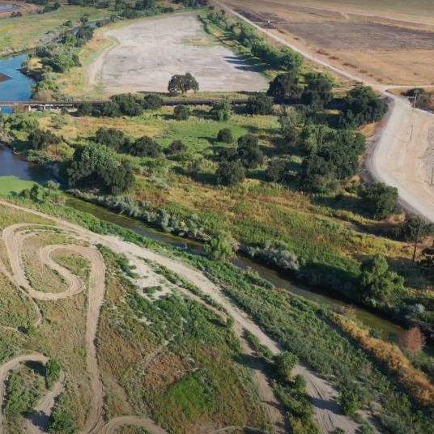
Project Objectives
Reduce catastrophic flood risk for communities including Lathrop, Manteca, and Stockton.
Protect farms from uncontrolled flooding.
Restore and improve the quantity, diversity and connectivity of riverine, floodplain, riparian, and wetland habitat for native fish and wildlife.
Improve irrigation intake reliability and waterway navigability.

Slide 41
New Quantitative Evaluation Criteria
Category | Quantitative Evaluation Criteria | Units
How well does the alternative contribute to the Project objectives?
Reduce catastrophic flood risk for communities including Lathrop, Manteca, and Stockton (urban flood risk reduction) | Change in stage on the San Joaquin River at I-5, Old River, and Howard Road Bridge (2072 hydrology) | Feet
Protect farms from uncontrolled flooding (rural flood risk reduction) | Change in stage on the San Joaquin River at BCID Canal, on Paradise Cut at the UPRR east crossing, and on Paradise Cut at Paradise Road (1955 design hydrology) | Feet
Restore and improve the quantity, diversity, and connectivity of riverine, floodplain, riparian, and wetland habitat for native fish and wildlife | Conservation strategy measurable objectives: inundated floodplain, riverine geomorphic processes, SRA cover, riparian habitat, and marsh and other wetland habitat | Acres, miles
Improve irrigation intake reliability and waterway navigability | Potential to reduce sedimentation in downstream channels | Binary (Yes/No)

Slide 42
New Quantitative Evaluation Criteria (Continued)
Category | Evaluation Criteria | Units
What are the costs and impacts of the alternative?
Capital cost | Estimated capital cost which includes: design and engineering, permitting, construction, construction management, land acquisition, existing infrastructure removal and relocation, environmental remediation, hydraulic mitigation, environmental mitigation | Dollars
Potential loss in RD revenue | Estimates acres of new floodway area, where benefit assessments that fund O&M would be reduced or eliminated, multiplied by the assessment rate for each RD and summed | Dollars per year

Slide 43
New Quantitative Evaluation Criteria (Continued)
Category | Evaluation Criteria | Units
Reduce catastrophic flood risk for communities (urban flood risk reduction) | Change in stage on the San Joaquin River at I-5, Old River, and Howard Road Bridge (2072 hydrology) | Feet
Protect farms from uncontrolled flooding (rural flood risk reduction) | Change in stage on the San Joaquin River at BCID Canal, on Paradise Cut at the UPRR east crossing, and on Paradise Cut at Paradise Road (1955 design hydrology) | Feet
Restore and improve riverine, floodplain, riparian, and wetland habitat | Conservation strategy measurable objectives: inundated floodplain, riverine geomorphic processes, SRA cover, riparian habitat, and marsh and other wetland habitat | Acres, miles
Improve irrigation intake reliability and waterway navigability | Potential to reduce sedimentation in downstream channels | Binary (Yes/No)
Capital cost | Estimated capital cost which includes: design and engineering, permitting, construction, construction management, land acquisition, existing infrastructure removal and relocation, environmental remediation, hydraulic mitigation, environmental mitigation | Dollars
Potential loss in RD revenue | Estimates acres of new floodway area, where benefit assessments that fund O&M would be reduced or eliminated, multiplied by the assessment rate for each RD and summed | Dollars per year

Slide 44
New Quantitative Evaluation Criteria (Continued)
Category | Evaluation Criteria | Units
Reduce catastrophic flood risk for communities (urban flood risk reduction) | Change in stage on the San Joaquin River at I-5, Old River, and Howard Road Bridge (2072 hydrology) | Percent
Protect farms from uncontrolled flooding (rural flood risk reduction) | Change in stage on the San Joaquin River at BCID Canal, on Paradise Cut at the UPRR east crossing, and on Paradise Cut at Paradise Road (1955 design hydrology) | Percent
Restore and improve riverine, floodplain, riparian, and wetland habitat | Conservation strategy measurable objectives: inundated floodplain, riverine geomorphic processes, SRA cover, riparian habitat, and marsh and other wetland habitat | Percent
Improve irrigation intake reliability and waterway navigability | Potential to reduce sedimentation in downstream channels | Percent
Capital cost | Estimated capital cost which includes: design and engineering, permitting, construction, construction management, land acquisition, existing infrastructure removal and relocation, environmental remediation, hydraulic mitigation, environmental mitigation | Percent
Potential loss in RD revenue | Estimates acres of new floodway area, where benefit assessments that fund O&M would be reduced or eliminated, multiplied by the assessment rate for each RD and summed | Percent

Slide 45
New Quantitative Evaluation Criteria (Continued)
Category | Evaluation Criteria | Units
Reduce catastrophic flood risk for communities (urban flood risk reduction) | Change in stage on the San Joaquin River at I-5, Old River, and Howard Road Bridge (2072 hydrology) | Percent
Protect farms from uncontrolled flooding (rural flood risk reduction) | Change in stage on the San Joaquin River at BCID Canal, on Paradise Cut at the UPRR east crossing, and on Paradise Cut at Paradise Road (1955 design hydrology) | Percent
Restore and improve riverine, floodplain, riparian, and wetland habitat | Conservation strategy measurable objectives: inundated floodplain, riverine geomorphic processes, SRA cover, riparian habitat, and marsh and other wetland habitat | Percent
Improve irrigation intake reliability and waterway navigability | Potential to reduce sedimentation in downstream channels | Percent
Capital cost | Estimated capital cost which includes: design and engineering, permitting, construction, construction management, land acquisition, existing infrastructure removal and relocation, environmental remediation, hydraulic mitigation, environmental mitigation | Percent
Potential loss in RD revenue & O&M Costs | Estimates acres of new floodway area, where benefit assessments that fund O&M would be reduced or eliminated, multiplied by the assessment rate for each RD and summed; O&M estimated costs. | Percent

Slide 46
Preferred Alternative Selection Process
September 2025 – SJAFCA will host two virtual meetings with reclamation districts to secure feedback on the evaluation of alternatives and possible preferred alternative
September 2025 – The Advisory Committee will review Chapter 6 of the Feasibility Study Report, including the detailed Evaluation and Comparison of the Final Array of Alternatives
October 2025 – The Advisory Committee will review and potentially recommend a preferred alternative to the SJAFCA Board of Directors

Slide 47
Outreach and Community Engagement Update

Slide 48
Updated Engagement Strategy
August 2025: Advisory Committee meeting (August 25, 2025) including presenting the Overview of the Evaluation and Comparison of the Final Array of Alternatives
September 2025: 10-day review period (September 12, 2025 – September 26,2025) for Chapter 6 of the Feasibility Report, including the Detailed Evaluation and Comparison of the Final Array of Alternatives
September 2025: Meetings with primary audiences as needed to secure feedback on Chapter 6 of the Feasibility Report, including the Detailed Evaluation and Comparison of the Final Array of Alternatives
October 2025: Advisory Committee meeting (October 15, 2025) and recommendation of the Preferred Alternative
November 2025: Public workshop #1
December 2025 – January 2026: Third virtual newsletter
December 2025 – January 2026: Update Project page on SJAFCA website
January – February 2026: 10-day review period (January 23, 2026 – February 6, 2026) for Draft Feasibility Report
January – February 2026: Meetings with primary audiences as needed
February 2026: Advisory Committee meeting (February 9, 2026) including presenting the Overview of the Draft Feasibility Report
March 2026: Release Final Feasibility Report

Slide 49
SJAFCA Update

Slide 50
California Department of Water Resources, Central Valley Flood Protection Board, and Delta Conservancy Updates

Slide 51
Advisory Committee Comments

Slide 52
Public Comments

Slide 53

Adjournment
  Glenn Prasad | Project Manager
  glenn.prasad@sjafca.org
  Melissa Weymiller | Project Manager
  melissa@larsenwurzel.com
  Ric Reinhardt | Feasibility Study Technical Team Lead
  rreinhardt@woodrodgers.com
  Petrea Marchand | Engagement & Facilitation Lead
  petrea@conserosolutions.com

