Slide 1

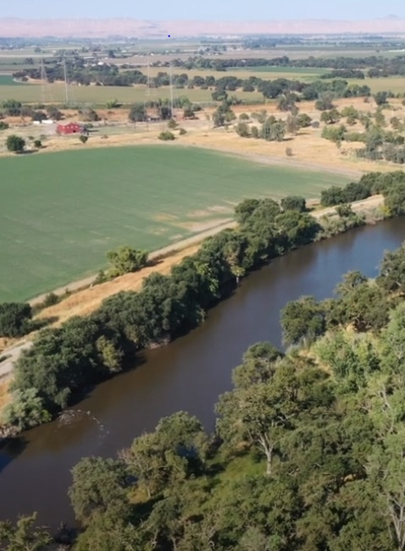
Paradise Cut Bypass Expansion
and Multi-Benefit Project
Advisory Committee Meeting
August 26, 2024
11.30 am – 1.00 pm
Location: City of Lathrop City Council Chamber │ 390 Towne Centre Drive │ Lathrop, California 95330
Glenn.Prasad@sjafca.org

Slide 2
Administrative Matters (Consero Solutions)
  Roll Call/ Sign up sheet
  Approval of 7/1 Meeting Summary [Possible Action]
Approve Addition of Sacramento-San Joaquin Delta Conservancy as Advisory Committee Non-Voting Member [Possible Action] (SJAFCA)
Recommend Official Project Name to SJAFCA [Possible Action] (SJAFCA)
Recommend Approval of Draft Decision Framework to SJAFCA [Possible Action] (Consero Solutions/SJAFCA)
Review Draft Engagement Strategy (Consero Solutions/SJAFCA)
Recommend Project Goals, Objectives, and Study Area to SJAFCA [Possible Action] (Wood Rodgers)
DWR and CVFPB Updates (DWR and CVFPB)
Advisory Committee Comments
Public Comment
Adjournment
Advisory
Committee
Agenda

Slide 3
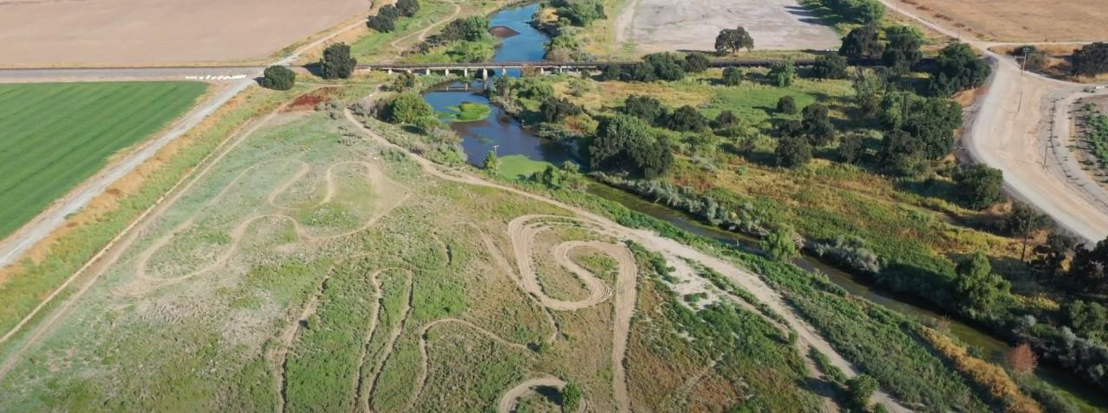

Administrative Matters
Roll call/ sign up sheet
Approval of Meeting Summary (Attachment A) [Possible Action]

Slide 4

Approve Addition of the Sacramento-San Joaquin Delta Conservancy as a Non-Voting Member to the Advisory Committee
Approval of Advisory Committee Membership [Possible Action]

Slide 5
Recommend Project Name to SJAFCA (Possible Action)
Proposed official Project name: “Paradise Cut Bypass Expansion and Multi-Benefit Project”

Slide 6
Decision Framework

Slide 7
Decision Framework (Attachment B)
Purpose: outlines the responsibilities, composition, and governance processes of the entities responsible for advice and decisions related the Project.
Includes Roles and Responsibilities for: SJAFCA, DWR, Advisory Committee, Technical Review Panel, and the Consultant Team
Approval: signed by the Advisory Committee Chair and SJAFCA Executive Director
7

Slide 8
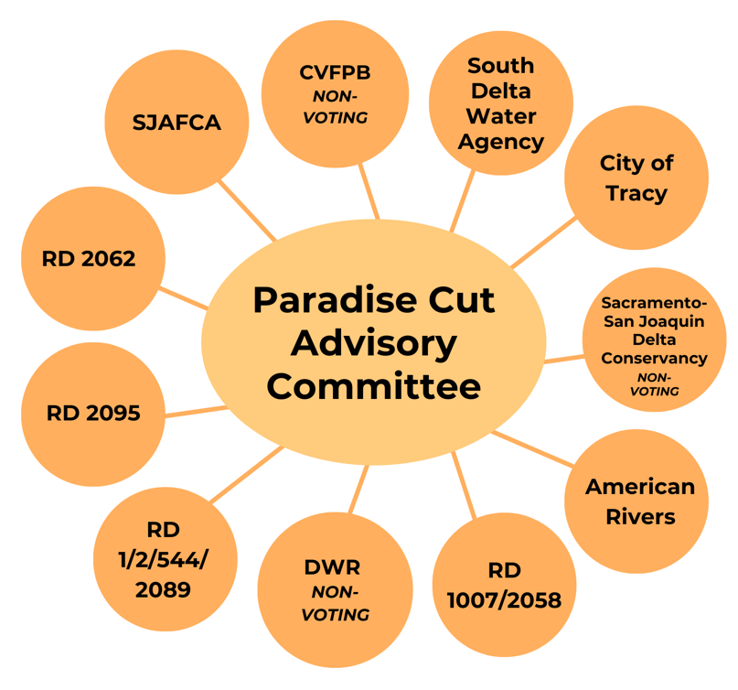
Updated Advisory Committee Membership

Slide 9
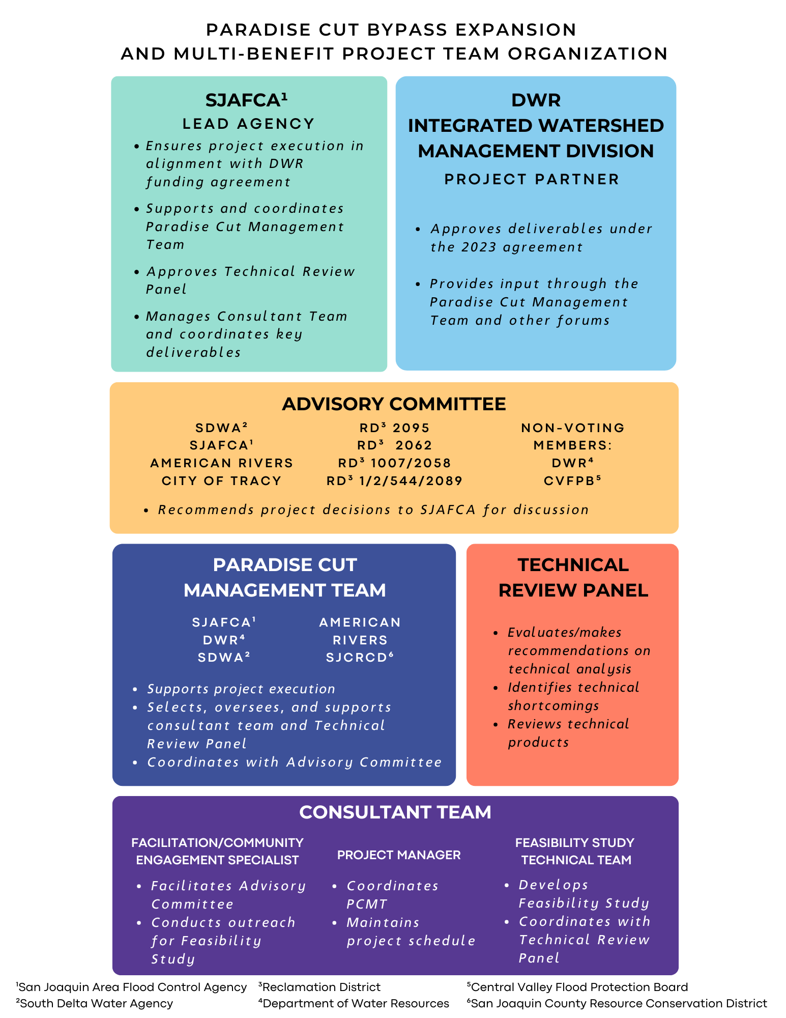
Team Organization

Slide 10
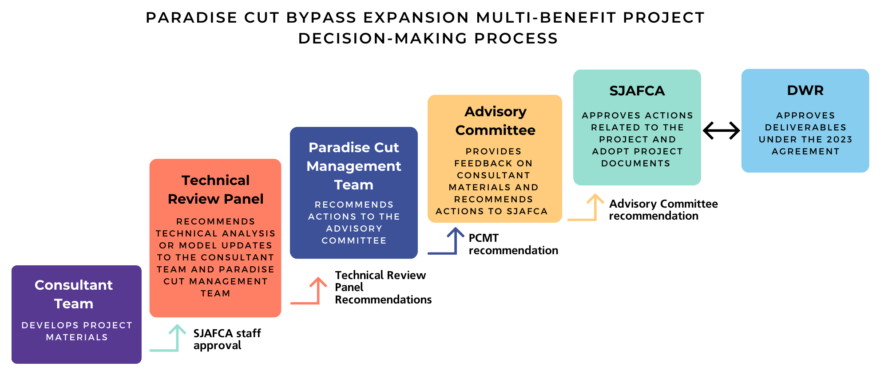
Decision-Making

Slide 11
Engagement Strategy

Slide 12

Engagement Strategy
Schedule
Aug. 26th
Sept.-Oct.
PCMT Draft #1 Discussion
Advisory Committee Draft #1 Discussion
PCMT Draft #2 Review
Outreach on Goals, Objectives, and Study Area
Advisory Committee Considers Final Draft Approval
Aug. 22st
Oct. 3rd
Oct. 15th

Slide 13
Approach
4 goals
21 measurable objectives
Small group meetings with primary audiences
Public workshops
Newsletter, FAQS, website updates

Slide 14
Primary Audience
San Joaquin Area Flood Control Agency
Advisory Committee
21 Reclamation Districts
Tribal leaders and representatives
California Department of Water Resources
Central Valley Flood Protection Board
Sacramento-San Joaquin Delta Conservancy
US Fish and Wildlife Service and California Department of Fish and Wildlife
San Joaquin County Flood Control and Water Conservation District
Banta-Carbona Irrigation District
Actively soliciting feedback and providing regular Project updates via:
Small group meetings
Virtual, telephone, and in-person communications
Presentations
Public workshops

Slide 15
Secondary Audience
US Army Corps of Engineers
United States Bureau of Reclamation
Federal Emergency Management Agency
California Wildlife Conservation Board and other potential funding agencies
State and federal legislators
Eastern San Joaquin Groundwater Basin Authority
San Joaquin County
City of Manteca
City of Lathrop
San Joaquin Resource Conservation District
Greater Joaquin County Regional Water Coordinating Committee
Caltrans District 10
Delta Stewardship Council
Local nonprofit or advocacy organizations
Educational institutions
Upstream water agencies
General public, landowners, and stewards
Providing regular updates via virtual communications and public workshops

Slide 16
Schedule
September 2024: Complete updated project fact sheet
September/October 2024: Introduce primary audiences to the Project and seek feedback on study area, goals and objectives, and engagement strategy
November 2024: Complete Frequently Asked Questions
November/December 2024: First virtual newsletter
January/February 2025: Update Project page on SJAFCA web site
April/May 2025: Meeting with primary audiences regarding preliminary alternatives
June/July 2025:
  Meeting with primary audiences regarding final alternatives and recommendations memo
  Second virtual newsletter
  Update Project page on SJAFCA web site
August/September 2025: Public workshop #1
October/November 2025: Meeting with primary audiences regarding draft feasibility study
November/December 2025:
  Public workshop #2
  Third virtual newsletter
  Update Project page on SJAFCA web site

Slide 17
Feasibility Study
Goals & Objectives

Slide 18

Phase 2 Project Goals
Project goals defined in the May 4, 2023 Memo from San Joaquin RCD to SJAFCA (Phase 2):
Flood risk reduction: Reduce catastrophic flood risk to people and property in the South Delta.
Habitat restoration: Restore riparian and other native habitats for Swainson’s hawk, riparian brush rabbit, riparian songbirds, and other species.
Channel restoration: Restore channel capacity in portions of the South Delta downstream of Paradise Cut.
Which goals should be carried forward for the Feasibility Study?
Should any goals be reframed or reworded?
Are there other goals that should be added?
18

Slide 19
Current Project Objectives
Project objectives identified in the DWR grant agreement scope of work:
Reduce catastrophic flood risk for communities including Lathrop, Manteca, and Stockton.
Protect farms from uncontrolled flooding.
Restore riverine, floodplain, riparian, and wetland habitat for native fish and wildlife.
Improve irrigation intake reliability and waterway navigability.
Improve water supply reliability and resilience to climate change by supporting more flexible water supply management.
Should these objectives be carried forward for the Feasibility Study?
Should any objectives be reframed or reworded?
Are there other objectives that should be added?
19

Slide 20
PCMT Request for Additional Goals & Objectives
The following priorities are from the CVFPP 2022 Update, CVFPP 2022 Conservation Strategy Update, and DWR Agreement (2023):
Climate change resiliency goals:
Increase flood system resiliency (CVFPP 2022 Update).
Restore the landscape-scale ecosystem functions necessary for climate change resilience (DWR Agreement 2023).
Improve water supply reliability and resilience to climate change by supporting more flexible water supply management (DWR Agreement 2023).
CVFPP flood and habitat goals:
Improve flood risk management (CVFPP 2022 Update).
Protect and enhance natural ecosystems and promote ecosystem functions (CVFPP 2022 Update).
Increase and improve the quantity, diversity, and connectivity of riverine and floodplain habitats (CVFPP 2022 Conservation Strategy Update).
Contribute to the recovery and sustainability of native species populations and overall biotic community diversity (CVFPP 2022 Conservation Strategy Update).
20

Slide 21
Recommended Goals
Based on the priorities identified in the DWR Agreement (2023), CVFPP 2022 Update, and CVFPP 2022 Conservation Strategy Update, the following updates to the project goals are recommended: ​
Flood risk reduction: Increase flood system resiliency in the South Delta.
Ecosystem restoration: Restore habitat and ecosystem functions necessary for climate change resilience.
Water supply: Improve water supply reliability and resilience to climate change by supporting more flexible water supply management.
21
Notes:
ACTION ITEM: Request approval from AC to delegate approval of final G&O to either John Herrick or the PCMT.

Slide 22
Recommended Objectives
Based on the priorities identified in the DWR Agreement (2023), CVFPP 2022 Update, and CVFPP 2022 Conservation Strategy Update, the following updates to the project objectives are recommended: ​
Reduce catastrophic flood risk for communities including Lathrop, Manteca, and Stockton.
Protect farms from uncontrolled flooding.
Restore and improve the quantity, diversity and connectivity of riverine, floodplain, riparian, and wetland habitat for native fish and wildlife.
Improve irrigation intake reliability and waterway navigability.
22
Notes:
ACTION ITEM: Request approval from AC to delegate approval of final G&O to either John Herrick or the PCMT.

Slide 23
Study Area Considerations

Slide 24
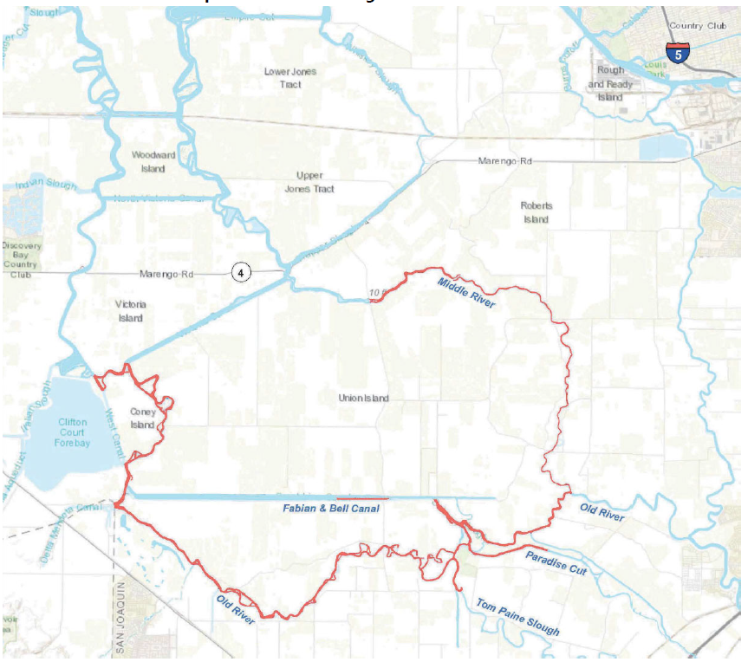
Water Supply Reliability
& Channel Capacity Study Extent
Recommendation: Use the same extents as the 2021 Anchor QEA Planning Guide
South and central sections of the Delta, within San Joaquin County, south of Bouldin Island, and north of the Pescadero RD including the following channels:
Middle River
Old River (West)
Old River (South)
Old River (East)
Old River Side Channel
Fabian & Bell
Paradise Cut
Tom Paine Slough
Source: Anchor QEA (2021) Planning Guide for the Channel Depth Restoration Program for the South Delta Channels

Slide 25
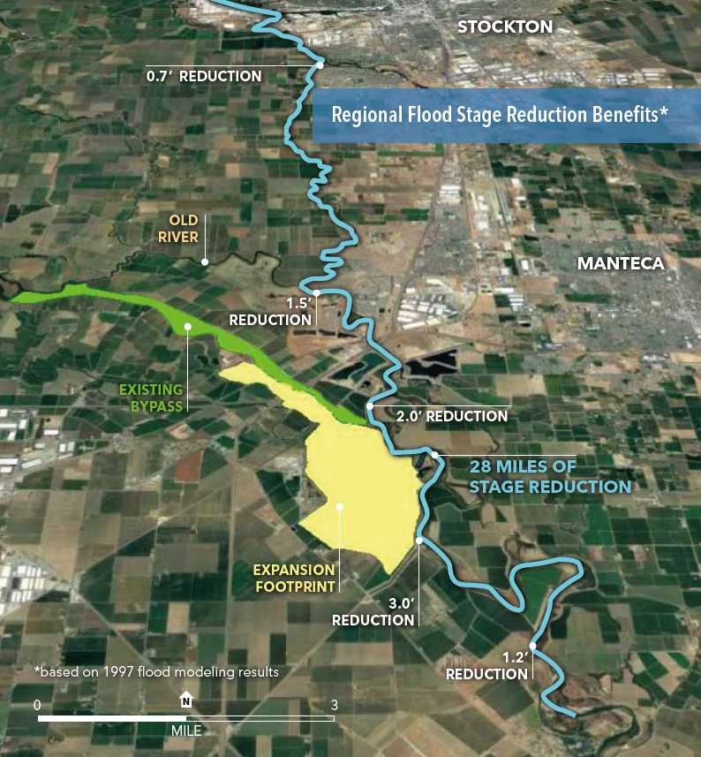
Flood Risk Reduction
Study Extent
Ecosystem Restoration
Study Extent
Recommendation: Project footprint and,
Manteca
Lathrop, including Stewart Tract
Stockton, south of French Camp Slough
Recommendation: Project footprint and areas subject to hydraulic effects
25
Source: San Joaquin County Resource Conservation District (nd). Paradise Cut Expansion Project. Fact Sheet.

Slide 26
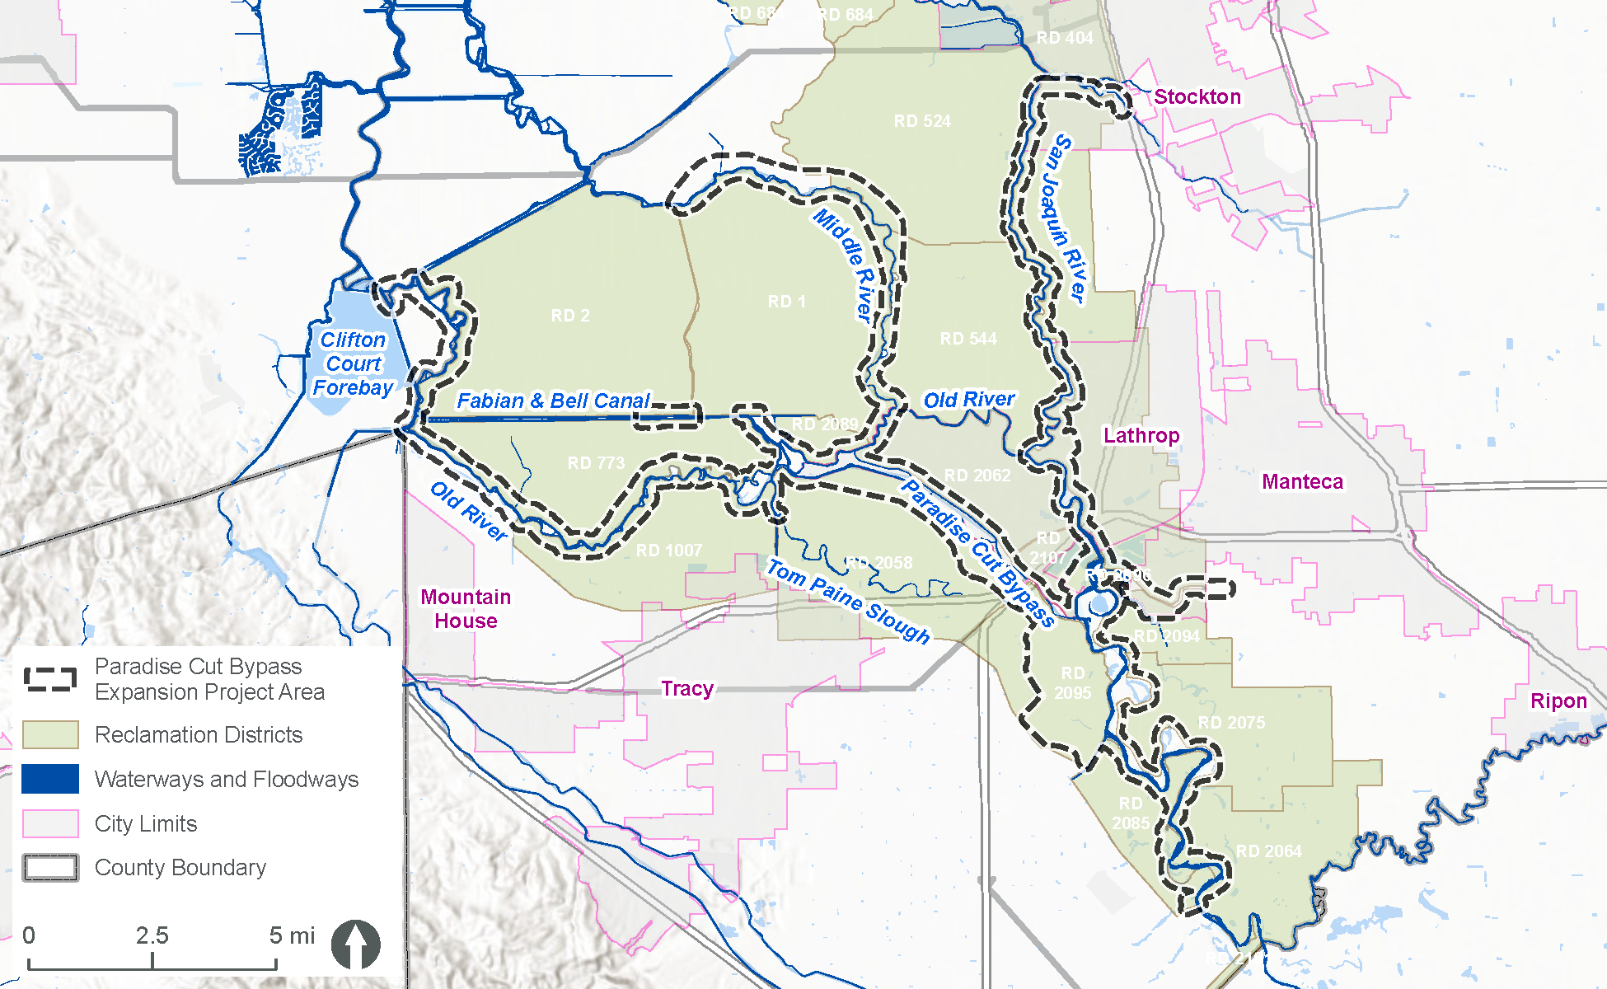
Proposed Study Area
26

Slide 27
Extra Slides

Slide 28
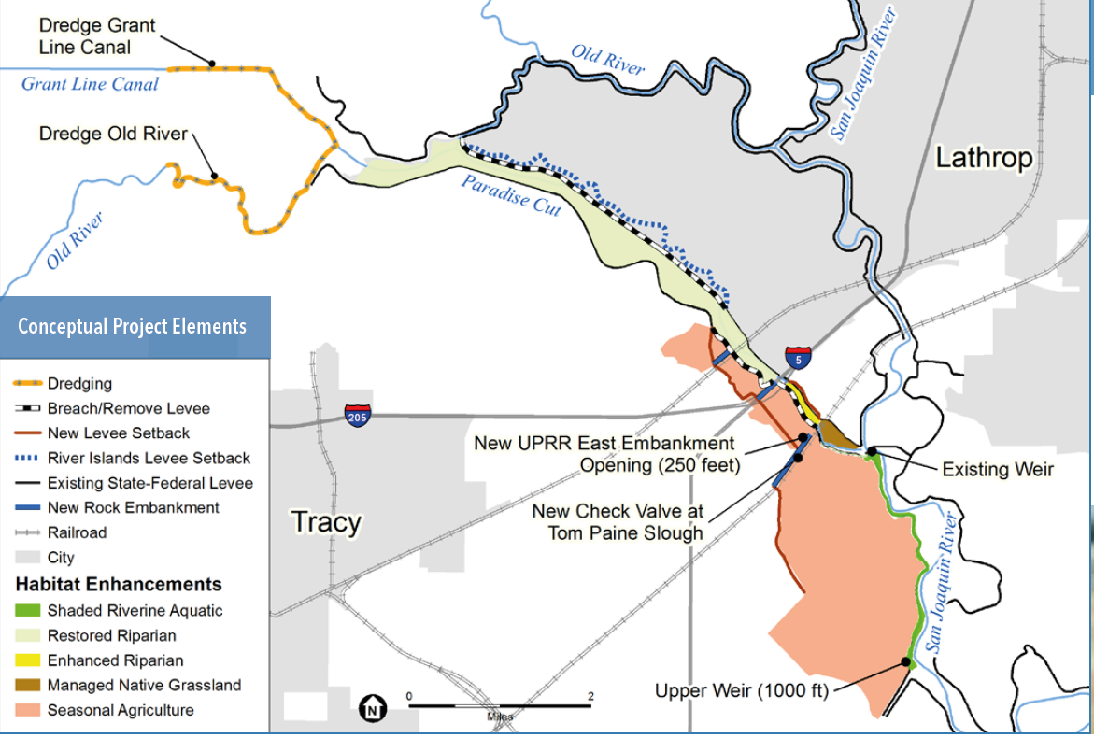
Minimum Viable Project
28
Source: San Joaquin County Resource Conservation District (nd). Paradise Cut Expansion Project. Fact Sheet.

Slide 29
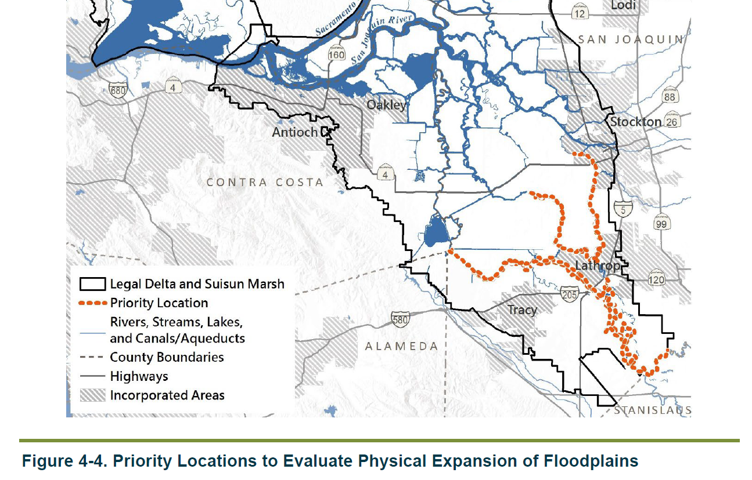
Delta Plan Policy ER P4
29
Notes:
New flood control works and capital improvement projects to existing flood control works in these priority locations (Figure 4-4, which is also Appendix 8A) must evaluate the feasibility (as defined in 23 CCR section 5001[p]) of setting back or removing existing levees in order to physically expand the width of the channel (see ER P4). By engaging in this evaluation early in project planning, before funding decisions are made, reclamation districts and flood control agencies can build partnerships and projects that both reduce flood risk and restore ecosystem function.

Slide 30
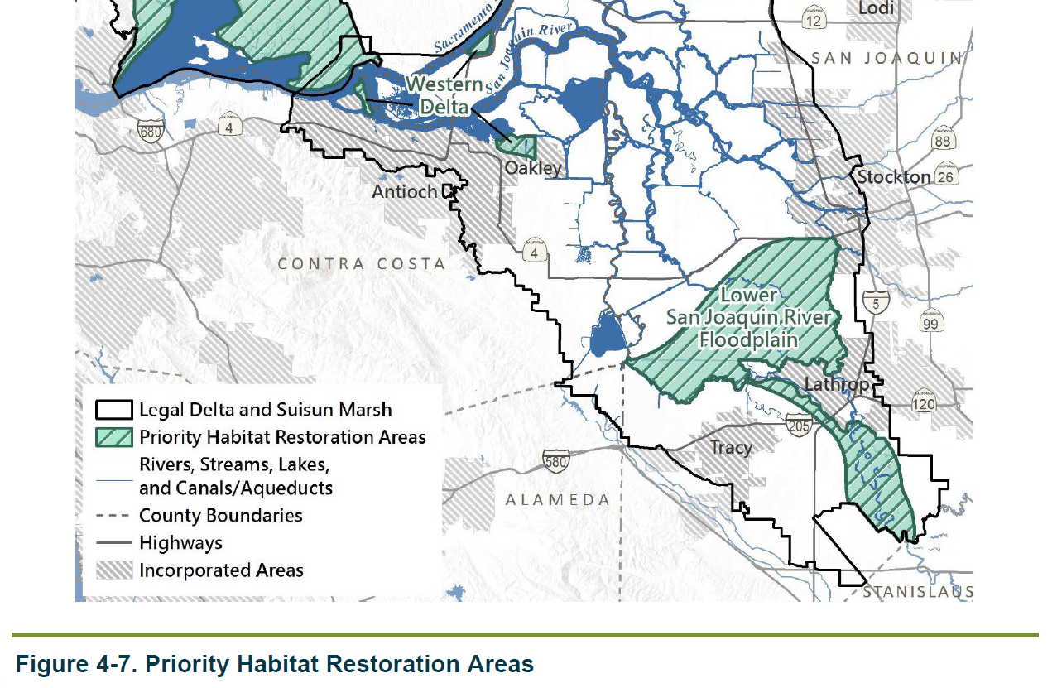
Delta Plan Policy ER P3
30
Notes:
Covered actions must demonstrate that they would not prevent, impede, or constrain future opportunities to restore habitat in the six Priority Habitat Restoration Areas (see ER P3).

