Slide 1

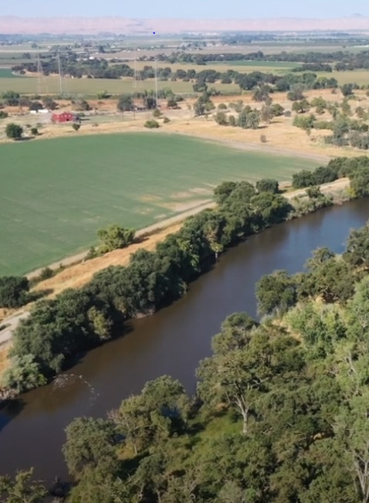
Paradise Cut Project
Advisory Committee Meeting
July 1st, 2024
11.30 am – 1.00 pm
Location: River Islands Executive Offices (73 Stewart Rd, Lathrop, Ca 95330
Glenn.Prasad@sjafca.org

Slide 2
Administrative Matters:
  Roll Call/ Sign up sheet
  Approval of Meeting Minutes and consensus on meeting notes format. [Possible Action]
  Confirmation of Members and Alternates
Scoping Discussions (SJAFCA/WR)
Funding for Next Phase (SJAFCA/WR)
Meeting Scheduling, Reoccurrence, and Location [Possible Action]
Governance Charter (SJAFCA/ Consero)
Engagement Strategy (SJAFCA/ Consero)
State Updates (DWR, CVFPB)
Advisory Committee Comments/ Items for Future Agenda
Public Comment
Adjournment
Advisory
Committee
Agenda

Slide 3
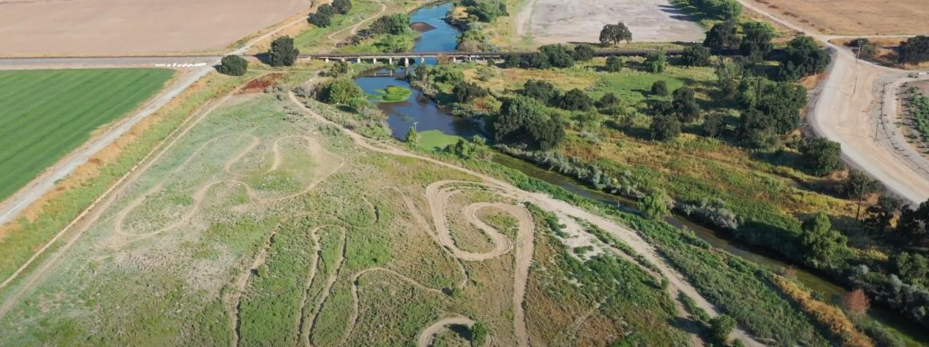

Administrative Matters
Roll call/ sign up sheet
Approval of meeting notes [action] and consensus on format
Confirmation of members and alternates

Slide 4
Committee Members and Alternates
AGENCY | MEMBER | ALTERNATE
SJAFCA | Chris Elias | Glenn Prasad
SDWA | John Herrick | Mary Hildebrand
American Rivers | Sarah Puckett | Julia Sullivan
City of Tracy | Ilene Macintire | Robin Kloepfer
RD 2095 | Bob Pombo | TBD
RD1,2,544,2089 | Nick Mussi | TBD
RD 2058, 1007 | Alexis Stevens | Greg Pombo
RD 2062 | Susan Dellosso | Ramon Batista
Please send any changes to Leanne Randall: Leanne.Randall@sjacfa.org

Slide 5
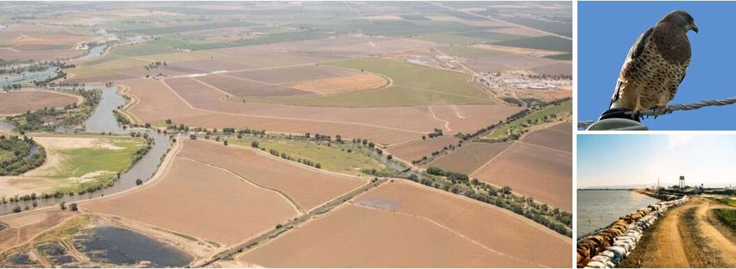
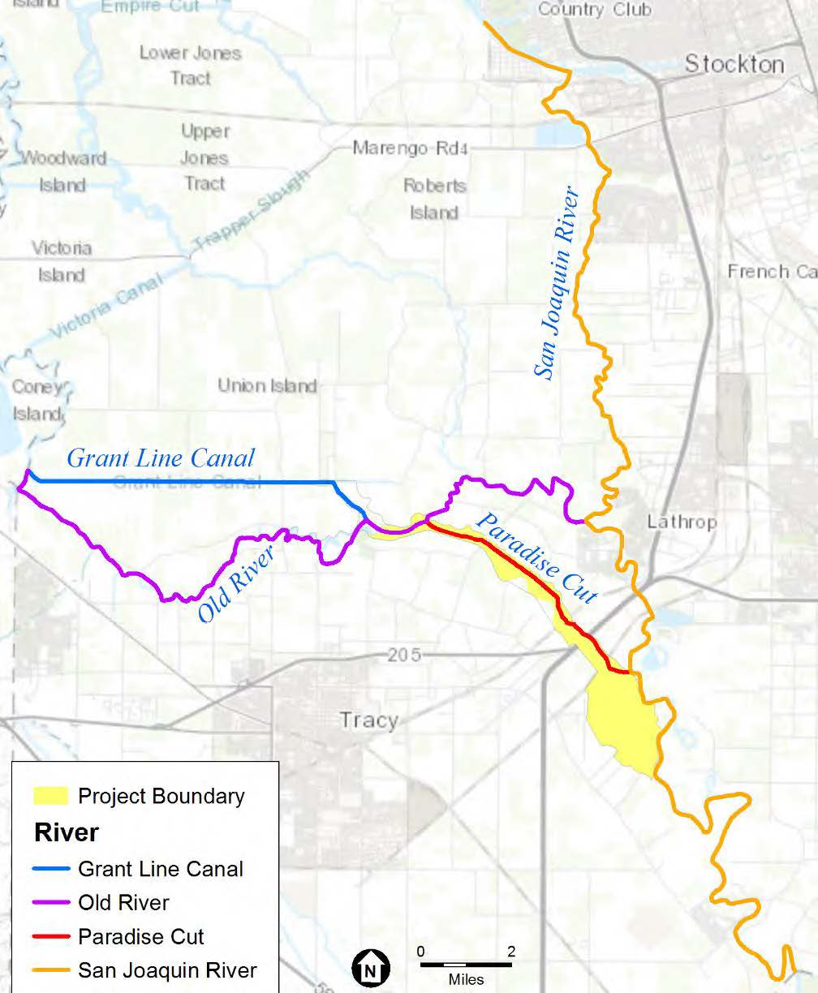
Paradise Cut Expansion and South Delta Restoration Project
Advisory Committee Scoping Meeting
July 1, 2024
Photo credit: ESA 2023

Slide 6
Alternatives

Slide 7
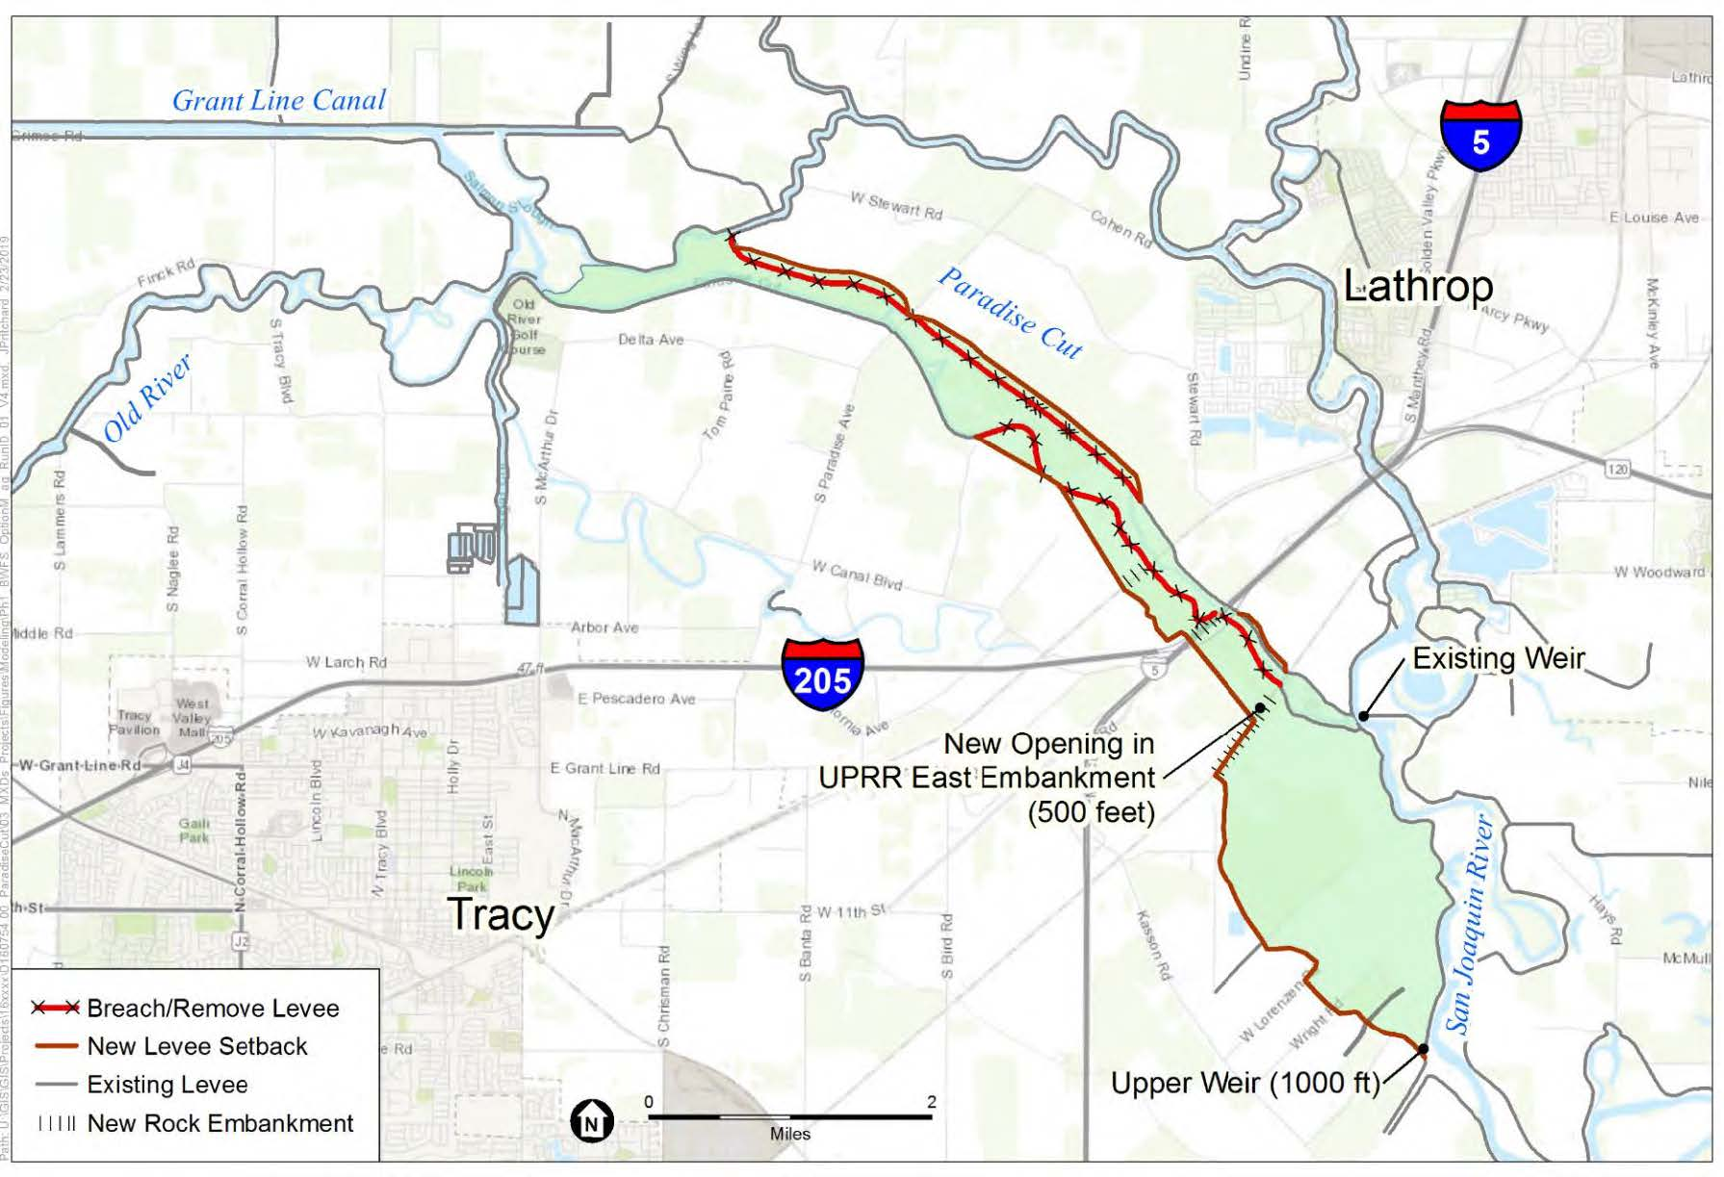
2017 CVFPP Update
Option M-ag (“CVFPP”)
Elements
New 1,000-foot weir and associated levee setback upstream of the existing Paradise Cut weir
New setback levees along Paradise Cut
Expansion of the east railroad trestle by 500 feet
Considerations
2-foot reduction in peak stage on the San Joaquin River at Mossdale Bridge
~500-acre increase in riparian and wetland habitat
Source: American Rivers (2019). Conceptual Design Technical Memo: Paradise Cut Expansion Project. April 9, 2019.

Slide 8
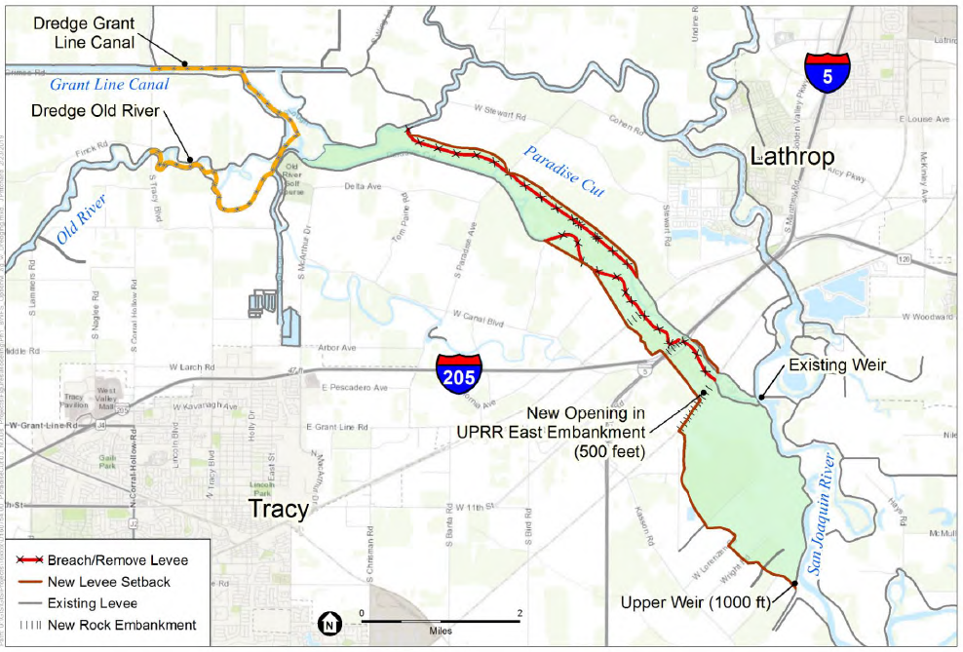
2019 Conceptual Design
CVFPP with Dredging
Alters the CVFPP alternative via:
2 vertical feet of dredging along a 5-mile section of Old River and Grant Line Canal
Considerations
Same flood stage reduction in the San Joaquin River as CVFPP alternative.
Minimal stage reductions in Old River and Grant Line Canal.
Source: American Rivers (2019). Conceptual Design Technical Memo: Paradise Cut Expansion Project. April 9, 2019.

Slide 9
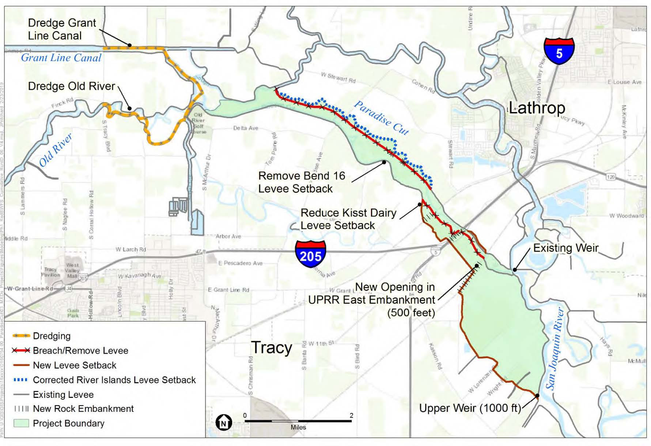
2019 Conceptual Design
Modified CVFPP
Alters the CVFPP with Dredging alternative via:
Realignment of the River Island levee
Reduction of the setback levee at Kisst Dairy to avoid costs and impact of moving a dairy facility
Elimination of the setback levee at Bend 16
Considerations
Same flood stage reduction in the San Joaquin River as CVFPP alternative.
Minimal stage reductions in Old River and Grant Line Canal
Increases flood stage within Paradise Cut by up to 3.5 inches
Source: American Rivers (2019). Conceptual Design Technical Memo: Paradise Cut Expansion Project. April 9, 2019.

Slide 10
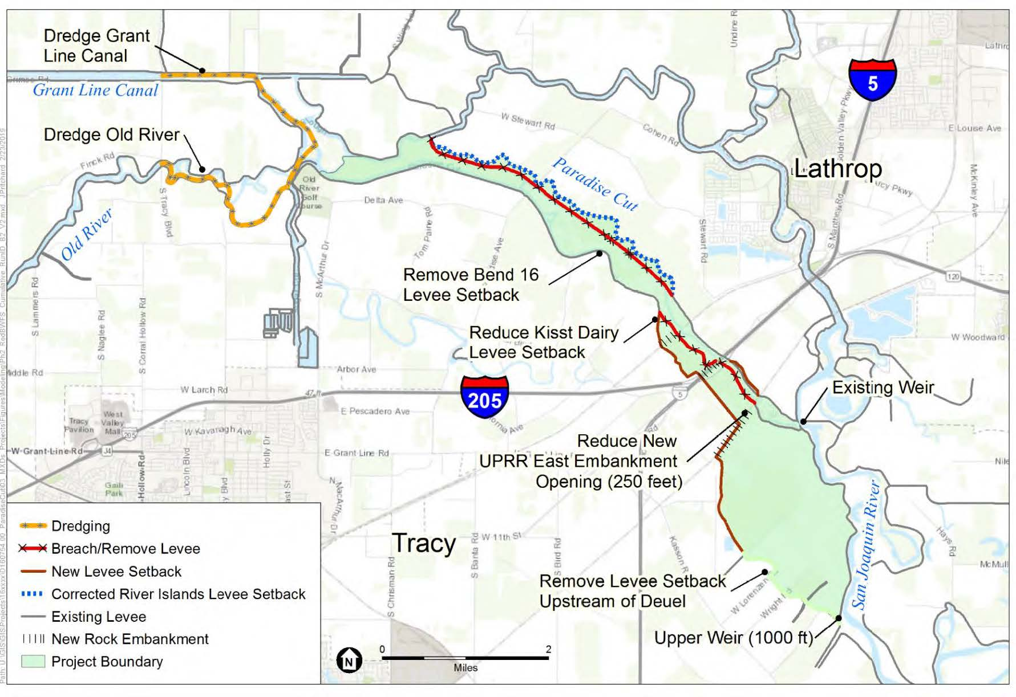
2019 Conceptual Design
Minimum Viable Project (MVP)
Alters the Modified CVFPP alternative via:
Elimination of the setback levee south of Deuel Vocational Institute
Reduction of east railroad expansion to 250 feet
Considerations
Same flood stage reduction in the San Joaquin River as CVFPP and Modified CVFPP
Equivalent or smaller downstream hydraulic impacts on Paradise Cut, Old River, and Grant Line Canal (relative to Modified CVFPP)
Presumed to cost less than CVFPP and Modified CVFPP by halving railroad trestle expansion and reducing levee setbacks by 1.5 miles
Source: American Rivers (2019). Conceptual Design Technical Memo: Paradise Cut Expansion Project. April 9, 2019.
Notes:
Identified as the Preferred Conceptual Design in 2019

Slide 11
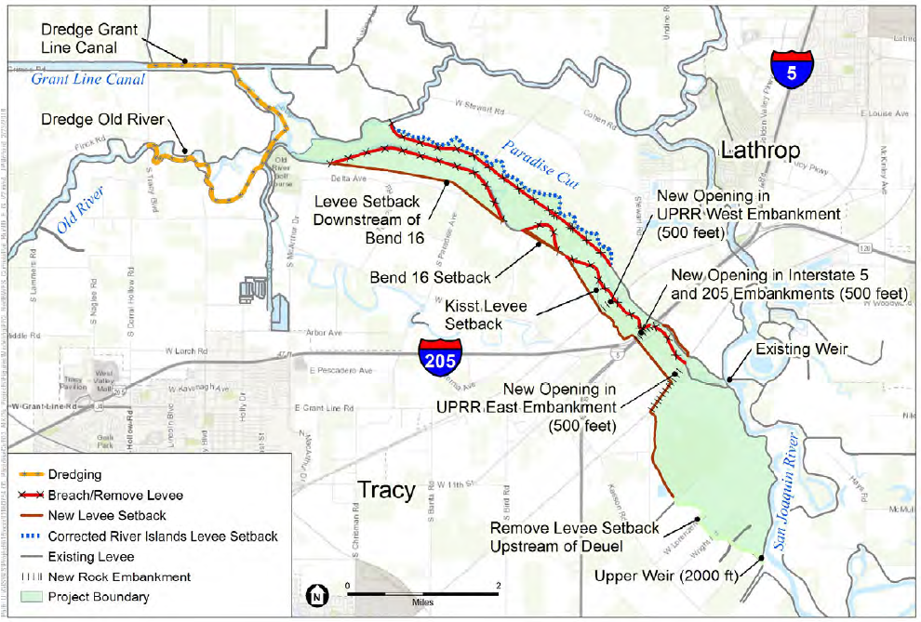
2019 Conceptual Design
Potential Maximum Project
Alters the Modified CVFPP alternative via:
Inclusion of setback levees at Kisst Dairy and Bend 16, and new downstream setback levee
Expansion of openings under I-5, I-205, and west railroad trestle by 500 feet
Expansion of upper weir opening to 2,000 feet
No setback levee at Duel Vocational Institute
Considerations
Reduces flood stages on the San Joaquin River relative to other alternatives
Upstream of crossings, reduces flood stages on Paradise Cut relative to the MVP; increases flood stages on Old River and Grant Line Canal
Source: American Rivers (2019). Conceptual Design Technical Memo: Paradise Cut Expansion Project. April 9, 2019.

Slide 12
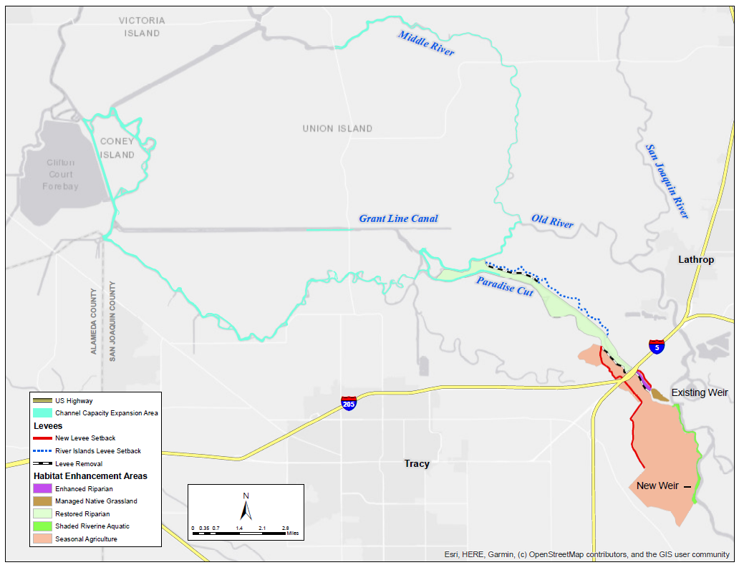
2021 Anchor Report
Additional Channel Restoration
Alters the Minimum Viable Project alternative via:
Up to 25 miles of dredging, in depths ranging from 6 to 8 feet, to restore South Delta channels to their deepest historical elevations
  Old River
  Middle River
  Fabian & Bell Canal
  Tom Paine Slough
  Paradise Cut
Considerations
Further data, modeling, and studies needed to understand potential effects
Source: San Joaquin County RCD (2023). Proposed Strategies to Address Concerns of Landowners and Reclamation
Districts Downstream of the Paradise Cut Expansion and South Delta Restoration Project. May 4, 2023.

Slide 13

Topic for Discussion
Would it be beneficial to evaluate other alternatives or develop variations of the four alternatives considered?

Slide 14
Critical Feasibility Issues

Slide 15
Critical Feasibility Issues
Conflicts with existing easements and land acquisition
Extent and cost of dredging
Extent and cost of downstream hydraulic mitigation
Cost of railroad bridge expansion
Juvenile fish migration over the expanded weir
Maintainability
Notes:
the design analysis did not identify a promising strategy for reducing the project’s adverse hydraulic impact on Old River and Grant Line Canal, a major concern of local residents

Slide 16
Topic for Discussion
Are there other critical issues that have not yet been identified that need to be resolved?

Slide 17
Other Issues to be Addressed

Slide 18
Feasibility Study
Other considerations to be addressed
Cost and Maintainability
Operation and maintenance costs
Capital costs and project financing strategy
  Cost of railroad bridge expansion
  Extent and cost of downstream hydraulic mitigation
  Cost of flowage easements
Retention of access to all pumps and pipelines so that they will be maintained properly in perpetuity
Assessment of long-term fiscal impact on Reclamation District (RD) 2095, which is where most new flowage easements would need to be obtained
Repurposing of RD 2095 levee

Slide 19
Feasibility Study
Other considerations to be addressed
Environmental Restoration and Mitigation
Impact avoidance, minimization, and mitigation strategies
Consideration of additional restoration activities within or near project footprint
Consideration of fish and flow impacts from SWP/CVP export pumps in engineering and restoration designs
Consideration of potential benefits of additional flows in Tom Paine Slough

Slide 20
Feasibility Study
Other considerations to be addressed
Dredging
Potential for sedimentation and other downstream effects of project alternatives under current and future hydrological conditions
Assessment of potential benefits of dredging upper portion of Paradise Cut
Assessment of potential impacts of channel dredging on irrigation water access particularly where lowering bed of the channel could increase pumping requirements
Assessment of potential impacts on flow split between Old River and Grant Line Canal

Slide 21
Feasibility Study
Other considerations to be addressed
Flood Risk Reduction
Modeling of flow velocity dynamics
Flood risk reduction benefits under current and future hydrological conditions
Management alternatives for the levee that would remain on the left bank of the San Joaquin River between the new and existing weirs
Effects of different extents/depths of channel restoration actions on flood risks to downstream levees
Constraints and opportunities associated with routing of overland-flowing waters back into Paradise Cut, and the fate of existing structures in overland flow areas
Optimal size of openings under I-5 and two railroads
Assessment of potential opportunities presented by River Islands' plans to degrade the federal project levee along the Stewart Tract banks of Paradise Cut and Old River
Assessment of locations where levees no longer conform to design specifications

Slide 22
Extra Slides

Slide 23
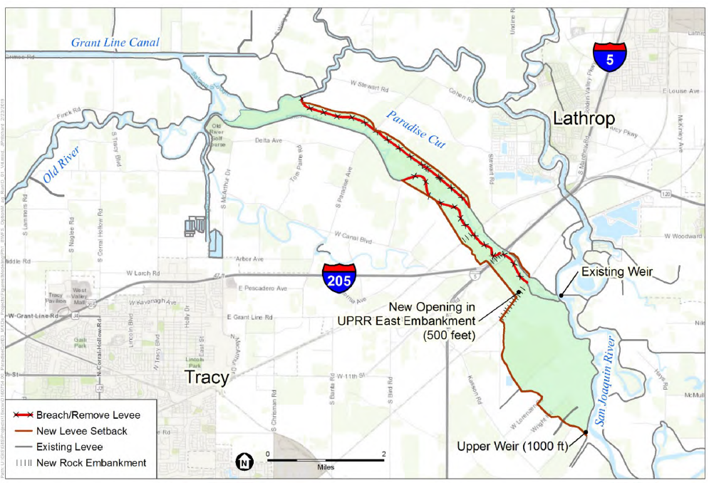
CVFPP Concept
Source: American Rivers (2019). Conceptual Design Technical Memo: Paradise Cut Expansion Project. April 9, 2019.

Slide 24
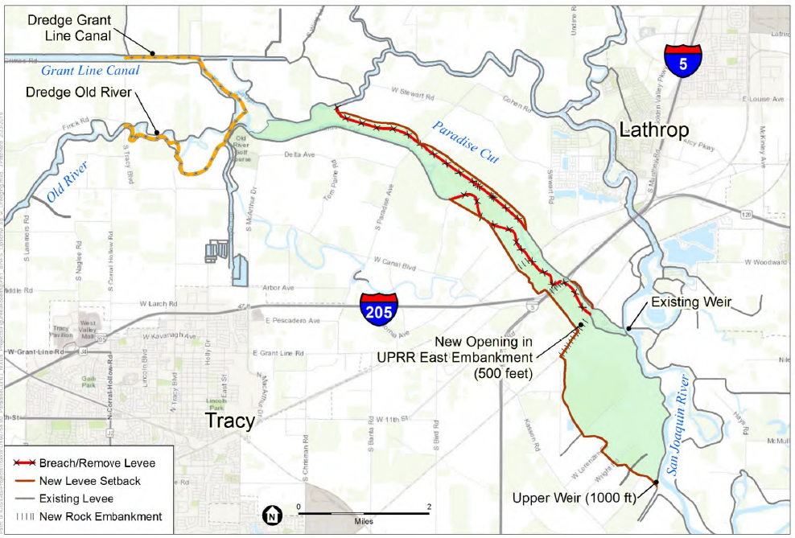
CVFPP with Dredging
Source: American Rivers (2019). Conceptual Design Technical Memo: Paradise Cut Expansion Project. April 9, 2019.

Slide 25
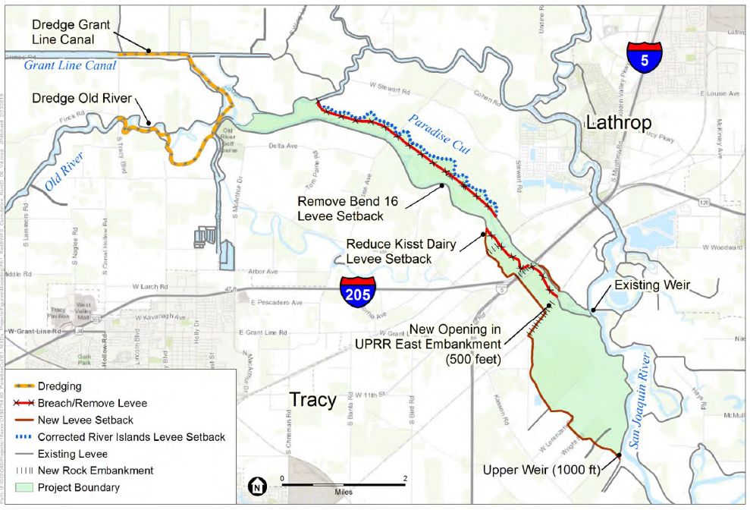
Modified CVFPP
Source: American Rivers (2019). Conceptual Design Technical Memo: Paradise Cut Expansion Project. April 9, 2019.

Slide 26
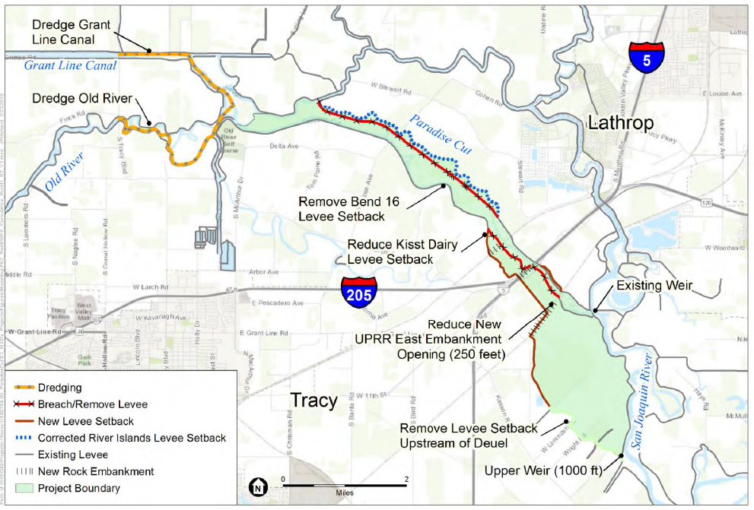
Minimum Viable Project (Preferred Alternative)
Source: American Rivers (2019). Conceptual Design Technical Memo: Paradise Cut Expansion Project. April 9, 2019.

Slide 27
Potential Maximum Project
Source: American Rivers (2019). Conceptual Design Technical Memo: Paradise Cut Expansion Project. April 9, 2019.

Slide 28
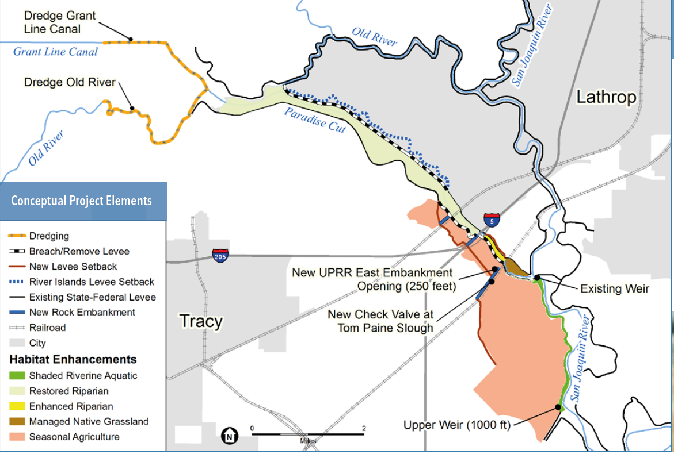
Preferred Alternative, with Habitat Enhancements
Source: San Joaquin County Resource Conservation District (nd). Paradise Cut Expansion Project. Fact Sheet.

Slide 29
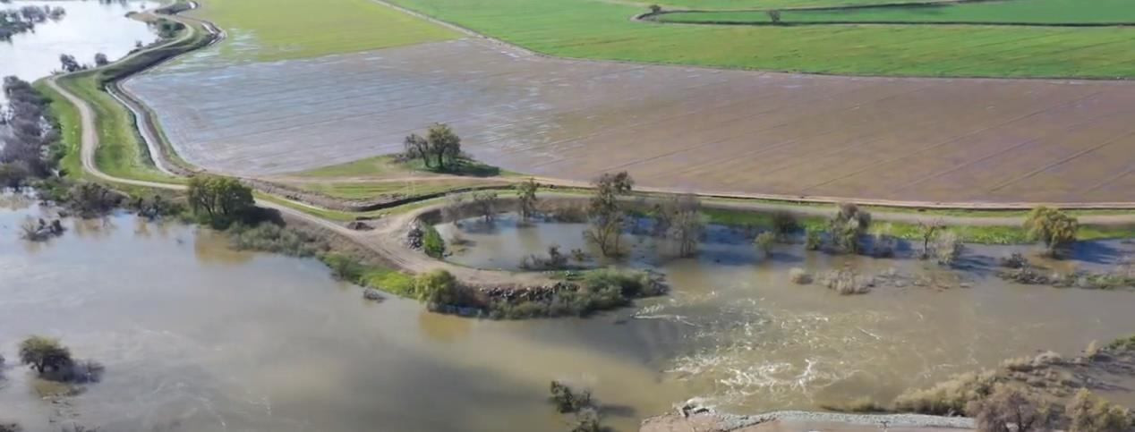
Funding for Next Phase

Slide 30
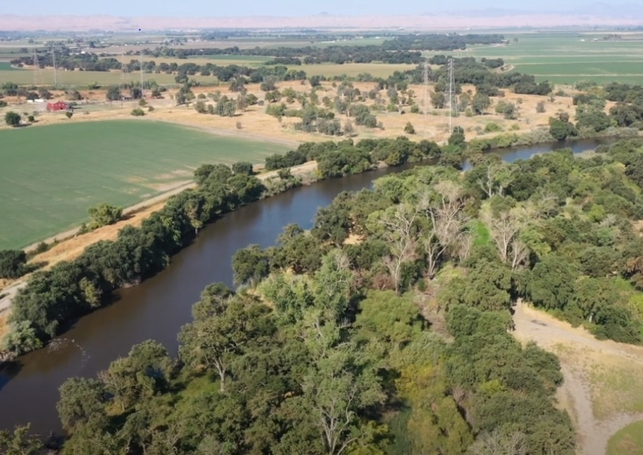
Meeting Scheduling, Reoccurrence, and Location
Monthly Meetings
  1st Monday of the Month from 11:30am – 1pm
  Will Keep Meetings Scheduled and Will Cancel as Needed
  August Meeting Cancelled
  September Meeting Proposed to Move to Monday, August 26th, 11:30am – 1pm due to Labor Day
Location:

Slide 31
Governance Charter & Engagement Strategy

Slide 32
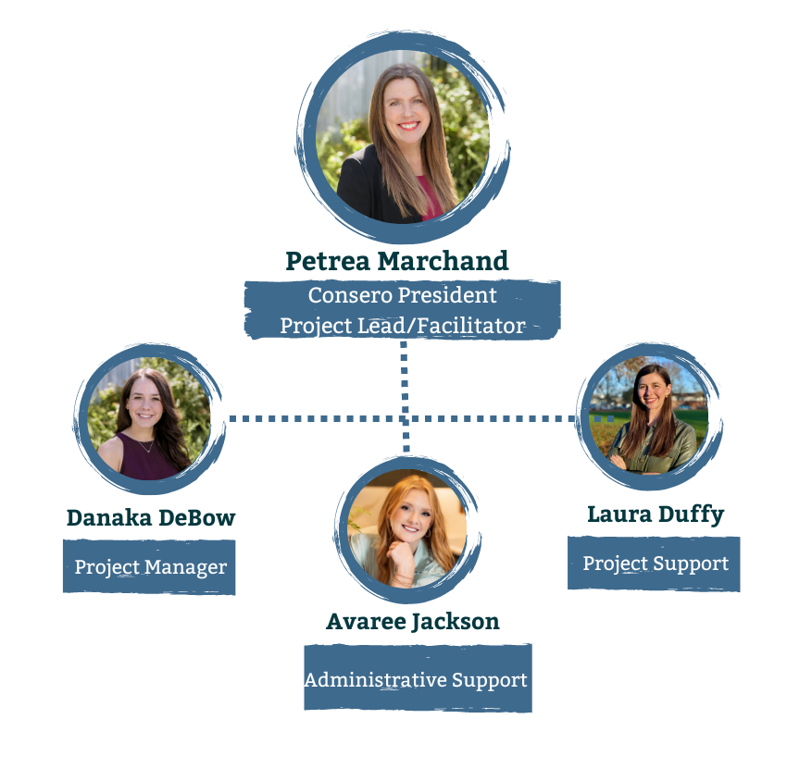

The Consero Solutions Team

Slide 33

Governance Charter
SJAFCA (with LWA and Consero)
PCMT
Special Advisory Committee
July
25th
Aug.
26th
Aug. 1st
  Roles and responsibilities
  Decision-making authority and process

Slide 34
Engagement Strategy
SJAFCA (w/ Consero)
PCMT discussion
Special Advisory Committee
PCMT review
Aug.
12th
Aug.
26th
  Goals and objectives
  Target audiences
  Platforms
  Schedule
Aug. 1st
Aug. 22nd

Slide 35
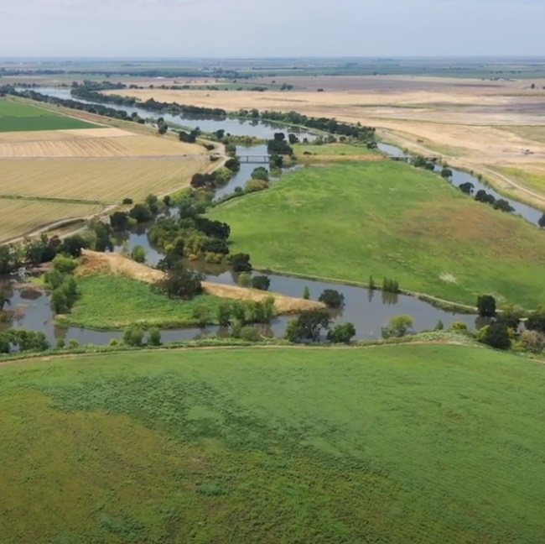


State Updates

Slide 36
Comments
Potential Items for Next Meeting
  Outreach Strategy
  Governance Charter
Advisory Committee Comments
Public Comments

Slide 37


Adjourned

Slide 38
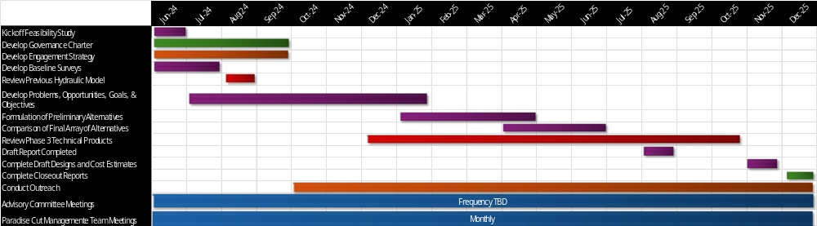
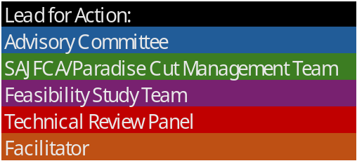
Project Schedule

